Slide 1
Continence Advisory Service

Slide 2
Details
Base-Brierely Hill Health and Social Care Centre
01384 321517
Team of 7 with 2 nurses on secondment for the nursing homes
Open referral system
To have a Dudley GP

Slide 3
What can be done?
Continence assessment takes an 1 hr
Pelvic floor exercises
Bladder training
medication
aids and appliances
look at fluid intake 1.5-2litres
Not all caffeine
keep bowel functioning

Slide 4
Pelvic Floor Exercises
Where is it?
Lets locate it now!
pull up and hold
Don’t hold breathe
Try to do this at least a couple of time per day
The difference will be seen in 6-8 weeks
Ensure drips go by “ shaking” technique is important

Slide 5
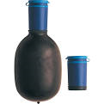
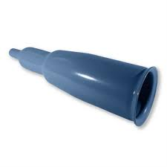
Aids
What is there available?
Sheaths
Bio derm
Uri bag
Flow directors
Pants
pads

Slide 6
Summary
The service is there to aid if having problems with bladder/bowel
Open referral system
Dudley Gp
Any questions ???????
Thank you for listening
Presentation by Gill Davey

