Slide 1
ERECTILE DYSFUNCTION
CAROLINE ROBERTS
CNS UROLOGY

Slide 2
FACTS
ED INABILITY TO ACHIEVE AN ERECTION ADEQUATE FOR SEXUAL INTERCOURSE
AFFECTS 1 in 10 MEN
80% CAUSED BY PHYSICAL CAUSES
CAUSES PERSONAL/ PARTNER DISTRESS
5% 40yr olds – 15% 70 yr ols

Slide 3

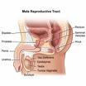
MALE REPRODUCTIVE SYSTEM

Slide 4
RISKS AND CAUSES
EXCESSIVE DRINKING
SMOKING
NEUROLOGICAL CAUSES
PSYCHOLOGICAL CAUSES
SOME MEDICATION
HEART AND VASCULAR DISEASE
HORMONAL PROBLEMS
ERECTILE TISSUE PROBLEMS

Slide 5
NEUROLOGICAL CAUSES
Brain sends a message: stimulation
Damage to Brain- Parkinsons, Stroke
Damage to Spinal Cord- Spinal
injury, Congenital disorders, Multiple sclerosis
Damage to nerve supply to penis- Pelvic injury, Prostate/ bladder/ Bowel operations, Diabetes, Alcoholism
Affects up to 70%

Slide 6
VASCULAR DISEASE
Remember the anatomy
Reduced blood flow- Often the most significant factor
Life style changes– reduce alcohol, stop smoking, increase exercise
Affects up to 75-85%

Slide 7
PSYCHOLOGICAL CAUSES
Anxiety
Stress
Depression
Fear
Relationship problems
Sexual inhibition
Abuse

Slide 8
DRUG THERAPY
Anti-hypertensives
Anti-depressants/psychotics
Anti-convulsants
Anti-parkinsons
Antacids
None medical drugs

Slide 9
DIAGNOSIS
Past medical history including psychiatric
Drug history including recreational
Alcohol including past
Social history including relationship
ED- ? Problem, length of problem, sudden or gradual, morning erections, normal sex drive, partners attitude, ? problem all the time, patient perception of cause

Slide 10
DIAGNOSIS CONT.
Blood pressure
Examination of genitals
Blood tests eg. FSH, LH, Testosterone, Thyroid, glucose, PSA
DRE

Slide 11
WHICH TREATMENT ?
Safety
Ease of Use
Effective
Speed of action
Partner
Choice is up to patient and partner

Slide 12
ORAL THERAPIES
Sexual stimulation- increases blood supply
Advantages- effective (50-80 %), mild transient side effects, none invasive
Disadvantages- not suitable for all, can take an hour (or longer, facilitator, rather than initiator, cost

Slide 13
PDE5 inhibitors
There are 4 approved types of PDE5Is:
•Sildenafil
•Tadalafil
•Vardenafil
•Avanafil
PDE5Is are the most commonly prescribed treatment for ED. All types of PDE5Is can be equally effective. Which drug is best for you depends on how often you want to have sexual activity, and your personal experience.
Because of the success of PDE5Is in treating ED, there are many fake pills on the market. These drugs are not approved for sale, they may be toxic and may damage your health. Always talk to your doctor or healthcare provider before using or buying medication for ED.

Slide 14
INTRAURETHRAL THERAPY
Gel inserted into urethra
Increases blood supply
Advantages-can be used on most patients
Disadvantages- less effective, side effects, slower, method requires skill, can cause partner discomfort, cost

Slide 15
INTRA CAVERNOSAL INJECTIONS
Advantages- effective, can be used on most patients, quick, mild side effects
Disadvantages- invasive, occasionally cause priapism, bleeding, long term fibrosis, cost, technique.

Slide 16
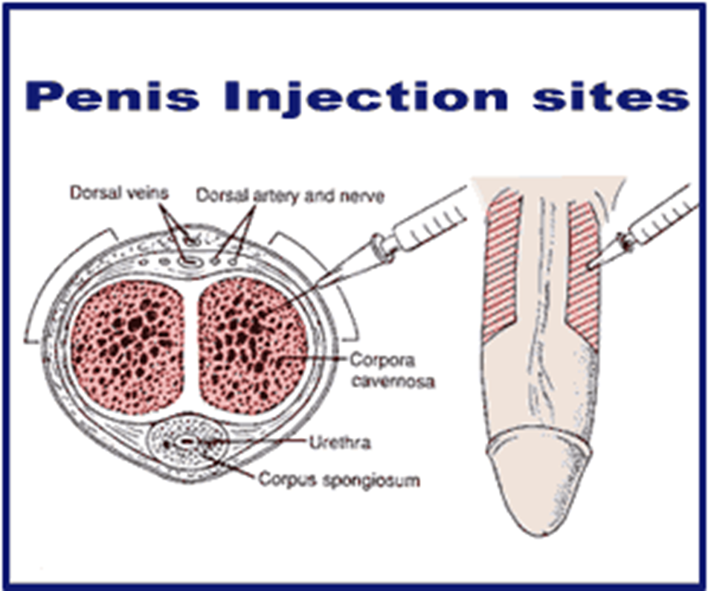
Injection site

Slide 17
VACUUM DEVICE
Draws blood into penis
Advantages- suitable for most men, few side effects, can improve own erections, cost,
Disadvantages- cost, not maintainable for longer than 30 mins, can be painful, may not ejaculate, penis cold & discoloured, pivot at base, lack of spontaneity.

Slide 18
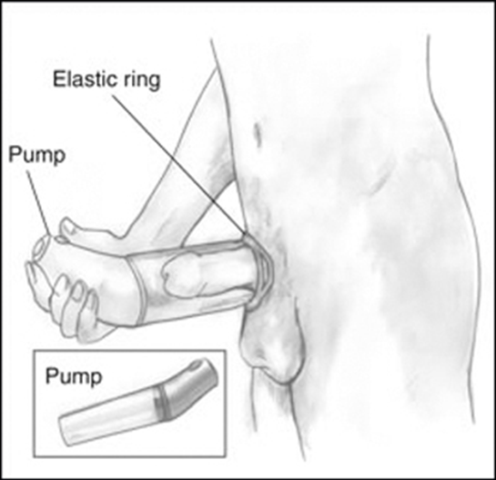
Vacuum Device

Slide 19
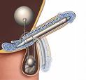

SURGERY
Prosthesis

Slide 20
SURGERY CONT
Advantages- useful when other options failed, high success rate, expensive, on off solution
Disadvantages- mechanical failure, surgical procedure, possible infection

