Slide 1
Health and wellbeing event 2020
Angela Nicholls
Clinical nurse specialist prostate cancer UK/DGOH

Slide 2
Welcome to the Health and Well being Clinic
Please refer to your welcome pack
The sessions covered:
Holistic Needs Assessment
Prostate cancer disease and treatment
Diet and nutrition
Continence and pelvic floor
Erectile dysfunction
Question and answers

Slide 3
Housekeeping
No fire drill expected
Toilets
Refreshments provided
Questions
Leaflets and information
Evaluation

Slide 4

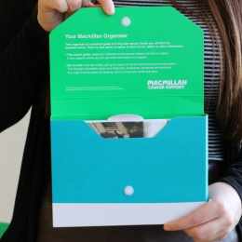

A Diagnosis of Prostate Cancer: what next?
You have received a diagnosis of prostate cancer so what next?
Issued a pack of information:
Attend a health and wellbeing clinic for further support and information

Slide 5
Health and well being Prostate Cancer Clinic
Why am I here?
Common ground: A diagnosis of prostate cancer
This session is part of a National Macmillan Living with and Beyond Cancer programme
Confidence/understanding condition
Provide information/answer questions
Promote positive lifestyle changes
Offer support to manage anxieties

Slide 6
Holistic needs assessment (HNA)
Checklist of concerns
Acts as a prompt so you can identify any concerns
Identify information or further support
Helps us identify if a referral to specialists is needed
Please leave your HNA with one of us today with your name, hospital number, DOB and a telephone number if you would like a nurse to contact you.

Slide 7

Health needs assessment (HNA):
Please refer to your health needs assessment in your pack, Can we help?

