Slide 1

Medicines Management Training for all Registered Theatre Staff
Hammara Sattar
Teacher Practitioner and Professional Development Pharmacist
January 2021

Slide 2

Welcome to your medicines management training presentation specifically designed to meet the needs of all Registered Theatre Staff.
Please ensure you work through the slides and review the notes under each slide for extra information and explanations. Thank you.

Slide 3
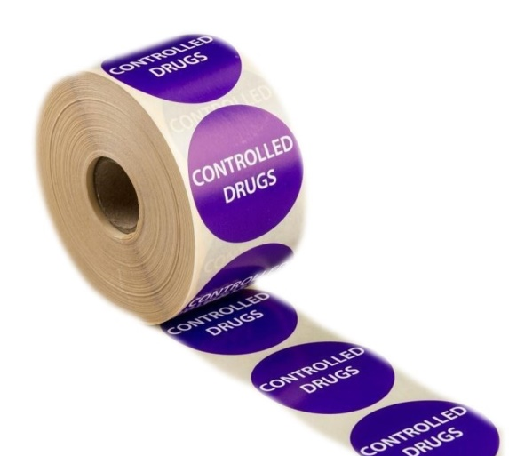
Content
  Importance of medicines management
  Drugs seen in theatres
  General drug handling
  Supply of medication (incl. OOH)
  All about controlled drugs
  Reducing risks
  Incident reporting
  Gina’s story
Notes:
OOH = out of hours

Slide 4

Importance of medicines management
Reduces the likelihood of incidents related to patient safety
Incidents can occur due to a variety of reasons e.g. human factors, ambiguity in processes & lack of awareness.
Medicines management includes areas such as delivery, storage, preparation, administration and safe disposal of medicines.
Notes:
A recent study assessing the incidence of errors in New Zealand used anonymous self-reporting by anaesthetists (Webster et al 2001). Almost 8000 study forms were returned to the investigators. The frequency of intravenous drug administration error was one per 133 anaesthetics with the largest two categories being incorrect doses (20%) and drug substitutions (20%) i.e. giving the wrong drug. Of these substitutions, 69% of those drugs given were not even within the same pharmacological class as the intended drug.

Slide 5
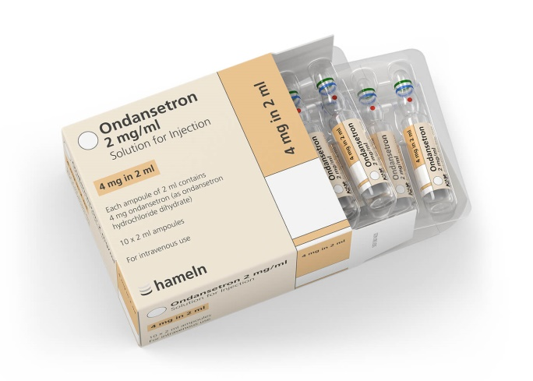
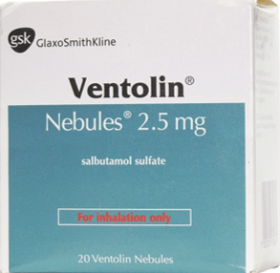
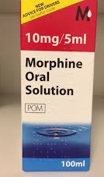
Drug seen in theatres
Oral medicines: morphine, paracetamol, tramadol, aspirin, sodium citrate & codeine.
Inhalation: salbutamol/saline nebulisation solution, oxygen therapy
Intravenous: morphine, diamorphine, PCA’s, cyclizine, ondansetron, hyoscine & antibiotics
Insulin sliding scale
Fridge items
Notes:
There are a variety of drugs that you may come across whilst working in theatres. Although most of these drugs may be parenterals there are also other formulations such as oral medicines and inhalation medication. Some drugs have very specific requirements in regards to their storage and administration and it is important for you to know about these as you may be handling these medicines.

Slide 6
General drug handling
All drugs must be kept in their original packaging. This will reduce the risk of selection error.
Do not store different batches of the same drug in the same box.
Ensure expiry date checks are carried out at regular intervals (last day of each month).
Store medicines for administration by different routes, separately
Ensure that flammable products are kept securely in the flammable cupboards.
Notes:
All drugs must be kept in their original packaging to ensure that they are identifiable. This will reduce the risk of selection error. Also the original packaging will clearly state the expiry dates and batch numbers.
To put this in perspective, you will need to look at the expiry dates on the boxes when you do your expiry date checks and batch numbers are important for example when products are recalled.
The MHRA may send an alert to pharmacy staff to state that certain batches of medicines may contain contaminants and so these products are no longer fit for use. We would then have to remove these drugs from the wards/theatre.

Slide 7
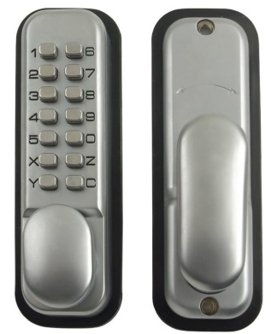
General drug handling
All syringes, including flushes and infusions, must be labelled immediately after preparation by the person who prepared them
Temperature monitoring both ambient and fridge must be completed daily.
All medicines storage areas must be kept locked when not in use
Where Digilock codes are used these must be changed every 6 months
Notes:
All syringes, including flushes and infusions, must be labelled immediately after preparation by the person who prepared them. The practice recommended by the NPSA is to use ‘Flag labelling’ to ensure that volume graduations on small syringes are not obscured. The only exception to this is in situations where preparation and bolus (push) administration is one uninterrupted process and the unlabelled product does not leave the hands of the person who prepared it. Only one unlabelled medicine must be handled at one time.
Temperature monitoring both ambient and fridge - Temperature monitoring both room temperature and fridge daily - document findings and ensure any temperature excursions are escalated
Received stock medicines must be reconciled with the delivery note upon delivery. Signed and dated delivery notes must be signed, dated and retained for 3 month

Slide 8
Obtaining drugs out of hours
Patients Own Drugs: only use if satisfied they are safe and suitable for use (not if in compliance aids)
OHH drug cupboard (via Site Co-ordinator)
Review drug borrowing procedure
Contact on-call pharmacist if necessary
It is NOT permitted to transfer ward stock CDs from one Ward/ Department’s CD cupboard, and Ward CD Record Book, to another. This would be seen as the Nurse/Midwife supplying a stock of a CD and would therefore be illegal.
Notes:
CDs should never be obtained from other Wards/ Departments during normal Pharmacy opening hours. If the request is very urgent the Pharmacy Dispensary should be contacted and asked to prioritise and expedite the supply of the order needed. In exceptional circumstances when the medication is required urgently and the Pharmacy Department is closed, the On Call Pharmacist must be contacted to organise treatment supply from Pharmacy or a single dose supply from another ward/department

Slide 9
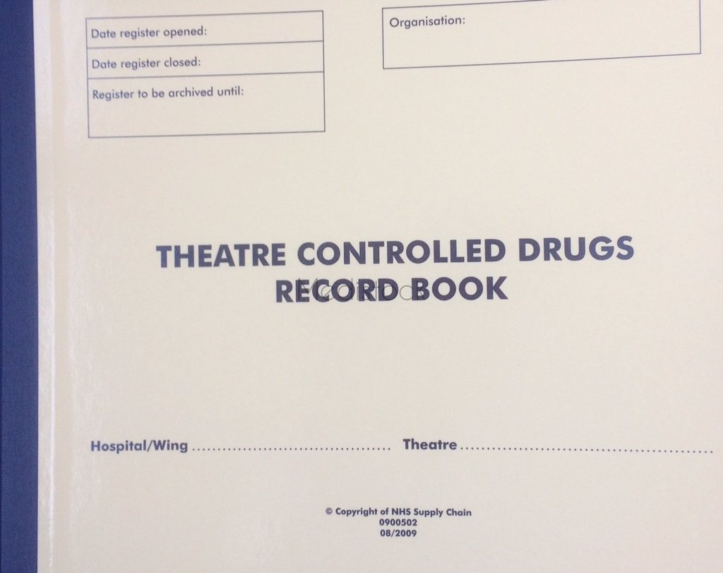
All about Controlled Drugs (CD’s)
Specific stock list of CD’s for theatres.
Updated regularly and reviewed at least annually
Ordering of a drug outside of the stocklist can be carried out with the approval of a pharmacist
The signatory list must be kept up to date
Notes:
There is a specific stock list of controlled drugs for theatres.
This is updated regularly and reviewed at least annually to reflect prescribing patterns and current usage.
Ordering of a drug outside of the stocklist can be carried out with the approval of a pharmacist
The signatory list must be kept up to date

Slide 10

All about Controlled Drugs (CD’s)
When ordering CD's include the numerical quantity required e.g. 10 ampoules rather than 1 box. Write "morphine sulphate oral solution" rather than "oramorph".
This is a legal requirement and it also ensures prompt dispensing/supply of medicines

Slide 11
Record keeping for CD’s
After accepting a delivery of CD’s you must check that the contents are correct.
The person who has signed the pink carbon copy is responsible for the CD’s until they are signed into the theatre CD record book and are securely locked away.
Another registered person must be available to witness the transfer to the CD cupboard and to countersign.
CD’s quantities must be checked daily to ensure correct levels of each drug.
Any discrepancies must be reported immediately.
Notes:
With each record book the stock balance must be checked to ensure that it agrees with the actual stock present in the CD cupboard. All entries for a given preparation (including receipt, administration and return) must run in strict chronological order; therefore it is imperative that entries are made at the time a transaction takes place.
If you collect a CD tin from pharmacy and then check the contents in theatres, ensure that you have signed both the "accepted for delivery" and "received by" lines
Incorrect entries in CD record books,must not be crossed out or altered. Instead the incorrect information should be bracketed and add a footnote e.g. entered in error
CD stock checks must be carried out pre and post list.

Slide 12
Record keeping for CD’s
If you collect a CD tin from pharmacy and then check the contents in theatres, ensure that you have signed both the "accepted for delivery" and "received by" lines
Incorrect entries in CD record books, must not be crossed out or altered. Instead the incorrect information should be bracketed and add a footnote e.g. entered in error
CD stock checks must be carried out pre and post list.

Slide 13
Theatre CD record book
Date received
Amount received (in dose words)
Serial number of the requisition (order number)
In the column headed ‘Patient’s name & NHS number’ record ‘Received
from pharmacy’
Signature of Registered Nurse completing the entry and authorised witness
Signature of witness
New resulting total balance
Notes:
In a Theatre CD record book
The CD page is identified using the index at the front of the Theatre CD record book. Where the product has not been used before the next available page should be used and the index updated. The following particulars should be recorded by the Nurse/Midwife on the correct page of the CD Record Book:
• Date received
• Amount received (in dose words)
• Serial number of the requisition (order number)
• In the column headed ‘Patient’s name & NHS number’ record ‘Received from pharmacy’
• Signature of Registered Nurse/ Midwife completing the entry (ODP to provide second check only if registered nurse not available)
• Signature of witness
• New resulting total balance
It is recommended that time of receipt is recorded also.

Slide 14
Administration and wastage of CD’s
Administration must only be carried out by:
  Registered Nurse/Midwife
  Doctor
  Registered Operating Department Practitioner (RODP)
The two members of staff must witness removal of the drug from the CD cupboard through to preparation, administration of the dose and destruction (e.g. part used ampoules).
Notes:
The two members of staff must witness the entire procedure from the removal of the drug from the CD cupboard through preparation of the dose, its administration to the patient and the destruction of any surplus dose not required.

Slide 15
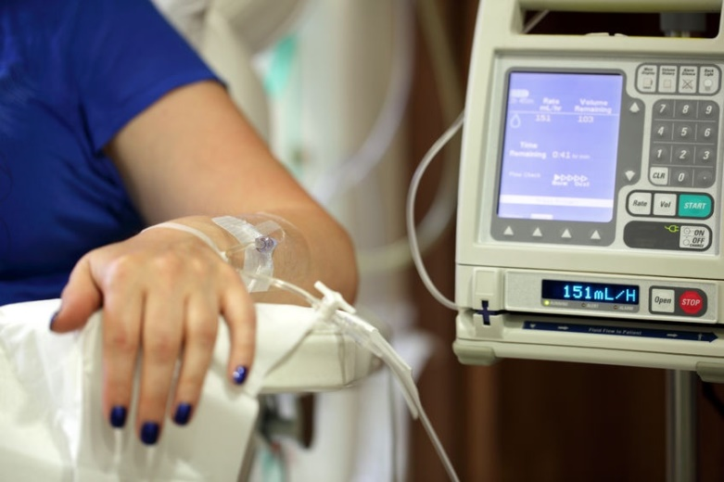
Transfer of CD’s: PCA
Administration to be recording on the prescription chart.
The prescription chart will be transferred with the patient detailing name, form, strength and volume of PCA set up
Currently you are not required to record the exact volume of PCA transferred.
Notes:
Transfer of CDs – Patient Controlled Analgesia (PCA)
When Patient Controlled Analgesia (PCA) is to be administered, the clinician, Nurse/Midwife setting up the device will ensure the administration is recorded on the inpatient Prescription Record Chart, the PCA prescription chart and in the Ward/ Theatre CD Record Book (Section 7.2.1 of policy). If the patient is then transferred to another ward or department the PCA prescription chart provides details of the name, form, strength and volume of PCA set up for the patient. No further record is currently required of the exact volume transferred with the patient to the receiving ward or department. When the receiving ward needs to replace the PCA, they will use CD stock from their own ward and record the administration on the inpatient Prescription Chart, the PCA prescription chart and the Ward CDs Record Book (Section 7.2.1). To ensure there is no delay it is advisable to ensure sufficient stock is available when receiving a patient on a PCA. Any remaining CD not administered will be disposed of as per Section 7.4 of policy and documented in the patients’ notes.

Slide 16
Storage of CD’s
CDs are the responsibility of the Registered Nurse in charge
CDs must be stored in the designated cupboard.
Cupboards must be kept locked when not in use
Keys must be accessible only to authorised members of staff
Different strengths of the same drug should be separated within the CD cupboard (e.g. diamorphine, morphine, midazolam).
No other medicines or items should be stored in the CD cupboard
Notes:
Once CDs reach the ward/theatres, and the receipt page/form signed, they become the responsibility of the Registered Nurse Charge on duty, and must be immediately stored securely in the CD cupboard. CDs should be stored in the designated locked CD cupboard.
Cupboards must be kept locked when not in use.
The lock must not be common to any other lock in the hospital
Keys must be available only to authorised members of staff and there
must be appropriate arrangements for keeping the keys
Different strengths of the same preparation should be separated within the CD cupboard (e.g. diamorphine, morphine, midazolam).
No other medicines or items should normally be stored in the CD cupboard.

Slide 17
Strong Potassium
Strong potassium chloride injection is only available in limited clinical areas (e.g. Recovery, Main Theatres) and pharmacy.
It must be stored separately, securely and treated as a controlled drug.
Pre-prepared diluted parenteral potassium solutions should be used where possible.
View the following link: Errors during intravenous administration of potassium chloride concentrate solutions - Patient Safety Alert (sps.nhs.uk)
Notes:
Errors during intravenous administration of potassium chloride concentrate solutions - Patient Safety Alert (sps.nhs.uk)

Slide 18
Morphine & Diamorphine
Possibility of confusion between strengths of morphine and diamorphine
Over 5 years, 9 patient deaths were reported in NHS hospitals from this cause.
Risks due to: Packaging of different strengths of diamorphine and morphine look similar.
Higher strength (e.g. 30mg) ampoules of diamorphine and morphine were stored alongside lower strength products (e.g. 10mg) in clinical areas. This increases the risk of errors
Notes:
There are risks associated with confusion between strengths of morphine and diamorphine, especially when patients who had not previously had opiates were given high doses.
Evidence of harm:
Over 5 years, 9 patient deaths were reported in NHS hospitals from this cause.
Major risks are:
Packaging of different strengths of diamorphine and morphine look the same (5mg, 10mg, 15mg, 20mg and 30mg products all look similar)
Labelling on outer carton and ampoule are unclear
Higher strength (e.g. 30mg) ampoules of diamorphine and morphine stored alongside lower strength products (e.g. 10mg) in clinical areas

Slide 19
How can we reduce these risks?
Store different strengths of the products separately in CD cupboards
Ensure that naloxone injection is available in all clinical locations where diamorphine and morphine injections are stored/ administered. It should be stored nearby so easily accessible
Observe patients closely for at least one hour after the first dose

Slide 20
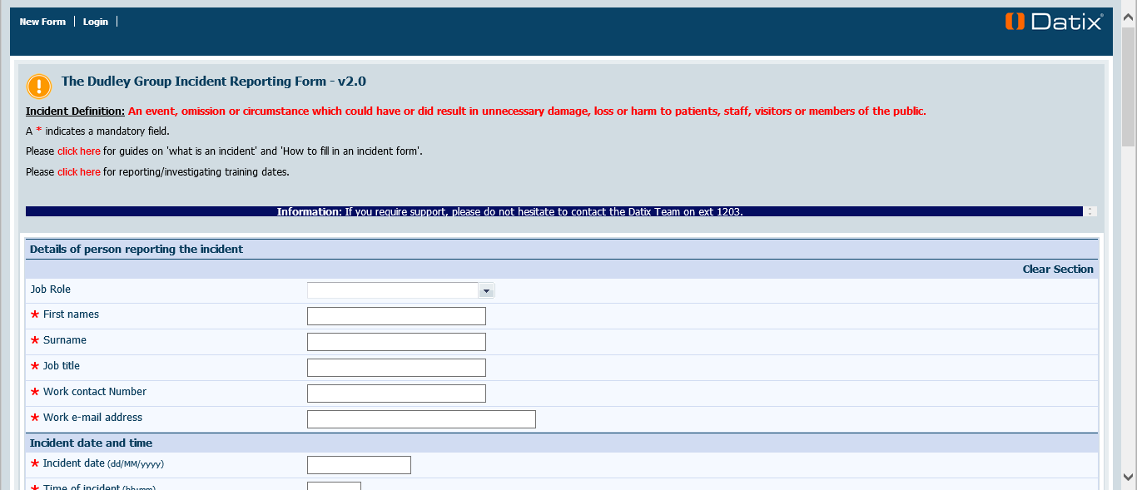
Incident reporting
Incidents must be reported via DATIX
This is the best way in which we can learn and ensure that these incidents do not occur again
Datix: The Dudley Group Incident Reporting Form - v2.0

Slide 21
Gina’s story
This video is an example of how errors related to medicines in theatres can occur and how we can reduce the likelihood of these events:
The Human Factor: Learning from Gina's Story. – YouTube

Slide 22
Key points from Gina’s story
Highlights the importance of medication management
Roles and responsibilities of all staff must be clearly defined
Safety checklists should be utilised
We can only learn from errors if they are reported
We can then make changes to processes to ensure errors do not happen again
Departments and Trusts can learn from each other
Notes:
Gina’s story shows the importance of having procedures in place for medicines management.
Roles and responsibilities of staff in theatres must be clearly defined to reduce the likelihood of errors occurring.

Slide 23
Reflecting on Gina’s story
After watching Gina’s story:
Take an active approach to designing systems and processes in your area to prevent errors.
Reflect on your current practice . Are there any service improvements that can be made in your area.
Think about human factors and how this can affect your practice. How can you minimise this?
If you have any medicines management issues please feel free to contact the pharmacy team.

Slide 24
Contact learning and development
You will now need to contact learning and development via email to confirm that you have completed and understood the “Medicines Management Training for all Registered Theatre Staff”.
Complete your details on the next slide and then copy and paste all of the information and email to dgft.learning@nhs.net

Slide 25
Contact learning and development
In regards to the “Medicines Management Training for all Registered Theatre Staff” I confirm that:
I have read the entire self-directed learning programme and understood its contents.
I know how and who to contact if I have issues regarding medicines management and to obtain further information as required.
I understand that there are supporting policies and guidelines available on the Trust HUB
I understand that I have a responsibility to report medicines management incidents on the Trust incident reporting system (Datix®) in line with the Trust incident reporting procedure
Full name:
Date of completion:
Job role:
Department:

Slide 26
Further information
Medicines management policy:
http://thehub/c/documents/policies/Documents/Medicines%20Management%20policy.pdf
Controlled drugs policy
http://thehub/c/documents/policies/Documents/Controlled%20Drug%20Policy.pdf
Oxygen therapy policy
http://thehub/c/documents/policies/Documents/Oxygen%20Policy.pdf
Injectable medicines guide:
https://medusa.wales.nhs.uk/Home.asp
Call your friendly pharmacist team for further advice! (ext. 2449)

