Slide 1



Summary report 2025

Slide 2
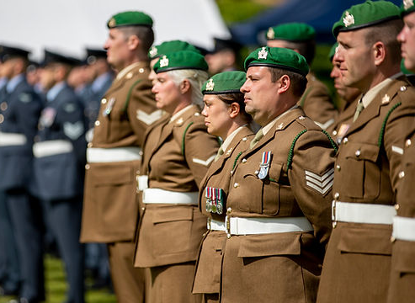
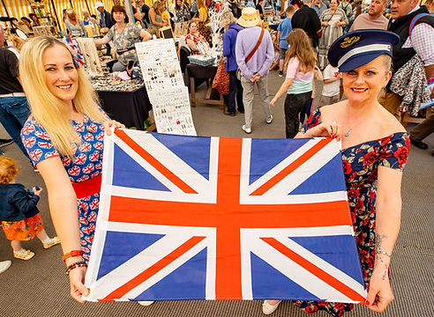
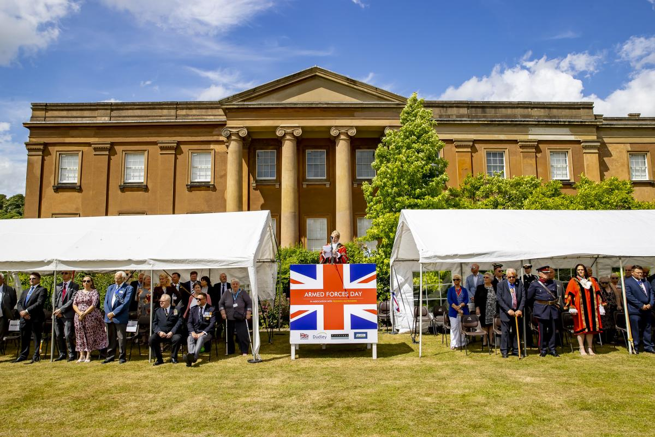
The Armed Forces event
The Armed Forces Day event at Himley Park is a free, family-friendly event held annually at Himley Hall & Park to honour and celebrate the work of the UK's armed forces.
It features a variety of activities and displays, including a vintage military vehicle display, vintage fairground rides, and opportunities to interact with current and former military personnel.

Slide 3


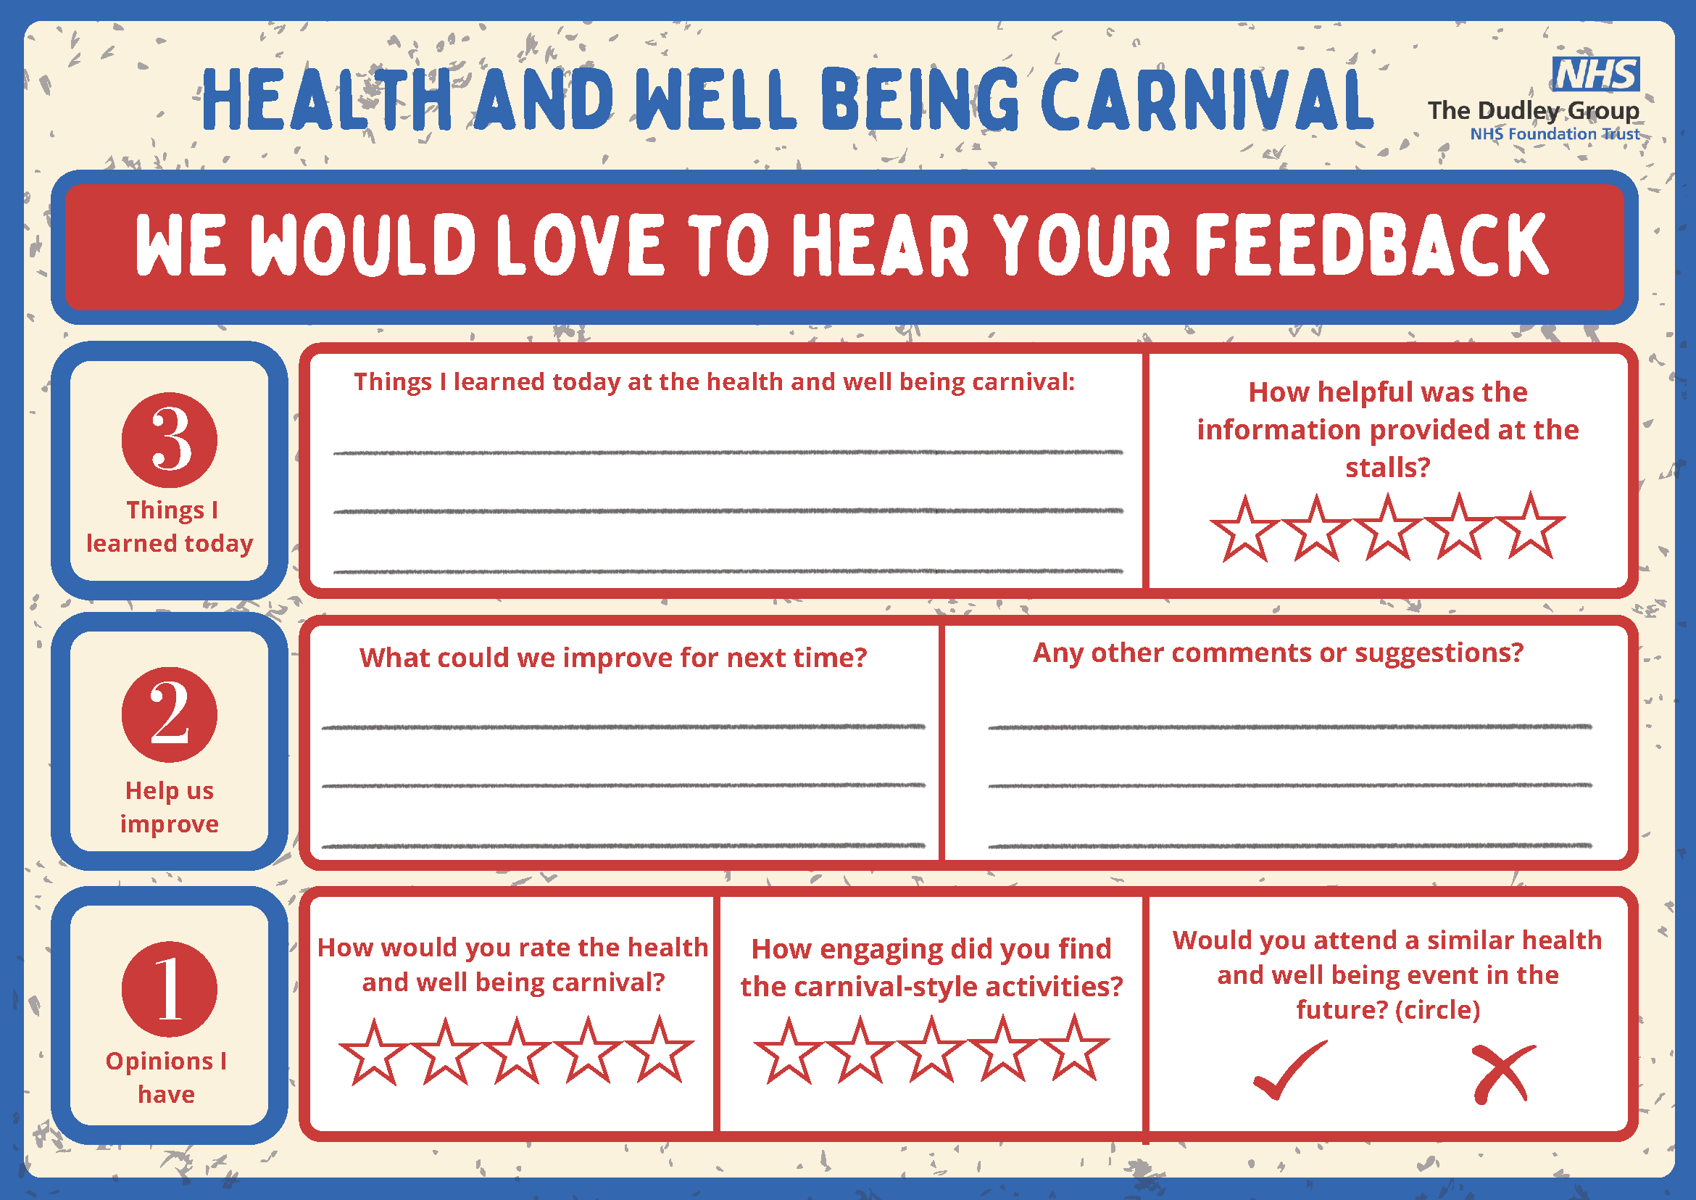
Health and Wellbeing Carnival Designs
Raffle
Tickets
Event
posters
Feedback sheets

Slide 4
The Health and Wellbeing Carnival
Hosted and organised by Dudley Group NHS Foundation Trust, knowing that it would be a great opportunity to reach a diverse audience and to strengthen collaborative partnership working. The aims of the carnival were to:
Promote health and well being awareness
Engage the armed forces community
Provide opportunities for health and well being incentives
Foster a supportive network
Support and empower individuals
Encourage participation
Provide attendees with valuable information and resources about maintaining physical and mental health, with access to expert advice and support on various health topics.
Offer a range of services, including cancer screening, mental health support, mini health checks, and employment advice, aimed at enhancing the well-being of attendees.
Create an inclusive environment for members of the armed forces and their families to access health, care, and wellbeing services in one place.
Motivate attendees to explore different stalls and engage with health professionals, creating an interactive and supportive atmosphere.
By offering a health and well being incentive for those who visit five stalls, the event encourages more engagement and participation among attendees.
Bring together various partners in the health, care, and well being sectors, creating a sense of community and providing attendees with direct access to the services they need.

Slide 5
Stallholders who attended
The Mary Stevens Hospice
Healthy Lifestyle Service
Workwell
Black Country Healthcare NHS Foundation Trust
Dudley Empowerment Partnership
The What? Centre and Brook
Brook
Home Instead
Thrive
Enhanced Primary Care Support Roles
Gateway Family Services
Change, Grow, Live. Atlantic Recovery Community Service
Black Country ICB
Beacon Centre for the Blind
Dudley Council Public Health
Healthwatch Dudley
Talking Therapies Employment Service
DGFT Lung Health Screening Programme

Slide 6





The Event
Over 600 people entered the carnival tent and engaged with the event
Over 200 people took part in the health and well being incentive
Event organisers asked us to return next year
Mayor congratulated on the collaboration and wealth of services
Received 28 complete feedback slips

Slide 7
Feedback
We asked attendees what they had learned at the health and wellbeing carnival, main themes were:
Health Support & Services
Employment & Volunteering
Community Resources
Free mental health and general health courses
Access to cervical, breast, and diabetic screening
Cancer, sexual health, and therapy services
Self-management for chronic conditions
Hydration and wellbeing tips
Importance of mental wellbeing
Support for getting back into work, especially for people with health issues
Info on volunteer opportunities and employment support services
Guidance for young people in pastoral support roles (16–19 age group)
Wide variety of local health and wellbeing services available in Dudley
Organisations like Brook, Mary Stevens Hospice, HomeInstead, and Dudley Healthwatch
Previously unknown services now discovered
Opportunities to improve personal relationships and social support

Slide 8

Feedback
We asked attendees:
How helpful was the information provided at the stall?
How would you rate the health and wellbeing carnival?
How engaging did you find the carnival-style activites?

Slide 9
Feedback
We asked attendees “What could we improve for next time, main themes were”:
Space & Layout
Additional Services
More to Explore
Several attendees suggested a bigger tent or placing it closer to the main event
Some felt it was a bit crowded
A request was made to include health checks
Suggestions included having more tents and stalls
Overall Satisfaction
The vast majority said “nothing to improve”
Many praised the event as “amazing,” “fab,” and “very helpful and friendly”
Feedback highlighted that the staff were knowledgeable and the information was comprehensive

Slide 10
Feedback
We asked attendees for any other comments or suggestions:
“Everyone was great!!!”
“Glad poster advertised this event as couldn't have known otherwise!”
Would you attend a similar health and wellbeing event in the future?
Overwhelming yes from all feedback.
“This event (carnival tent) is the reason I've come along today”
“Fantastic idea! Well done”
“Great to hear about the different types of cancers and screening programmes”
“Fab day”

Slide 11
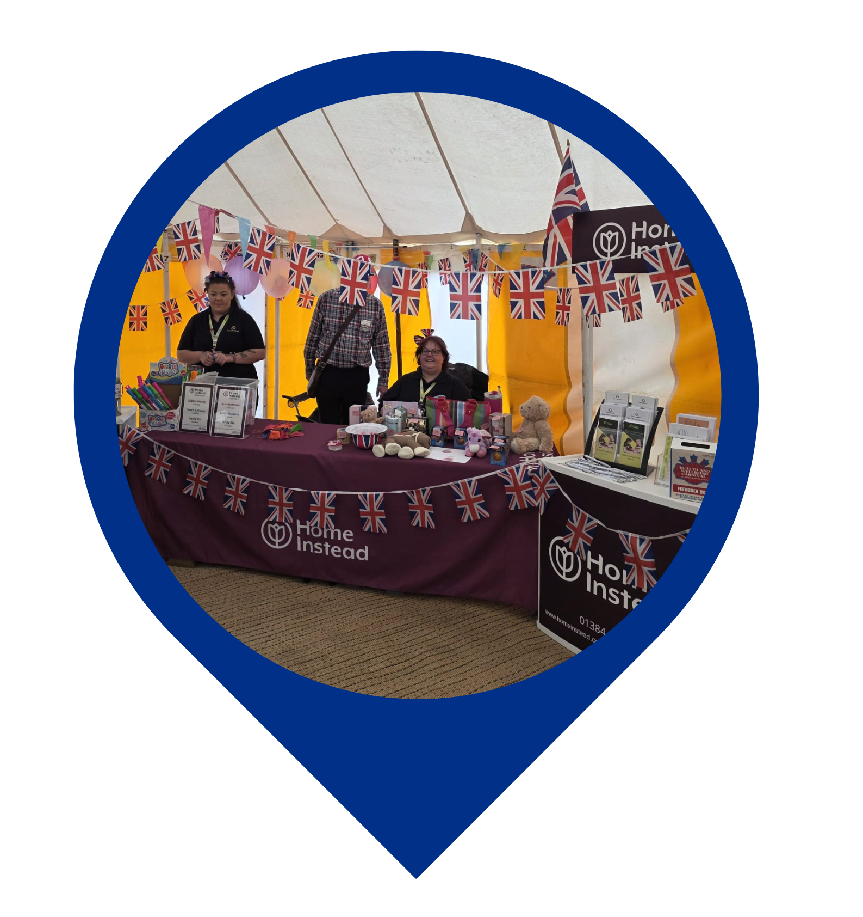
Stallholder Feedback
Mandy Brownhill - Community Engagement
Home Instead Dudley & Sandwell South
“Thank you for this invite we loved it.
So busy we spoke to hundreds of people about our services and about Home Instead Charities.
Everyone had a great time.
It was lovely to see people so engaging and participating in the activities.
It was good to share information that will help people be more informed about what is available and who can help.
Getting the message out to people is critical and events like this are so valuable.
Would be great to do again in the future.
Thanks once again I really hope you do it again next year, if you plan any in other areas that we cover please let us know.”

Slide 12
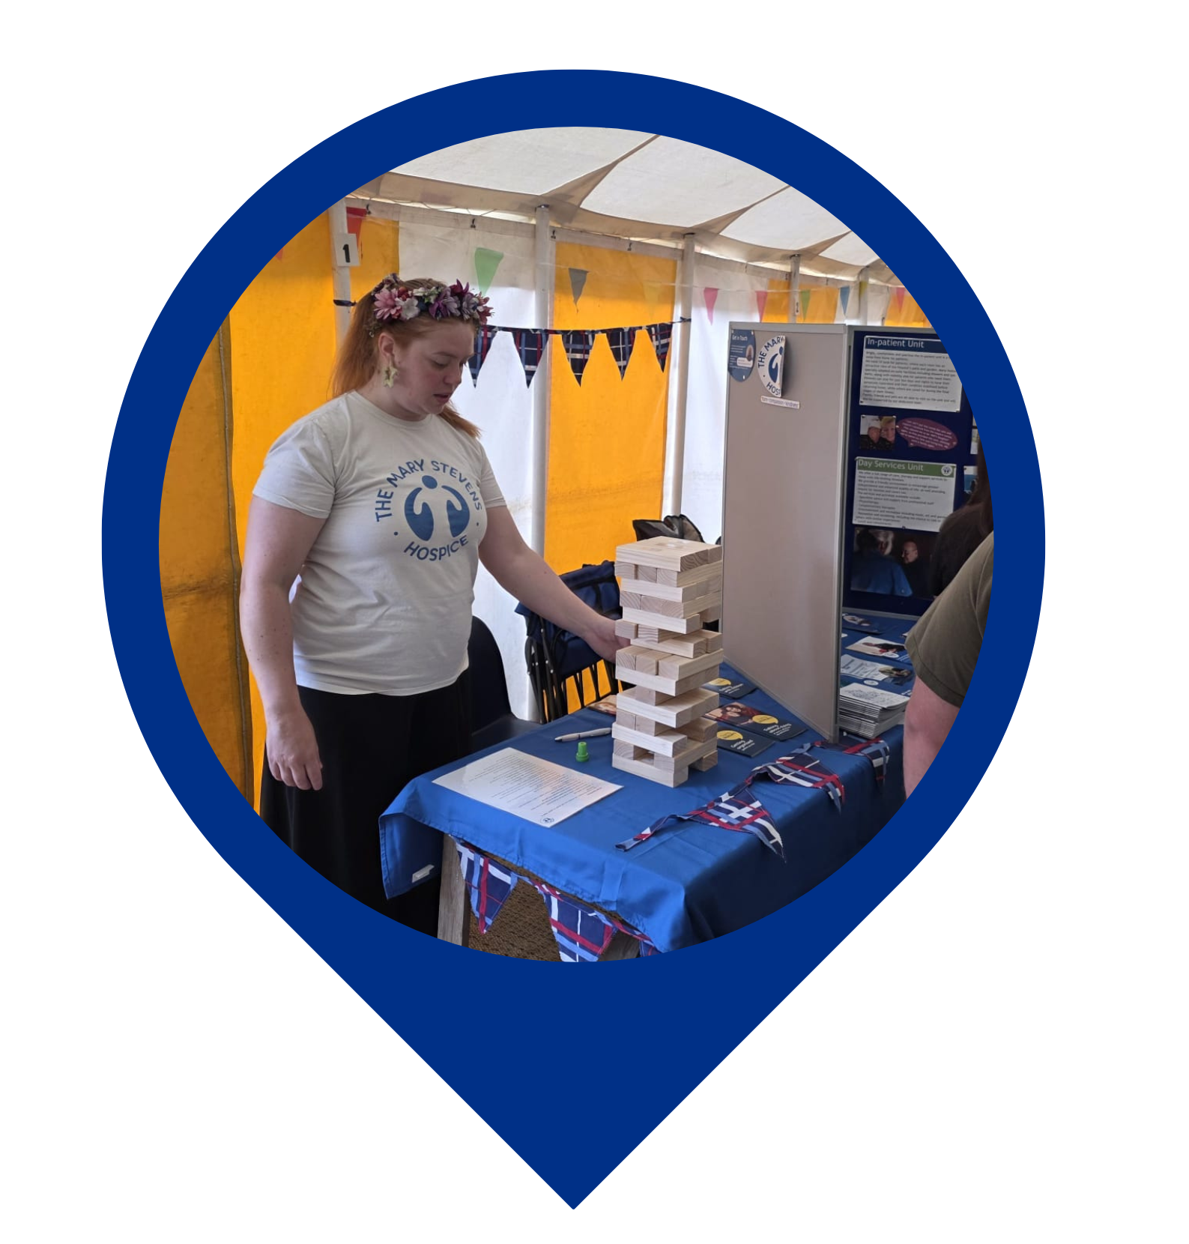
Stallholder Feedback
Maria Goodwin
Mary Stevens Hospice
“Thank you very much for having us!
I thought it was a great idea and would love to be a part of it again.
It is always great to join forces with other fantastic health and wellbeing groups to engage with a larger number of people at events like this, rather than having to do it on your own.
I really liked the idea of having an activity at each stall and this worked really well with those attending, keeping them engaged and coming up to your stall to interact, where they might not have done originally!
I had some fantastic conversations, opening up conversations around the Hospice and death and dying with great answers to the questions I was asking on the jenga activity. I had someone who was really interested in volunteering for the Hospice and has contacted me to find out more. I had a conversation with a staff member from a local college, which hopefully will lead to me doing some collaboration work with them going forward. I also gave out all my All in One Place booklets, which are a tool to keep all your important documents and information safe for end of life. We had some great feedback on these booklets and people taking them home to pass on or use for themselves.
Anything like this that you do, I would be really keen to be part of, so please do keep me updated.”

Slide 13
Stallholder Feedback
Lydia Hester-Collins - Senior Health Improvement Practitioner
Strategic Partnerships Team, Health & Wellbeing, Dudley Council
“This was one of the best events we have attended, public health spoke to approximately 150 people and had approximately 50 conversations with people and families regarding a mix of subjects, some of the most popular subjects discussed at our stand were.
Armed Forces Covenant Webpage and the support to residents
Household Support Fund
Community Support for Financial advice
Dudley Community Information Directory Website
Public health and support for older adults and carers.
Lunchbox Ideas for children in school / some adults like this too (for themselves)
Free Activities across the borough and the Park Active Hubs.”
“The activities provided by the stalls really engaged people, they enjoyed getting involved, mainly the children enjoyed play your cards right, but it gave parents the opportunity to ask questions too. The activities made people feel more confident to talk and ask questions. This is why when we run say hello benches to reduce isolation and loneliness, we encourage an activity as people feel more confident to open up the conversation.
Going out to where people are really made the difference to how many engaged and when we asked people where they were from, a large proportion were from Dudley.”
One lady shared that she primarily came for the health and wellbeing tent when she saw it advertised as part of the wider event, she went away with lots of information on how she could access some of the groups across the borough.
One lady shared information about her parent and how she was struggling with dementia, she was offered support there and then and we talked through some of her options for further guidance. We gave her information about the support Dudley Dementia services /gateway offer and she said she was going to contact them to find out more.
A few members of staff from schools came along to ask about financial wellbeing and weight management support across the borough, they were signposted to household support, park active and the information on healthy Dudley including the healthy lunchbox resource.
One community service came and said that they would like some of the services to come and deliver talks, we signposted to ABL health and health checks and said that if they contact the healthy ageing team, they may be able to visit and talk to the group about services that support older people. Also directed to Dudley’s Community Information Directory to sign up and advertise for free and to find out more from other community orgs that may offer support.
Ex armed forces asked about the support that was available for veterans and community, was able to discuss the armed forces covenant website and signposting on there too.

Slide 14
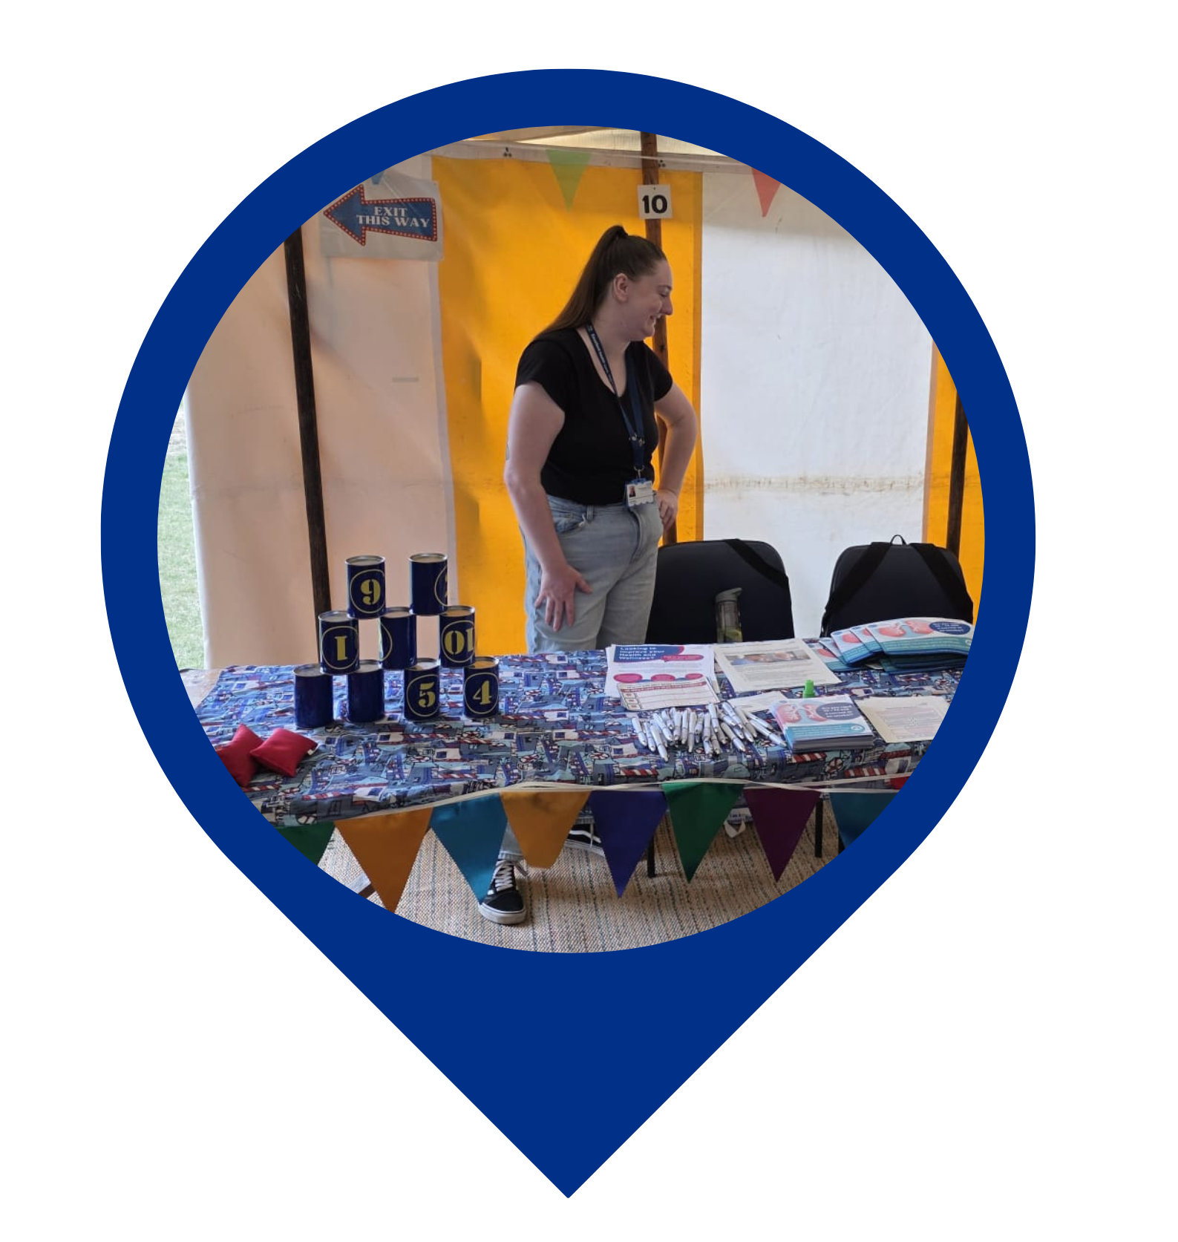
Stallholder Feedback
Janet Major - Health And Wellbeing Coach
Dudley Group NHS Foundation Trust
“I took part in the event on Sunday 29th June at Himley in the Health & Wellbeing Marquee and it was great, a good response from people who took an interest in the services. Our aim was to promote Health & Wellbeing and the services available through their GP surgeries, including Health Coaching, as well as the other services set out. We never had a quiet period, to be honest, it goes to show how people are interested in their Health & Wellbeing , what there is on offer, in this sort of surrounding it does grab the attention and I think this should be considered for future events as there is always lots going on throughout the summer months.
Staff who took part also did an excellent job from organising the event from the very start to the finish job which shows our dedication to what we do in our roles.
Look forwards to the next event.”

Slide 15
Stallholder Feedback
Roz Geary - Cancer ICS Programme Manager
From a Breast Screening perspective
Jayne had a lot of engagement with the ladies about breast self-examination
We had lots of conversations probably about 25+ with men and couples about prostate screening. There were about 5 patients who had prostate cancer and were able to tell us about their positive experiences in hospital, but all the men I spoke too told me that they had had resistance from the GP or practice about asking for or receiving a PSA test.
“We had eight plus conversations with women over 70, not accessing breast screening, which, although they are told at their last appointment they need to self-refer should they wish to continue, is a common theme.
Conversation/Signposting two women with a family history of breast cancer, but who struggled to access their GP. One directed to the geneticist, another advised to speak to the breast care nurse.
30 plus breast awareness conversations, with limited knowledge on how to check breasts, know signs and symptoms of breast disease, and reasons for non-attendance to screening invitations, with the majority citing fear of results, or better not to know, as reasons not to attend when invited
Several males were interested in how to check their chests, as they had not realised that they could have a diagnosis of breast cancer.
All materials on breast awareness, signs and symptoms were distributed, and more were needed due to the high numbers of visitors to the health tent.”
We had lots of engagement with the younger men about testicular cancer.
We had lots of people approach us about concerns, but more about concerns about accessing information on an advice and guidance basis, almost a reassurance line, as they felt some of their concerns were trivial and waiting in line for a GP appointment wasn’t always what they wanted.
A lot of the women we spoke to told us that they went for breast screening, but there were lots of concern amongst them about how the new cervical guidance would work, or how be beneficial it would be, a lot of the women aged 35 plus wanted us (the NHS) to work more with schools and share the information, as these were the ladies that remember Jade Goody and that engagement work has now ceased to be as powerful as it was.
We had several families ask us about genetic services and support especially regarding BRCA testing.
We were received very positively in general; we only had a few general grumbles about the NHS which was lovely.

Slide 16
Next steps
To explore the possibility of supporting this event
again next year.

Slide 17
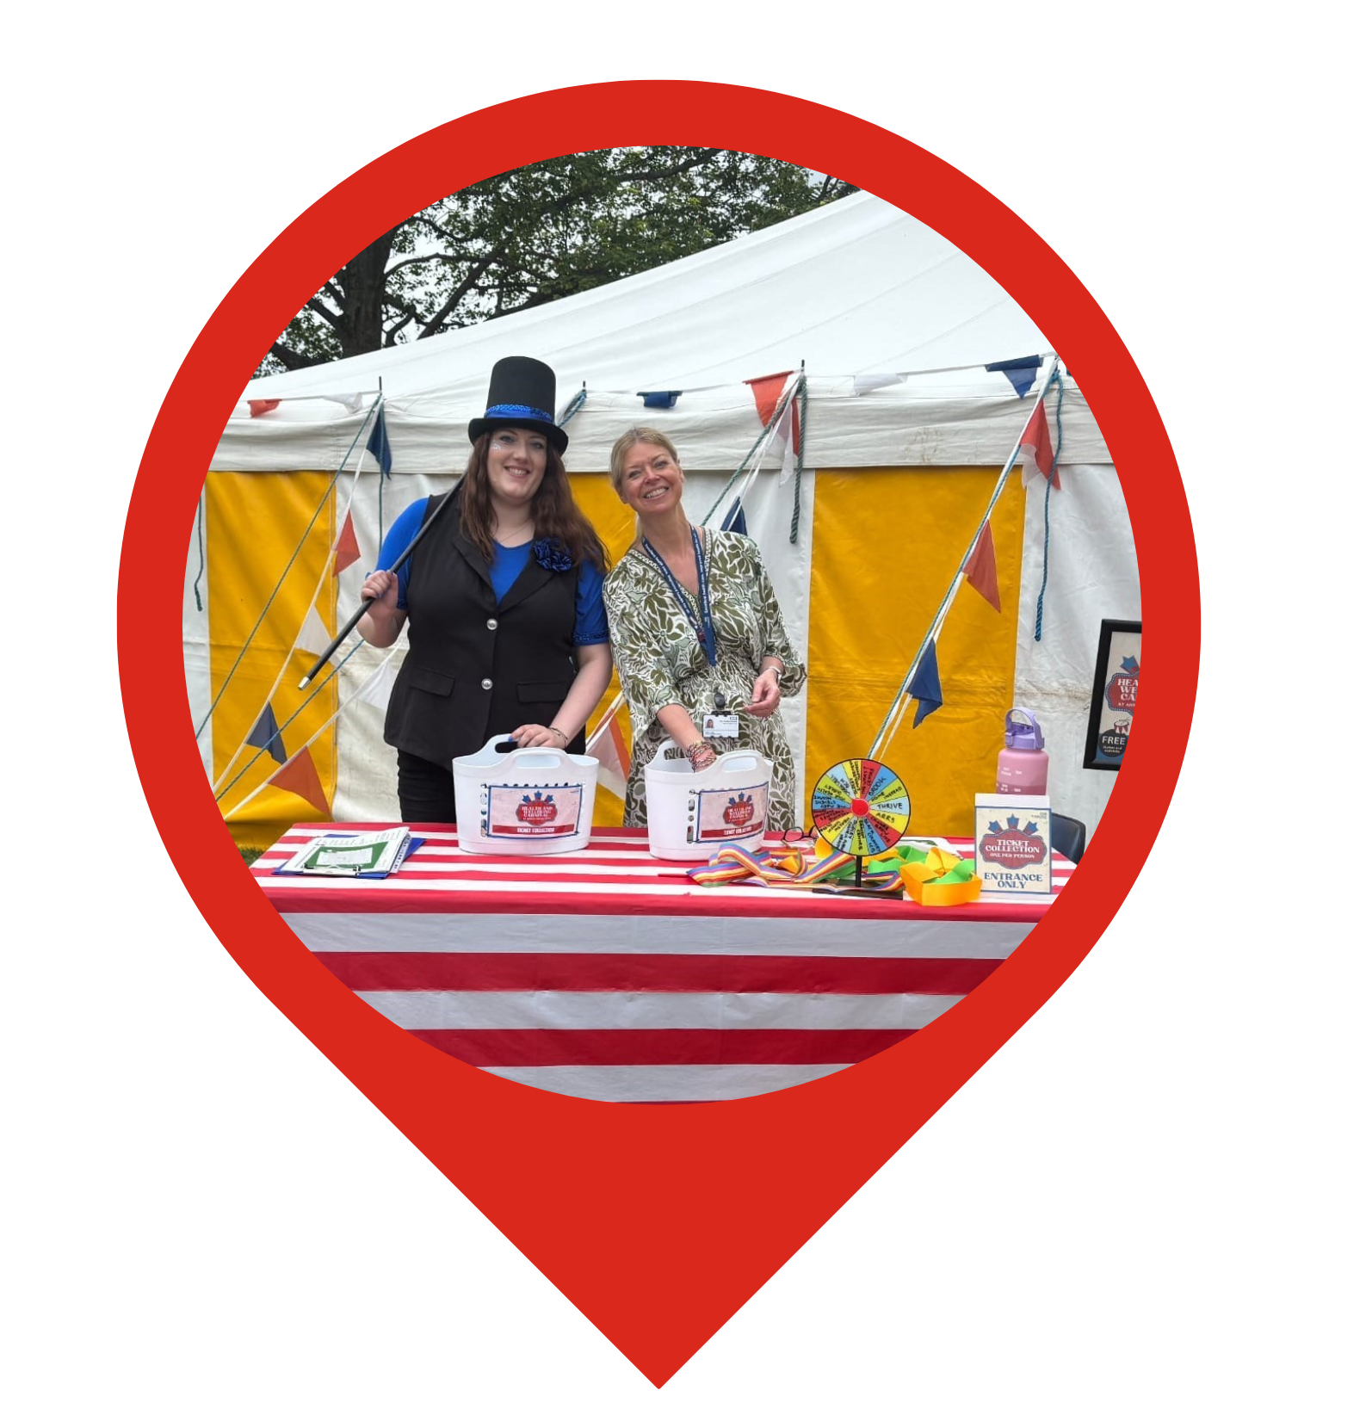
Thank you
“Thank you to everyone who took part and attended the Health and Wellbeing carnival.”

