Slide 1



Women’s Health Hub Menopause Cafes
Summary report 2025

Slide 2



Me and the Menopause workshop
Tuesday 12 November 2024
To ensure women’s health is better supported across the borough, truly meeting the needs of local women, the Dudley Health and Care Partnership (DHCP) organised a workshop on behalf of The Black Country Integrated Care Board (BCICB), titled “Me and the Menopause.”
Understanding Women’s Health Experiences
This workshop focused on understanding the real-life experiences of women living with heavy menstrual bleeding (HMB) and menopause. The goal was to explore key challenges women face, including:
Requesting GP appointments with specialists in women’s health
Accessing timely and appropriate appointments
Whether women feel GPs and healthcare professionals understand their health problems

Slide 3
The workshop
The purpose of the workshop was to provide an opportunity for local patients to help shape what a hub could look and feel like, using a bottom-up approach and listening to what really mattered to the people who would benefit from the hub. During the workshop, we wanted to:
Understand the perceptions of women with HMB – what do they think should happen?
Provide an opportunity for people to help shape the women’s health hub offer
To explore some of the barriers that people feel they face when trying to access care and support

Slide 4
How we organised the session
Dr Heidi Kerr and Dr Vicky Hobbs from Lion Health helped to shape the session as they will be overseeing the hub as GPs with a special interest in women’s health.
Invites were shared far and wide inviting people to join us in the online conversation and we received lots of interest.
Even people who were not free to join us were interested in sharing their views – they wanted to be heard.
31 people from a range of backgrounds joined the call and at the start we reminded everyone that it needed to be a safe space to share details and to be respectful. Participants were reminded to keep comments brief as time was limited and invited to share comments using the chat function or whiteboard.
Context was provided for participants to enable full participation and understanding.

Slide 5
Warm up session
We had 6 questions we wanted to ask participants to get a broad understanding of the current situation. We asked people to raise their hands if the following statements applied to them:
17
15
6
18
11
7
I have gone through or going through the menopause
I have sought help for menopause symptoms (this can be through any avenue e.g. self care, GP, HCP, alternative remedies)
I have never sought help for the menopause
I have suffered from Heavy Menstrual Bleeding
I have sought help for Heavy Menstrual Bleeding
I have never sought help for Heavy Menstrual Bleeding

Slide 6
Themes
Although we had questions, the conversation flowed and the following themes came up.
We would prefer to see a female professional
Accessibility to appointments and specialist care varied from person to person
Difficulty in finding and receiving the right support, advice and treatment that was reliable
Patients sometimes feel unheard and dismissed which makes them give up
We need more help for the menopause – not enough is known and shared about it
It’s more than just a clinical model

Slide 7

Next steps
20 of you said you would be interested in attending an online support group
12 of you said you would be interested in finding out more about becoming a menopause champion
This report will be shared as part of the business case for the Women’s Health Hub and will help to shape the hub and we will be looking at what we can implement and how we can implement
We will also share the report with support groups within local health and care organisations so they can address any gaps

Slide 8



Menopause cafes
Aims
Dudley borough Women’s Community Health Hub
Our vision
New service to support women in the community
Education
To empower people through knowledge and understanding of health and wellbeing, to make proactive decisions about their lifestyles leading to positive differences for their future health.
Referral via your GP
Peer support
Support with heavy periods
Menopausal care
Signposting to further services
In person and remote consultations offered

Slide 9
The Menopause Café topics covered:
How menopause can affect women’s health and wellbeing
Available treatments including self-care options, hormone replacement therapy (HRT), and other medical interventions
Mythbusting

Slide 10
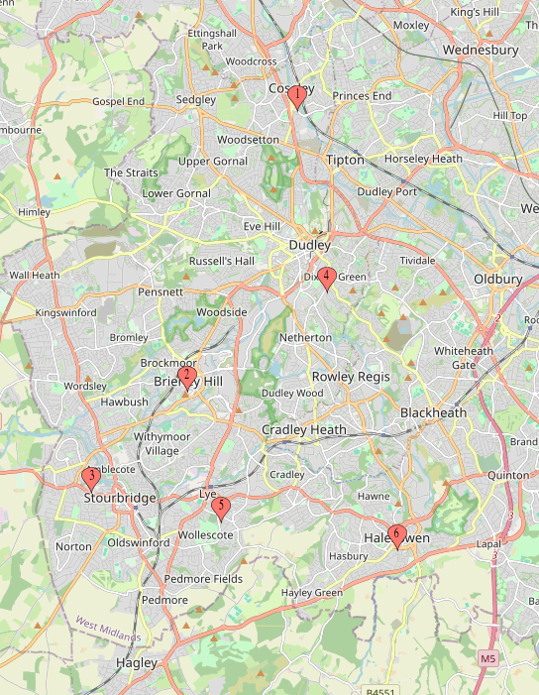

Impact
6
1
Menopause cafes held across the Dudley Borough
Coseley Family Hub
2
Brierley Hill Family
Hub
153
3
Lion Health Surgery
Ladies attended the menopause cafes
4
Dudley Family Hub
Dr Heidi Kerr and Dr Victoria Hobbs
A specialist in women’s health spent time discussing the menopause and dispelling many of the myths surrounding it.
5
Lye Community Centre
6
Halesowen Leisure Centre

Slide 11
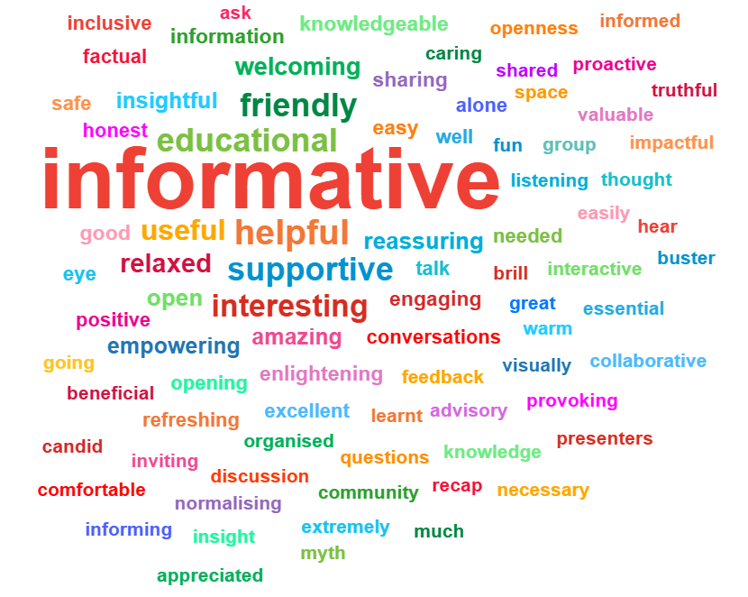
Feedback
We asked attendees:
“What 3 words would you use to describe the event?”
The image on the right is a collation of all responses from all menopause cafes.
Informative, Educational, Supportive, Helpful, Useful were the mostly commonly used words.

Slide 12
Feedback
We asked attendees “What did you learn?” The key themes were:
Hormone Replacement Therapy (HRT)
Symptoms and Experiences of Menopause
Myth-Busting and Clarifying Misconceptions
Practical Information and Resources
Range and variation of symptoms
Recognition and management of symptoms
Timeline and stages of menopause
Weekly hormone fluctuations
Systemic impact and causes
Personal stories shared by others
Addressing false beliefs about HRT and menopause
Debunking outdated or incorrect advice
Reassurance and validation
How to talk to your GP
Clinic and referral pathways (Women’s Health Hub)
Websites and further reading
What to ask for and where to go
Most prominent theme.
Different types and forms of HRT (gel, tablets, patches)
Risks and benefits of HRT
Dosages and titration
Clarifying myths and misinformation
Safe use and long-term use
Personal eligibility for HRT
HRT alternatives and complementary support
Emotional Support and Shared Experiences
Self-Care and Lifestyle
Intergenerational and Future Awareness
Importance of nutrition
Four pillars of health (likely: sleep, nutrition, exercise, stress management)
Self-help strategies and lifestyle advice
Taking care of yourself through the transition
Realization: “I’m not alone”
Support from peers and community
Listening to others’ journeys
Importance of empathy and shared learning
Preparing for perimenopause and menopause
Understanding how to support family members (e.g. mother)
Becoming aware at younger ages (40s, even earlier)

Slide 13
Feedback - Education & Awareness
“Doctors need more education… I’ve had to go from doctor to doctor to help me.”
“Would like to know where to go for better advice when GP does not seem to know much.”
“GP enthusiastic, excellent.”
“Increase GP knowledge to be able to support their patients.”
“Needs to go out to more departments / companies.”

Slide 14
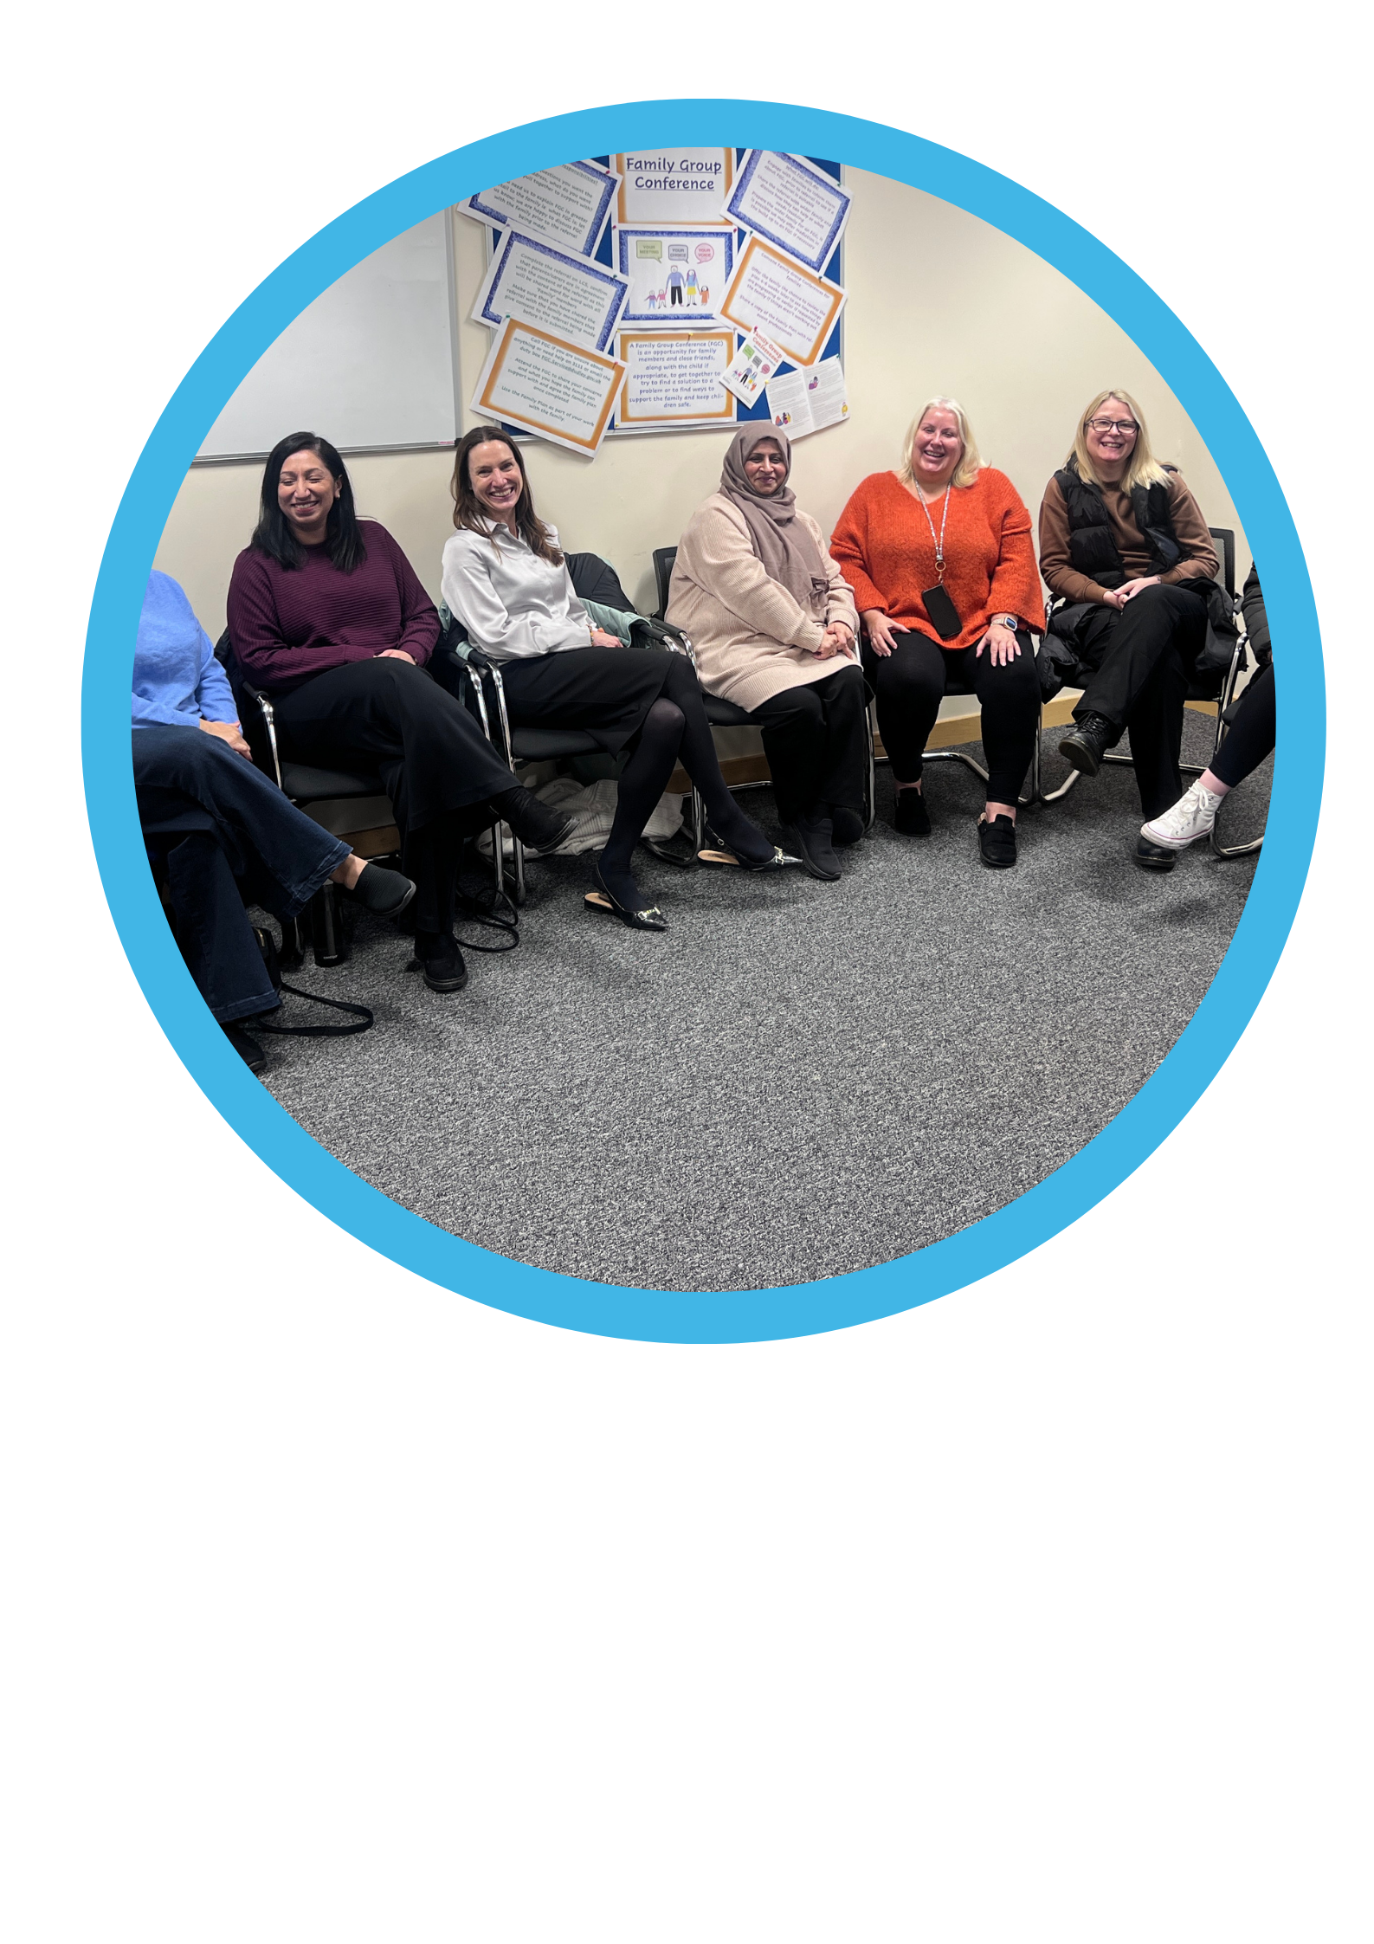
Feedback - Sustainability & Expansion
“More frequent meetings.”
“More sessions like this to talk about sleep, nutrition, exercise etc.”
“The menopause cafés are a great initiative; it would be great to see these run on a regular basis.”
“Menopause in the workplace – workshops.”
“More events like this around Dudley.”

Slide 15
Feedback - Support & Community
“This is a vital initiative… It’s good to talk and share experiences to make informed decisions.”
“How amazing it is when women get together.”
“Would love a follow-up meeting to continue connecting with the lovely ladies.”
“More face-to-face support groups.”
“Great event. Every woman should attend one of these sessions.”
“Referrals into menopause cafés.”

Slide 16
Feedback - Practical Support
“Speak more on diet/nutrition and nutrients.”
“Hot flushes: I use pads from fridge, pet coolers, cold water on wrists… Doctors need more education.”
“Maybe a fact sheet to take away.”
“Email with links/websites for future reference.”
“Maybe a whiteboard for key websites/medications.”
“What do you do if HRT isn’t working well?”

Slide 17
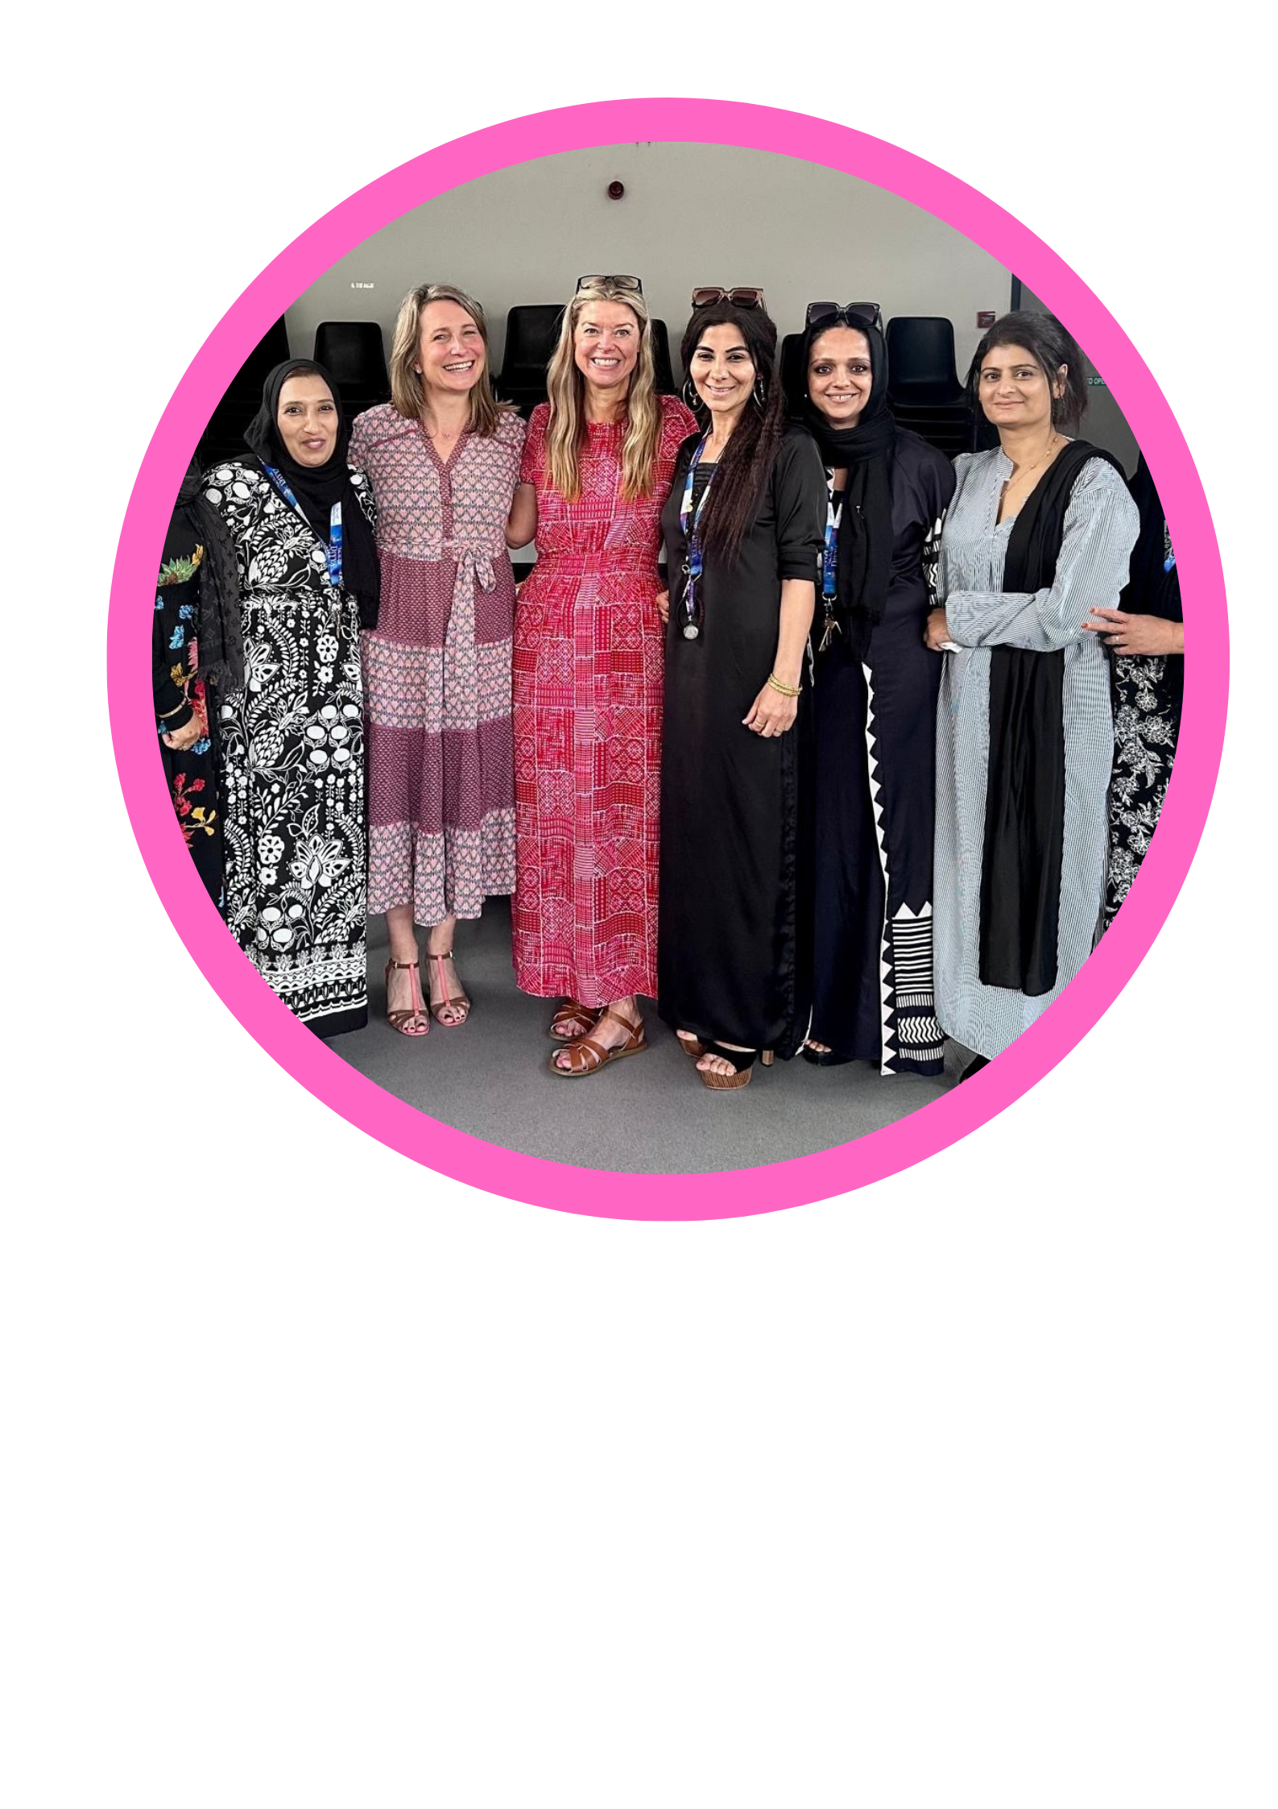
Feedback - Access & Inclusion
“Ensure access to interpreters where required– lost in translation for some, which was a shame.”
“Would like this at Russell’s Hall Hospital.”
“Should be available for all pre and menopausal women.”
“Translators for non-English speaking – they suffer in silence.”

Slide 18
Feedback - Innovation & Collaboration
“Fantastic idea to bring menopause conversation to the foreground.”
“Encouraging self-care – self-management programme.”
“It would be good if a dietician and bone health exercise could be done in one place, such as at a hub.”
“Love the idea of linking with other services, e.g., strength training / bone health.”

Slide 19
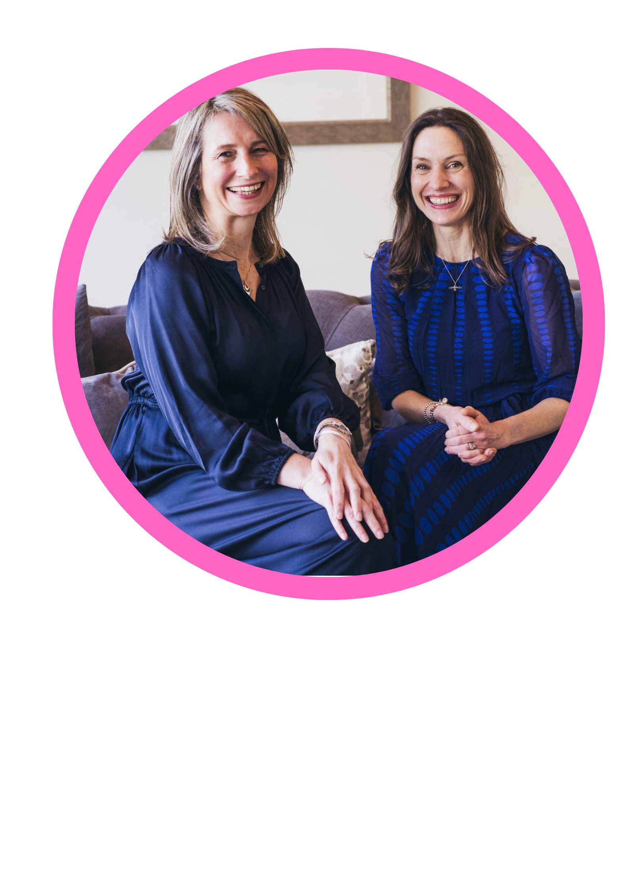
Feedback
“We would like to thank all the women who gave up their time to come to the six menopause cafes that we ran. We thoroughly enjoyed meeting you all and hearing your stories. These cafes were the perfect environment to stimulate conversation and deliver trusted medical information to empower women in their menopause journey.”

Slide 20
Thank you
Thank you to all of the amazing women who joined our sessions with warmth and humour and shared their stories and experiences. We will be looking at the next steps with colleagues.
We know we can be stronger together and make the difference that we all need.

