Slide 1
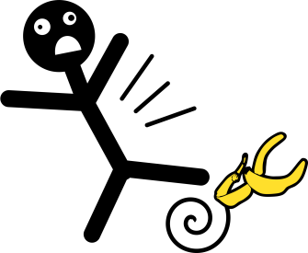
Falls Prevention and Management
In The Hospital Setting
Compiled BY Soaad Gheleh
Falls Lead
Updated January 2024

Slide 2

What is a fall?
A fall is defined as an event which results in a person coming to rest inadvertently on the ground or floor or other lower level
(World Health Organisation Jan 2018)
A fall is not:
-Lowering or supporting a patient to the floor
-Intentionally sitting down
- A deterioration in health, causing collapse

Slide 3
The Implications Of Falls
280,000 falls a year are reported to the National Patient Safety Agency
An inpatient fall is the most common Patient Safety Incident National Patient Safety Agency (2007)
One in every 3 people aged 65 and over fall at least once per year NHS Choices 2015
Financially the cost of inpatient falls is around
£2.3 billion annually. This is due to:
-Prolonged inpatient stay
-Additional investigations
-Chronic and long-term support
-Staff injury and sickness
-Litigation

Slide 4

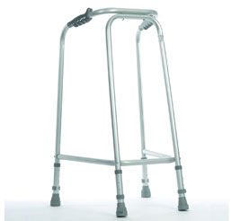
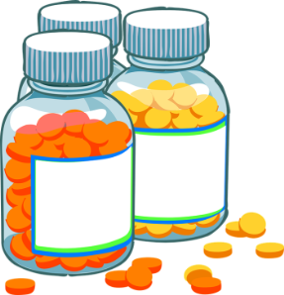


What Causes Falls?
There are lots of reasons people fall
They include:
Extrinsic (factors that we may impose on the individual)
- Poor lighting
- Regular bed or ward moves
- Obstacles
- Lack of walking aids
- Unfamiliar surroundings
- Lack of suitable footwear
Intrinsic (factors specific to the individual)
- Balance and gait
- Reaction times
- Medications
- Sensory impairment
- Cognitive impairment
- Cardiovascular causes

Slide 5
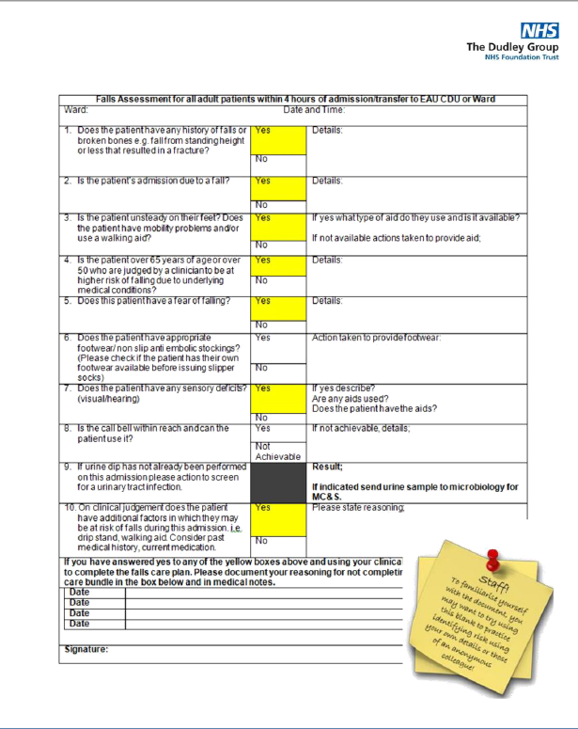
Inpatient Falls Risk Assessment
(Outdated document see the digital version in further slides)
Every adult patient should have a Falls Risk Assessment completed or reviewed within 4 hours of admission to a new area and then at least weekly
Each question should be answered. If the answer to any of
the questions is yes (yellow boxes), the Patient Fall Prevention and
Management Document (Hospital) should be commenced.
This document incorporates the Falls Bundle
If none of the above question apply, but on making a clinical
judgement you still feel the patient is at risk of falls, then your
reasoning for doing this should be documented here
The person completing the assessment must sign and date at point of completion. This assessment should be reviewed upon admission, upon moving to a new area, following any change in the patient’s condition and also post fall

Slide 6
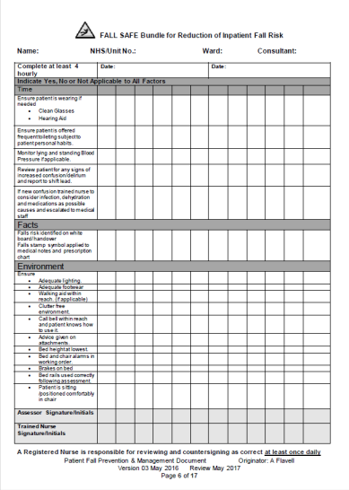
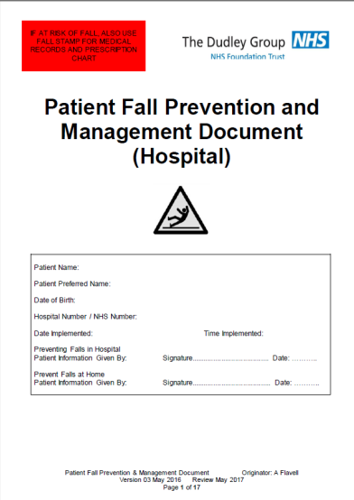
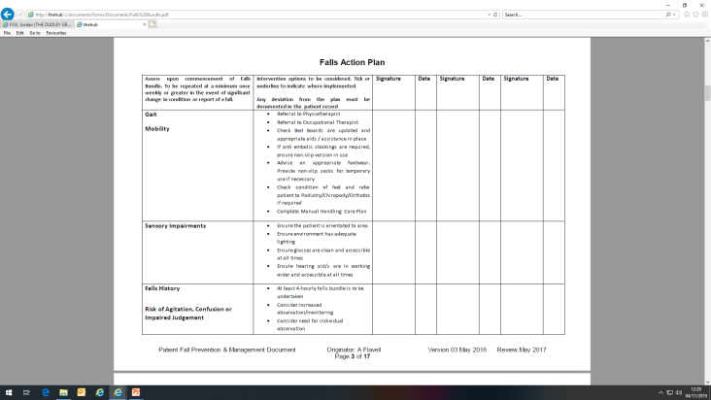
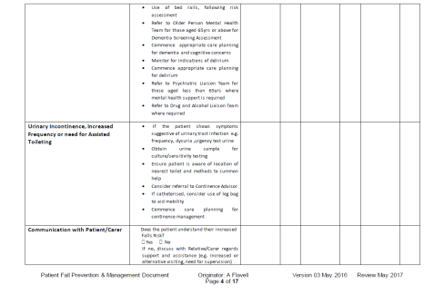
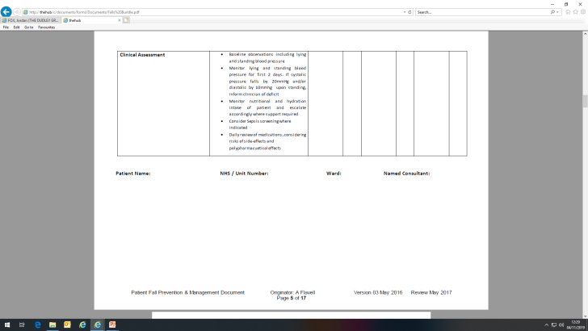
Inpatient Fall Prevention And Management Document
(see digital the updated document in further slides)
The front section should be completed as soon as the bundle is instigated
This is the falls bundle
At the back of the bundle are tear out information pages to be given to the patient for advice on falls prevention in hospital please sign at the front of the bundle to say you have given this to the patient
The risk assessment/action plan below should be completed for every patient commenced on the falls bundle

Slide 7
Digital update
All falls prevention and management documents have been moved to a digital platform and can be found on Sunrise. This includes the falls risk assessment, falls bundles, bedrail risk assessment, post-fall documentation, and patient advice leaflet.

Slide 8
Falls Prevention Aids
FALLS BUNDLE – This should be completed for every patient identified as at risk of falls at a minimum of 4 hourly (at least once every 24 hours by a qualified nurse). This can be increased if necessary
BED/TROLLEY RAILS – These should NOT be used with patients who are agitated or confused as there is a high risk of entrapment or fall from a greater height
ENHANCED OBSERVATION - Assessing for additional staffing support may be necessary if the patient is showing high levels of confusion or lacks the mental capacity to understand/make rational decisions which is likely to affect their safety. Different levels of observation can be considered, however, please ensure least restrictive options are always considered
FALLS LOGO – All patients on a Falls Prevention Bundle should have a falls symbol displayed on ward/area patient whiteboards/tracking board
FALLS RISK ALERT - This must be manually added to Sunrise once your patient has been identified as a risk of falls. This can be done by clicking on the 'Falls Risk Status' dropdown option under the comments section in the patient info tab. Once chosen, this will then display a falls risk icon on the patient alert column on the tracking board
LYING/STANDING BLOOD PRESSURE – Needs recording on Sunrise for every patient over 65 years and above, and/or all patients who have a history of falling or complain of dizziness on standing/walking.

Slide 9
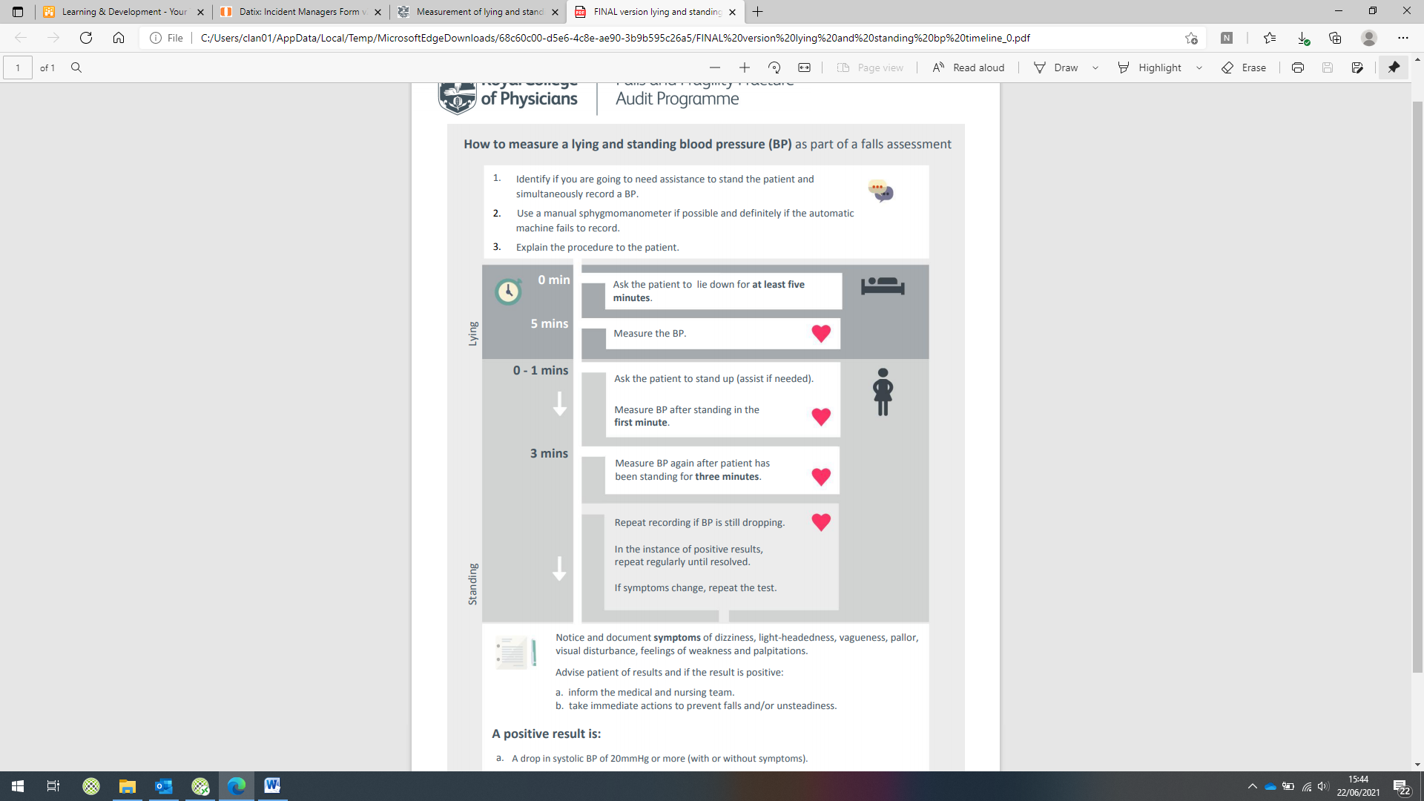
Lying and Standing Blood Pressure
In line with NICE Guidelines all patients aged 65 and over, and patients aged 50 to 64 years who are considered to be at higher risk of falling because of an underlying condition should have their lying and standing blood pressure on admission.
This is because postural (orthostatic) hypotension, a drop in BP on standing, is a contributing high risk factor to falls.
Postural hypotension
A positive result is:
-A drop in systolic BP of 20mmHg or more (with or without symptoms)
-A drop to below 90mmHg on standing even if the drop is less than 20mmHg (with or without symptoms)
-A drop in diastolic BP of 10mmHg with symptoms (although clinically less significant than a drop in systolic BP)
What to do:
-Notice and document symptoms of dizziness, light-headedness, vagueness, pallor, visual disturbance, feelings of weakness and palpitations
-Advise the patient of results and if the result is positive
-Inform the Medical and Nursing team
-Take immediate actions to prevent falls and/or unsteadiness

Slide 10
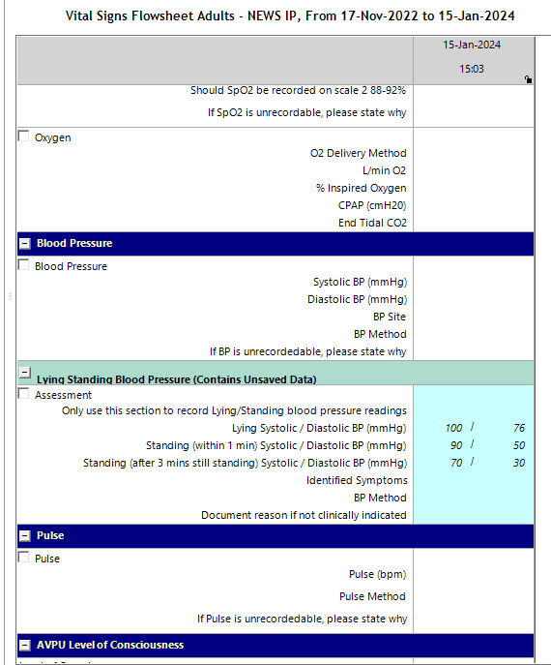
Sunrise Lying and standing blood pressure
Lying and standing pressure can be recorded as a stand-alone reading without triggering the other mandatory fields by following the following steps -
Sunrise>Flowsheets>Lying standing blood pressure.
Please be mindful to record the correct readings under the correct category.

Slide 11
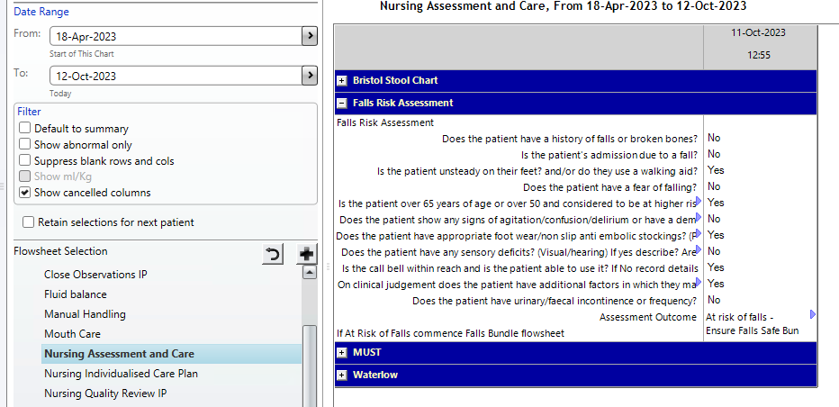

Inpatient Falls Digital Risk Assessment
All adult patients who are admitted to the Department must have a falls assessment completed within 1 hour of arrival to the Department. This can be found as an electronic assessment on Sunrise > Flowsheets > Nursing Assessment and care > Falls risk assessment
If the patient is assessed as being at risk of falls (answer yes to any one or more of the falls risk assessment), implementation of measures to reduce immediate falls risk (risk factors are listed below the initial falls assessment) is required. This includes a link to the trolley rails assessment
The falls risk icon will automatically be created.

Slide 12
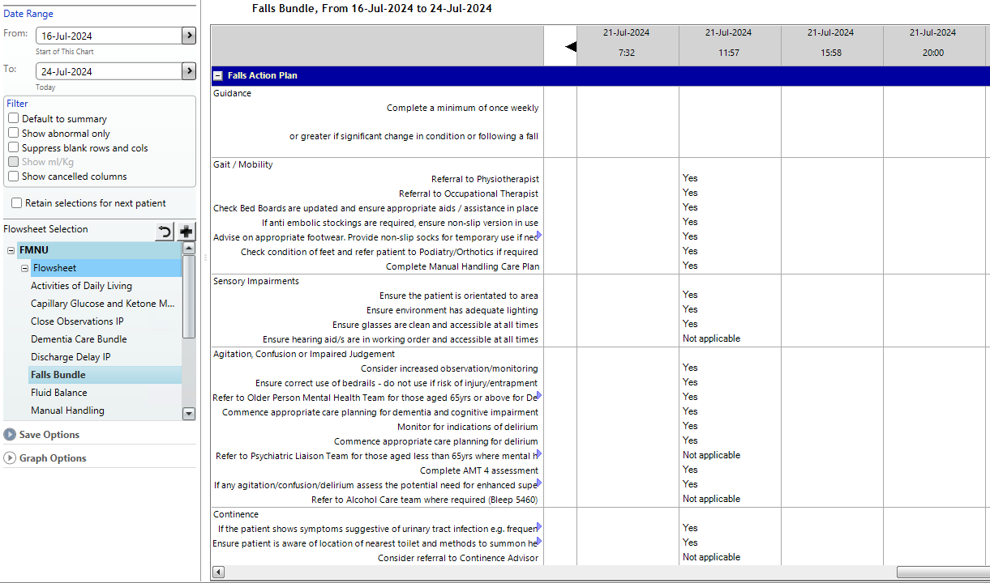
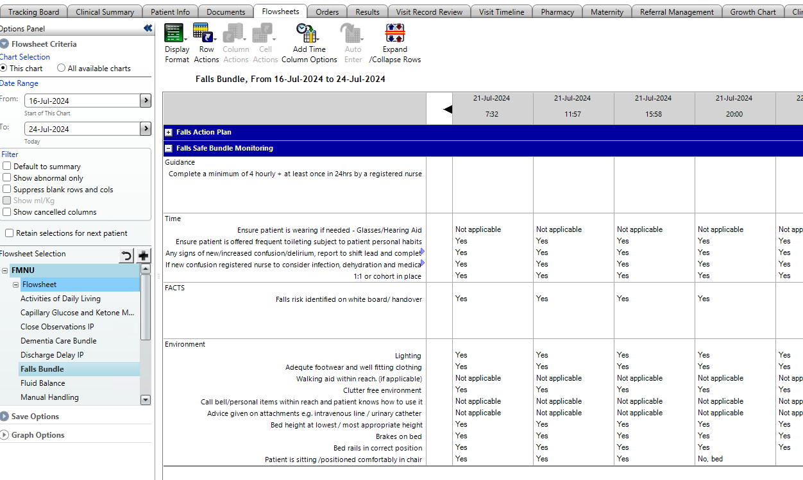
Inpatient Falls Digital Falls Bundle
All adult patients who are identified as high risk of falls. Follow the prompt to commence the Falls Bundle for completion of the risk assessment. Select from the Flowsheets>Falls bundle> Falls action plan and then Falls Safe Bundle Monitoring.
As illustrated below Falls bundle has 2 elements Falls Action Plan and Falls Safe Bundle Monitoring. Both elements must be completed otherwise the risk assessment is incomplete.
Following the initial falls risk assessment, further reassessment is required at hour 5 and every 4 hours thereafter that the patient remains in the Department. Reassessment is also required if the patient sustains a fall in the Department. A prompt for completion of the falls risk assessment is included in the quality round checklist on Sunrise

Slide 13
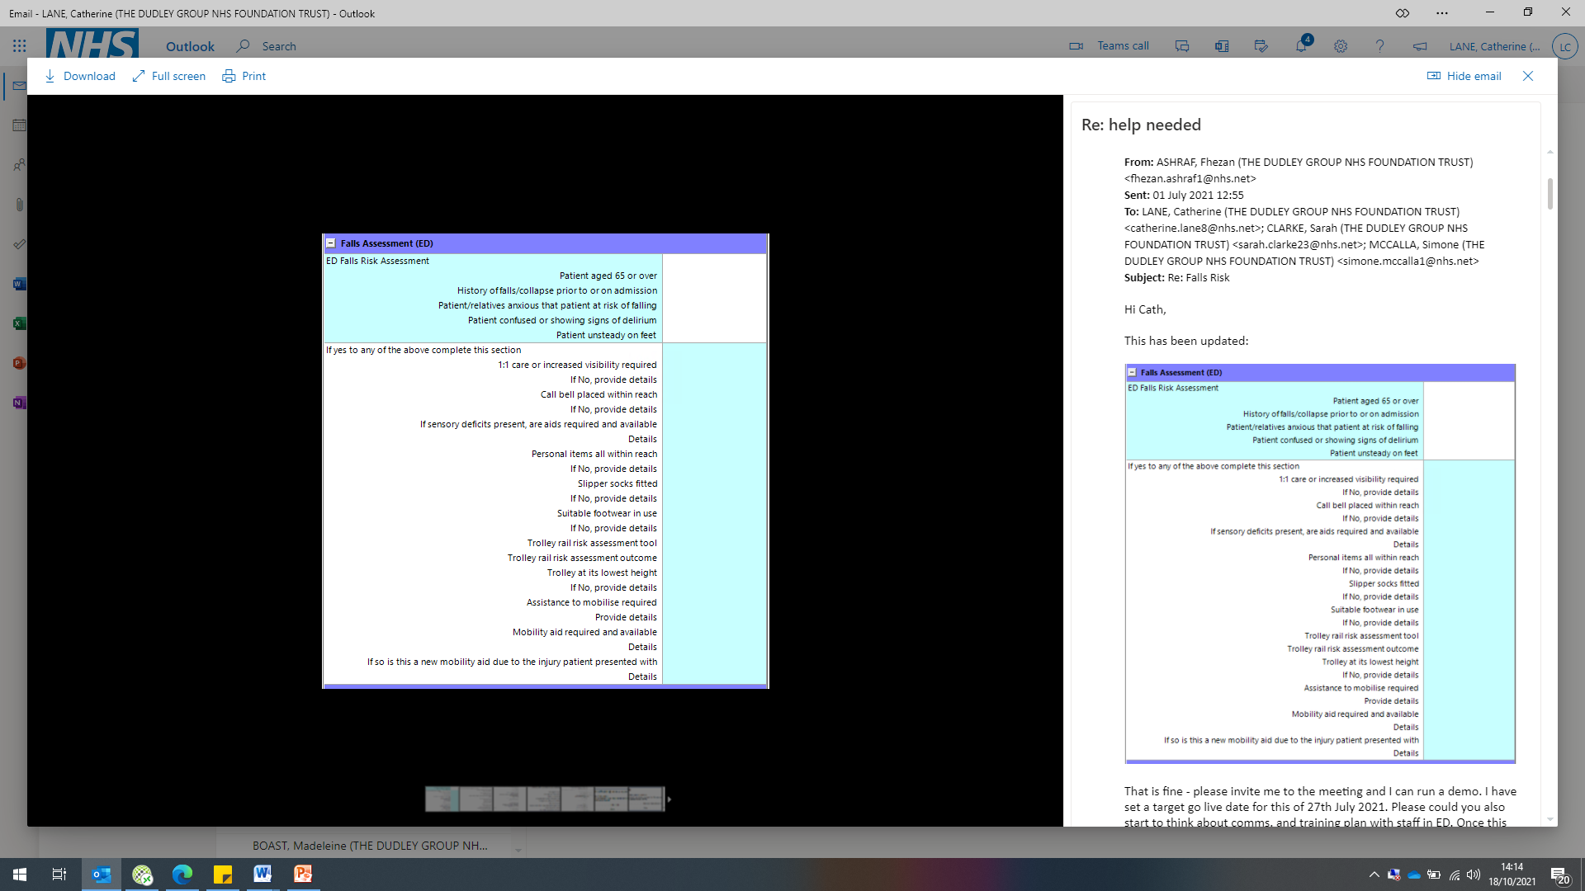
Emergency Department Falls Assessment
All adult patients who are admitted to the Emergency Department must have an Emergency Department specific falls assessment completed within 1 hour of arrival to the Department. This can be found as an electronic assessment on Sunrise > Flowsheets > Assessment and care > ED falls assessment
If the patient is assessed as being at risk of falls (answer yes to any one or more of the falls risk assessment), implementation of measures to reduce immediate falls risk (risk factors are listed below the initial falls assessment) is required. This includes a link to the trolley rails assessment
Following the initial falls risk assessment, further reassessment is required at hour 5 and every 4 hours thereafter that the patient remains in the Emergency Department. Reassessment is also required if the patient sustains a fall in the Department. A prompt for completion of the falls risk assessment is included in the quality round checklist on Sunrise

Slide 14
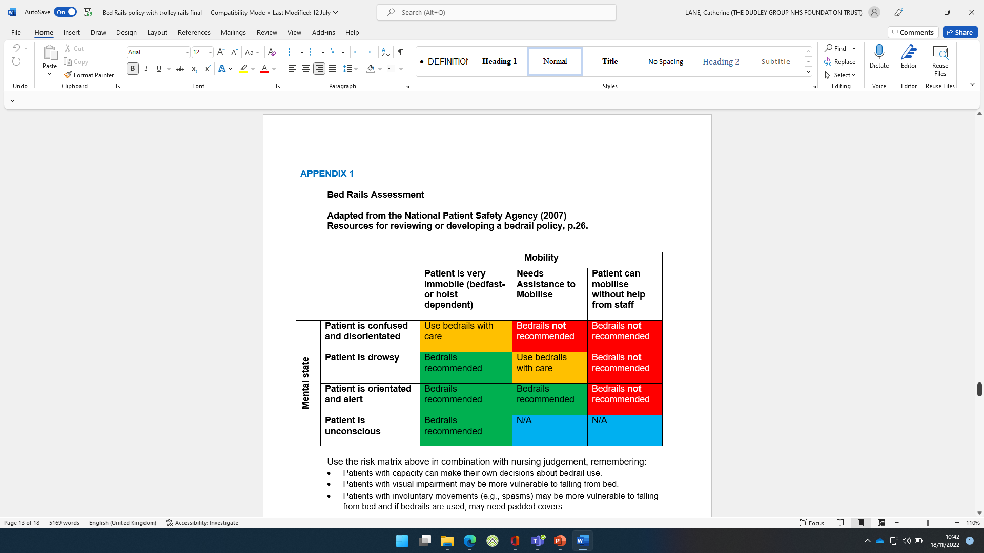

Bed Rail Assessment
Every adult inpatient should have a Bed Rail Assessment completed or reviewed within 4 hours of admission to a new area and then at least weekly
Bed rails should be thought of as an intervention that requires serious consideration prior to use
When completing the assessment remember:
  Patients with capacity can make their own decisions about bedrail use.
  Patients with visual impairment may be more vulnerable to falling from bed.
  Patients with involuntary movements (e.g., spasms) may be more vulnerable to falling from bed and if bedrails are used, may need padded covers.
  Patients <40kg and/or 146cm are at higher risk of entrapment, assess risk, document, and consider alternative measures.
Bed rails should not be used as a form of restraint

Slide 15
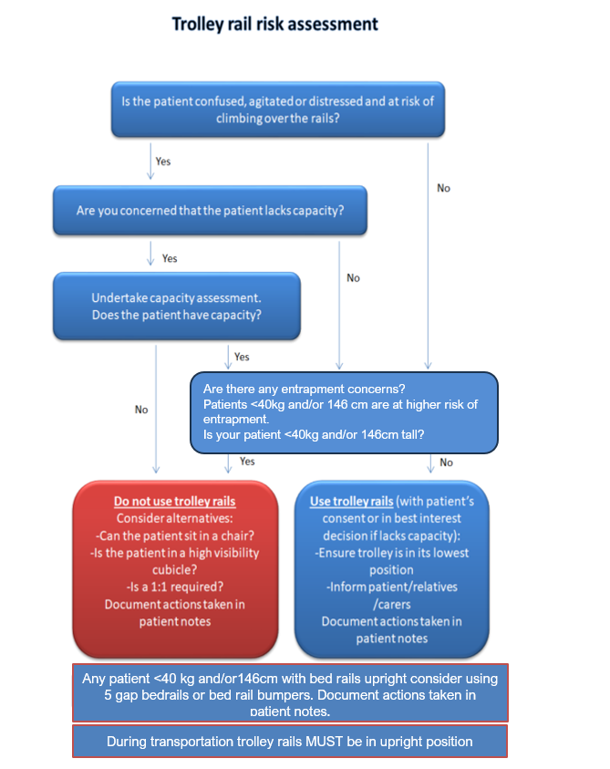
Adult Bed/Trolley risk assessment
Follow this chart to help you
risk assessment to avoid
the risk of harm .

Slide 16
Risk Management
Our adverse incident investigations have shown that the physical or clinical condition of bed occupants means that some are at greater risk of entrapment in bed rails. Those at greater risk could include older people, adults or children with:
• communication problems
• confusion, agitation or delirium
• learning disabilities
• dementia
• repetitive or involuntary movements
• high or low body mass (which may change entrapment risks)
• impaired or restricted mobility
• Variable levels of consciousness, or those under sedation.
Risk assessments should account for any characteristics which might put the bed user at greater risk from use of bed rails. The decision to use bed rails should be made with the consent of the bed user whenever possible. The reasoning for the decision to issue bed rails should be effectively communicated and recorded, including to the carers or family members when this is appropriate.
CASE STUDY 1 – Inappropriate prescription leading to fall A bed occupant died after climbing over the bed rails and falling.
The user touched the bed position control and raised the bed to its maximum height. They then tried to get out of the bed by climbing over the rail, only to fall and suffer a broken neck. The additional height of the bed rail likely increased the severity of the injury.
Advice – If bed users are known to be in a confused state, then bed rails may serve to increase the overall risk of injury. A risk assessment should have identified the hazard of leaving bed controls accessible and the potential for an increased fall height.

Slide 17
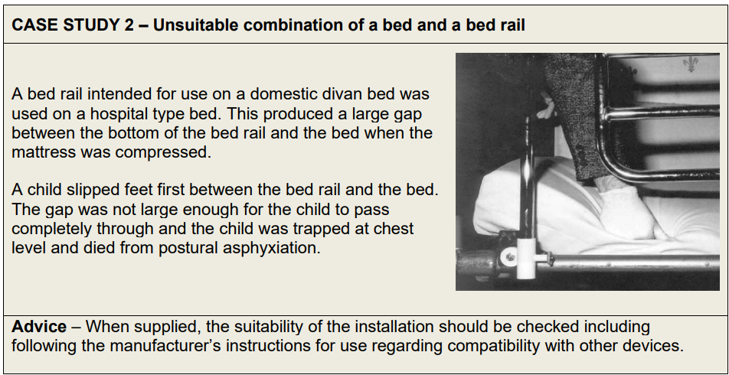
Case study 2

Slide 18
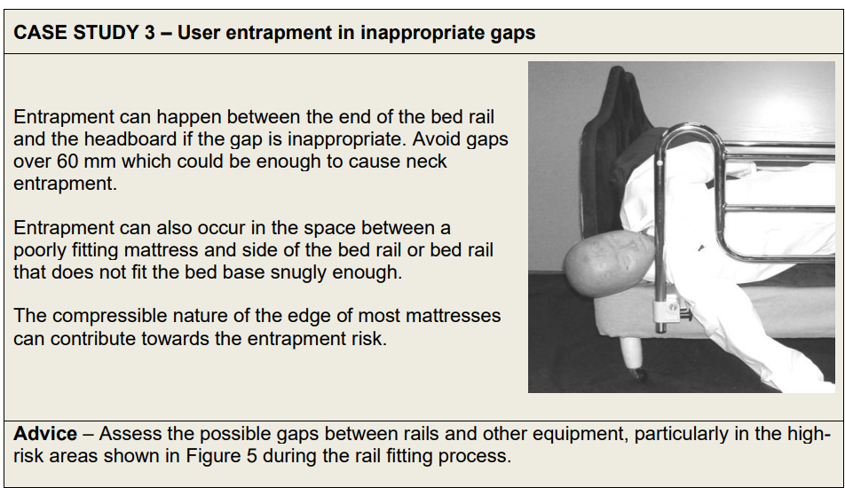
Case study 3

Slide 19
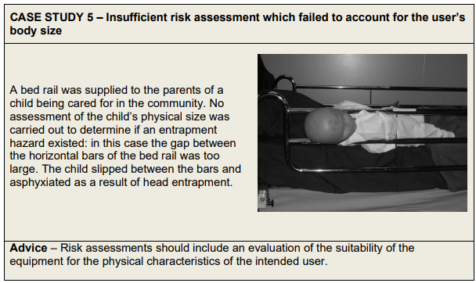
Safety with children and small adults
The majority of bed rails on the market are designed to be used only with individuals over 1.46 m in height (4’ 11”), which is also the height of an average 12-year-old child. A risk assessment should always be carried out on the suitability of the bed rail for the individual child or small adult, as bar spacing and other gaps will need to be reduced.

Slide 20
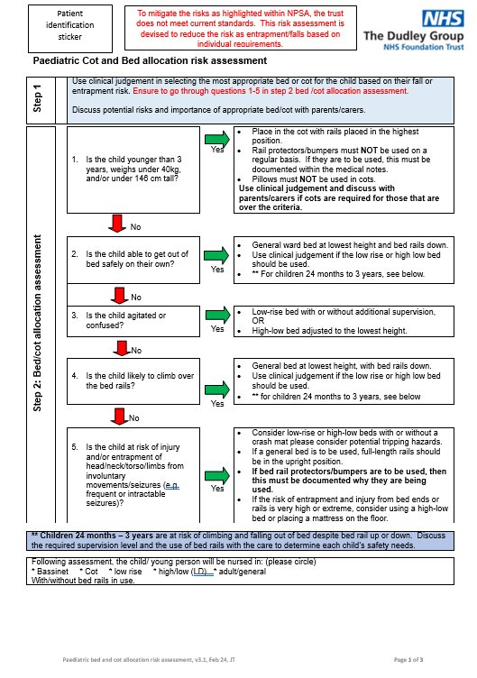
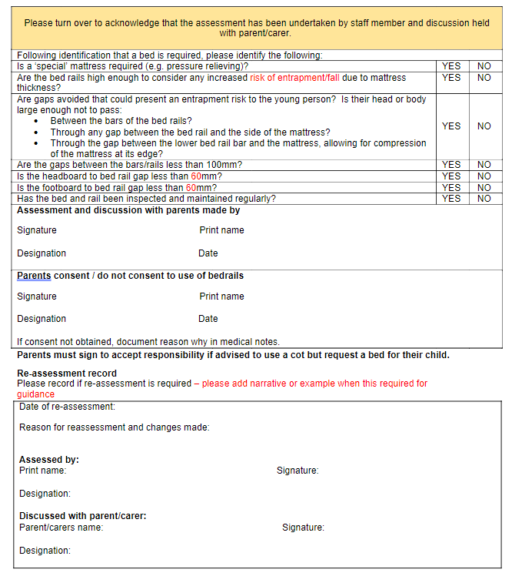
Paediatric Bed/Trolley risk assessment

Slide 21
What To Do When Someone Falls
Initial Assessment
A, B, C, D, E
Patient capabilities, obvious cause of fall?
Observations, blood glucose level and neurological observations
Mobility
Assess the patient for injury prior to moving
Is patient able to get themselves up if no injury suspected?
If injury is suspected use Scoop stretcher or hover technology (ensure all equipment is in working order)
Medical Review
Any fall with suspected injury should have a medical review within 30 minutes
A red task should be requested on the nerve centre if parent team are unavailable. If necessary a MET call can be raised
If no injury is suspected a medical review still needs to be completed within 12 hours
Once patient is safe
Complete lying and standing blood pressure if safe to do so
Medics to document their review by completing the post-fall document on Sunrise
Update falls and bed/trolley rails assessments
Consider whether the patient requires enhanced care to prevent further falls
In line with national and hospital guidance we need to be fully transparent when someone has fallen. The patient should be kept fully up to date with changes in their condition and their next of kin should be informed where appropriate
Complete a Datix detailing the circumstances of the fall

Slide 22

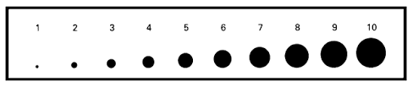
Neurological Observations
If a fall is UNWITNESSED or a HEAD INJURY IS SUSPECTED then neurological observations MUST be completed and inputted onto Sunrise
Glasgow Coma Scale (GCS), pupil reaction and limb powers must be completed post-fall when
The fall was unwitnessed
The patient hit their head during the fall
There is a change in GCS post-fall
Frequency of observations
Half hourly – two hours
One hourly – four hours
Two hourly – ongoing
If there is any deterioration in GCS during the above period, escalate and continue half hourly neurological observations until advised otherwise by the medical team
The patient MUST be woken up for neurological observations if asleep
Ensure any changes in GCS, limb power, pupil reaction or size are ESCALATED IMMEDIATELY TO A MEMBER OF THE MEDICAL TEAM

Slide 23
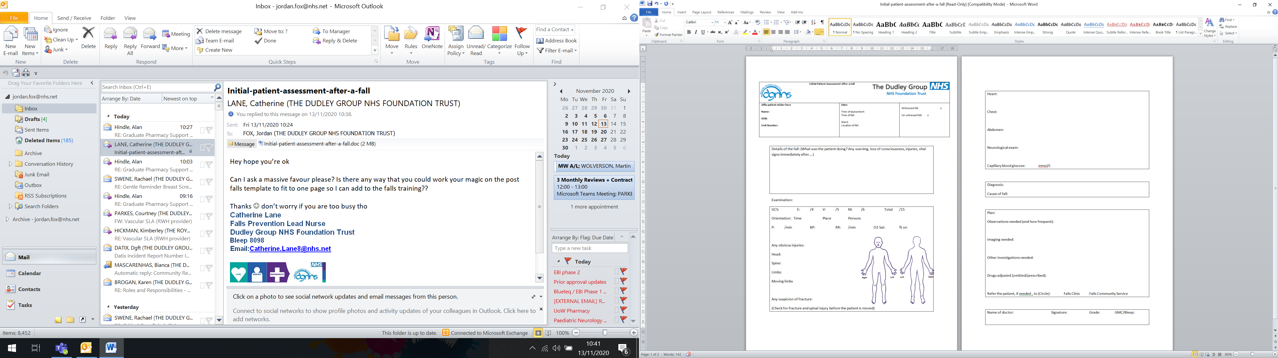
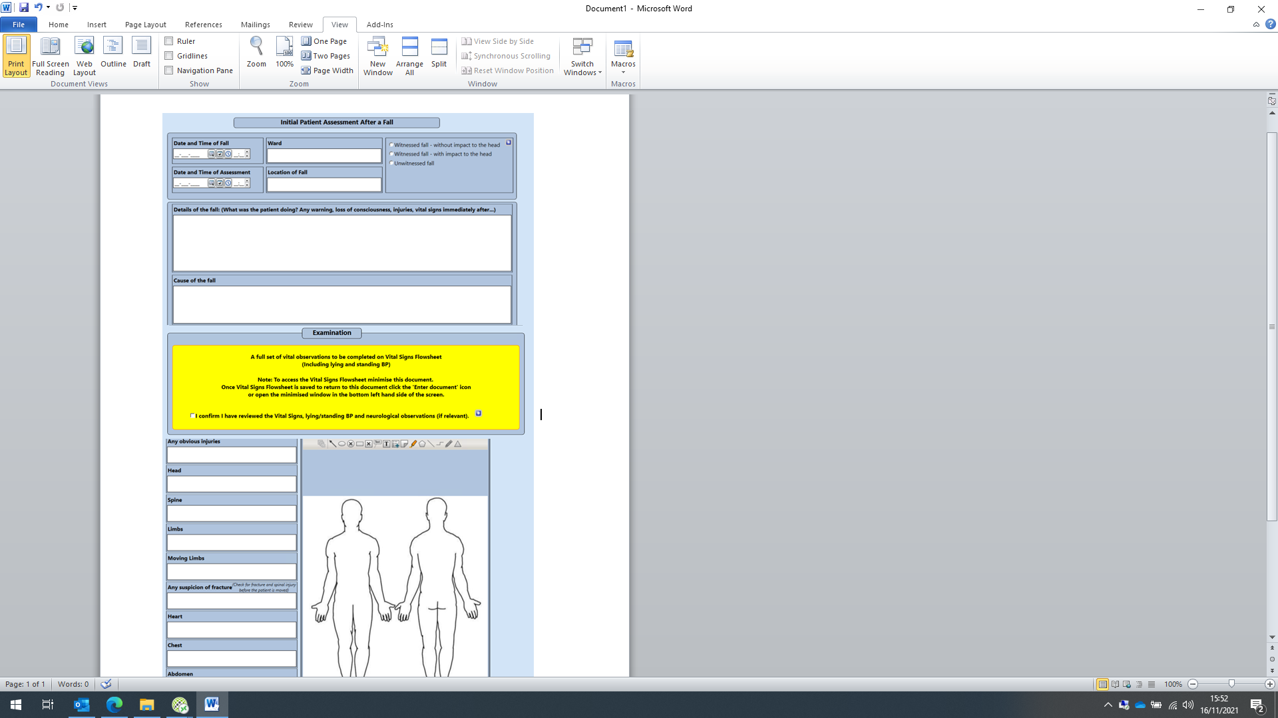
Post Fall Document
The Post Fall Document can be found on Sunrise (Select patient > Enter document > Search for Post Fall Document by typing into search field > Complete document and save)
This is to be completed by the reviewing Doctor post fall
The Post Fall Document on Sunrise (left) has replaced the paper document below which is now obsolete

Slide 24
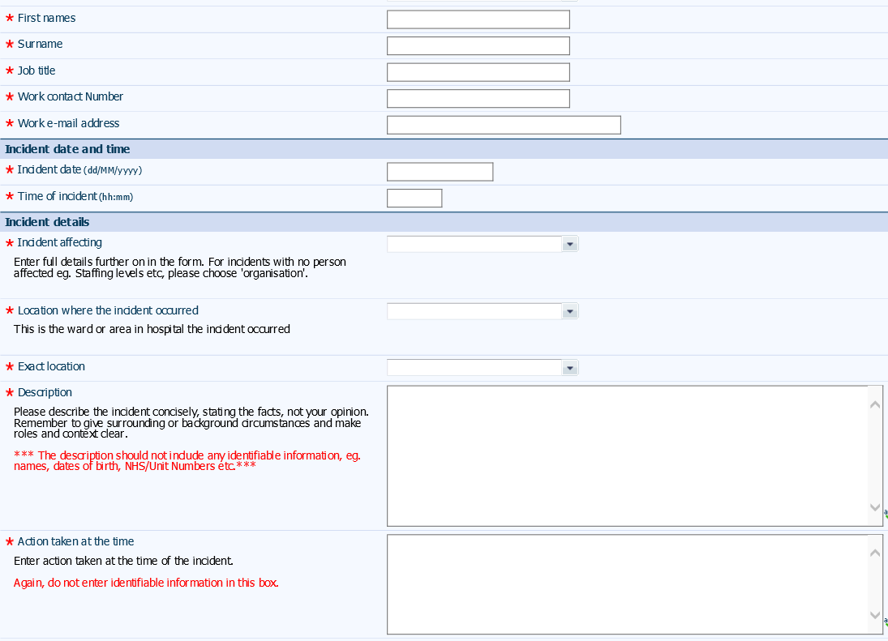
Datix – What To Include
When any patient falls or a near miss occurs a Datix MUST be completed
}
Details of the person completing the Datix
}
When did the incident occur?
}
Who did the the incident affect?
i.e. patient, staff, visitor
}
Where the incident occur?
}
This section is for an incident description. What occurred and what happened leading up to the incident. This should be made up of factual details and should contain no identifiable information
}
This section is for actions taken post fall. Please include how the patient was retrieved from the floor

Slide 25
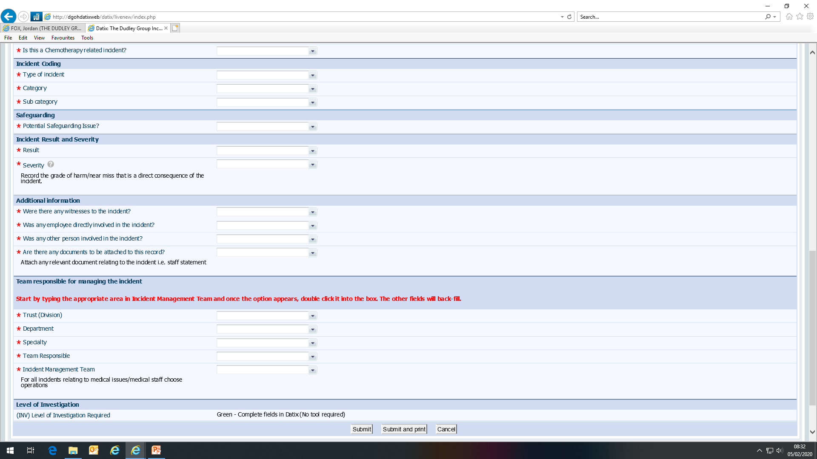
Datix – What To Include
}
What type of incident is it? Fall whilst alone, fall with staff, near miss etc.
}
Potential safeguarding issue?
}
Level of harm caused by fall:- No harm/ low harm/severe harm. What kind of impact will this have in the long term?
}
Any witnesses? Anybody else involved? Any supporting documents?
}
Who manages the incident? This is usually the area where the fall occurred and is the nursing team NOT operations

Slide 26
Ongoing Care
How do we keep patients on their feet once they leave hospital?
Just like preventing a patient from falling whilst in hospital, it is very difficult to prevent all falls once a patient is discharged. What we can do is make sure that patients have access to the right support and with education we can help minimise their risk of falls once at home. As healthcare professionals, we can refer our patients to the Community Falls Team. This specialist team will visit the patient in their home, conduct a holistic assessment and identify any hazards in the home. They can also carry out a full medication review and refer on to the Consultant-led falls clinic
Community falls pathway referral
It is our responsibility to keep patients mobile wherever possible. The Therapy team in your area will be able to signpost local groups and ability-appropriate activities that could help prevent patients from deconditioning and future readmissions
We can’t (and shouldn't) keep people still, so let’s get them as safely mobile as possible

Slide 27

So, Remember
Falls risk assessment carried out on admission (including to ED), after a significant even or change in condition and as a minimum every week
Ensure falls prevention strategies are considered and implemented if identified as being appropriate for the individual
DATIX should include as much factual detail as possible
Ensure your patient is monitored correctly following a fall and any new strategies to prevent further falls are utilised
Refer any patients you are concerned about to the community falls service

Slide 28
Falls Prevention and Management Training Declaration
Once you have read this training package, please ensure you send an email to Learning and Development confirming that you have completed the training. The email for Learning and Development is - dgft.learning@nhs.net
On updating of your training record the following will be accepted:
I confirm that I have read the entire Falls Prevention and Management Training and understood its contents
I understand that there are supporting Policies and Guidelines available on the Trust HUB
I confirm that I have a responsibility to follow the guidance set out in this training and the associated Policies and Guidelines
If you do not email confirmation of completion, your training record will NOT be updated
Please contact Soaad Gheleh, Falls Lead , if you have any falls related queries
Email – Soaad.gheleh@nhs.net
Tel - 01384 456 111 Ext 3758
Thank you

