Slide 1


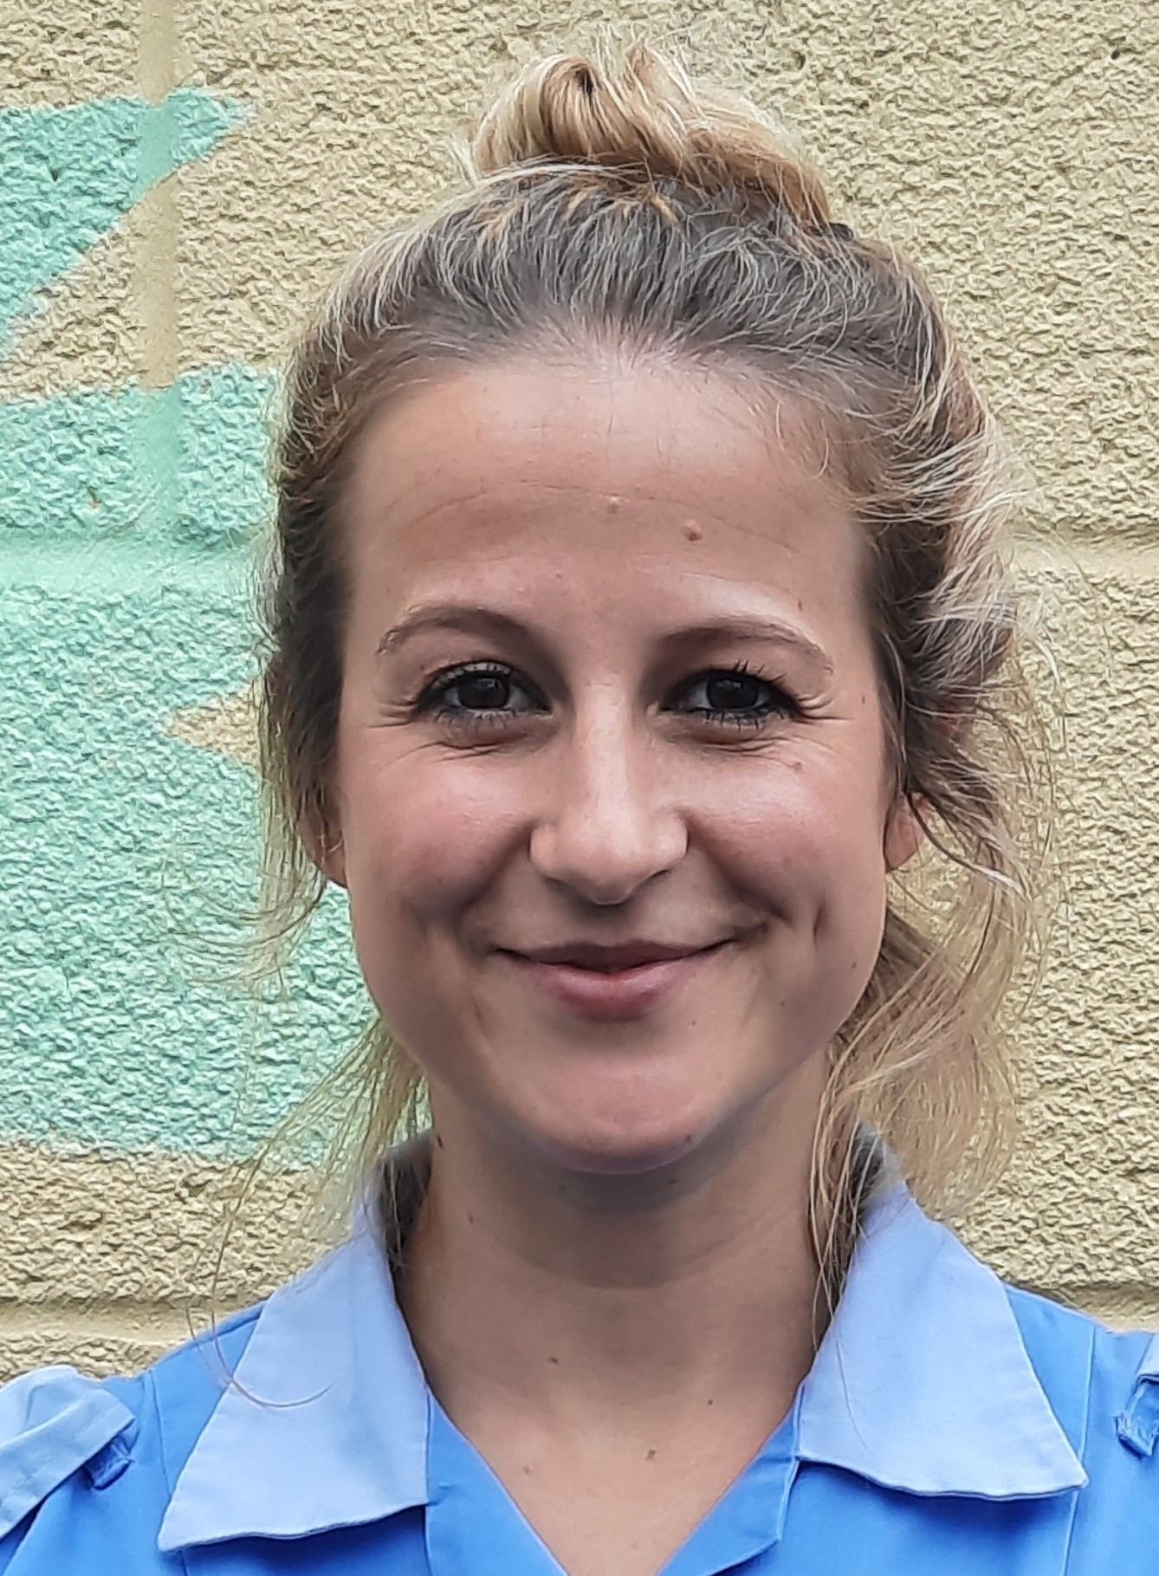
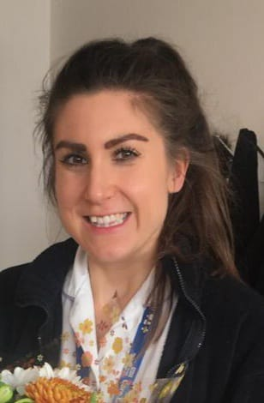

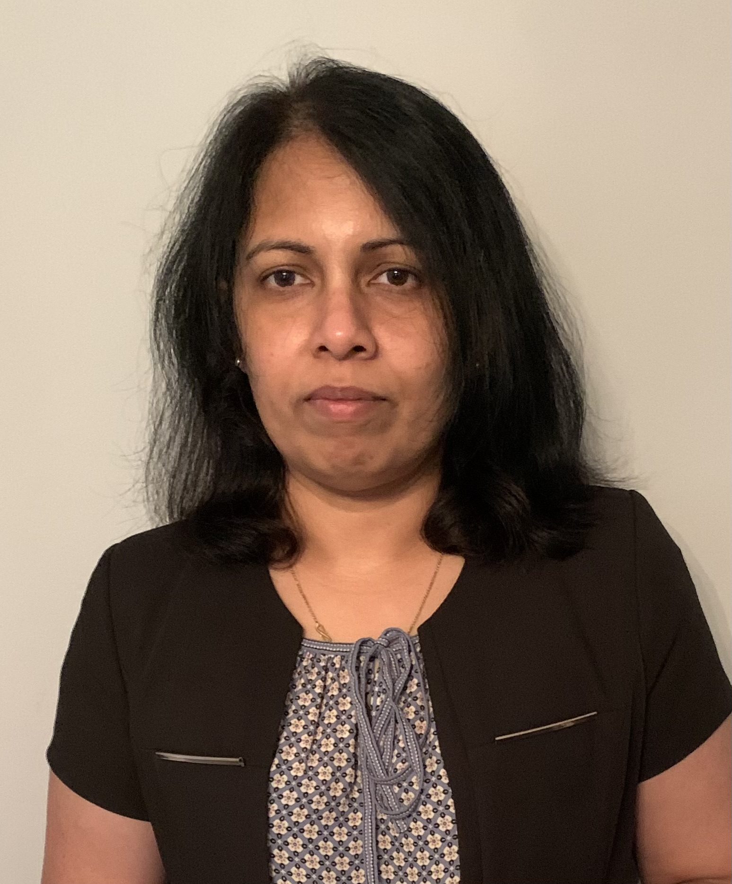
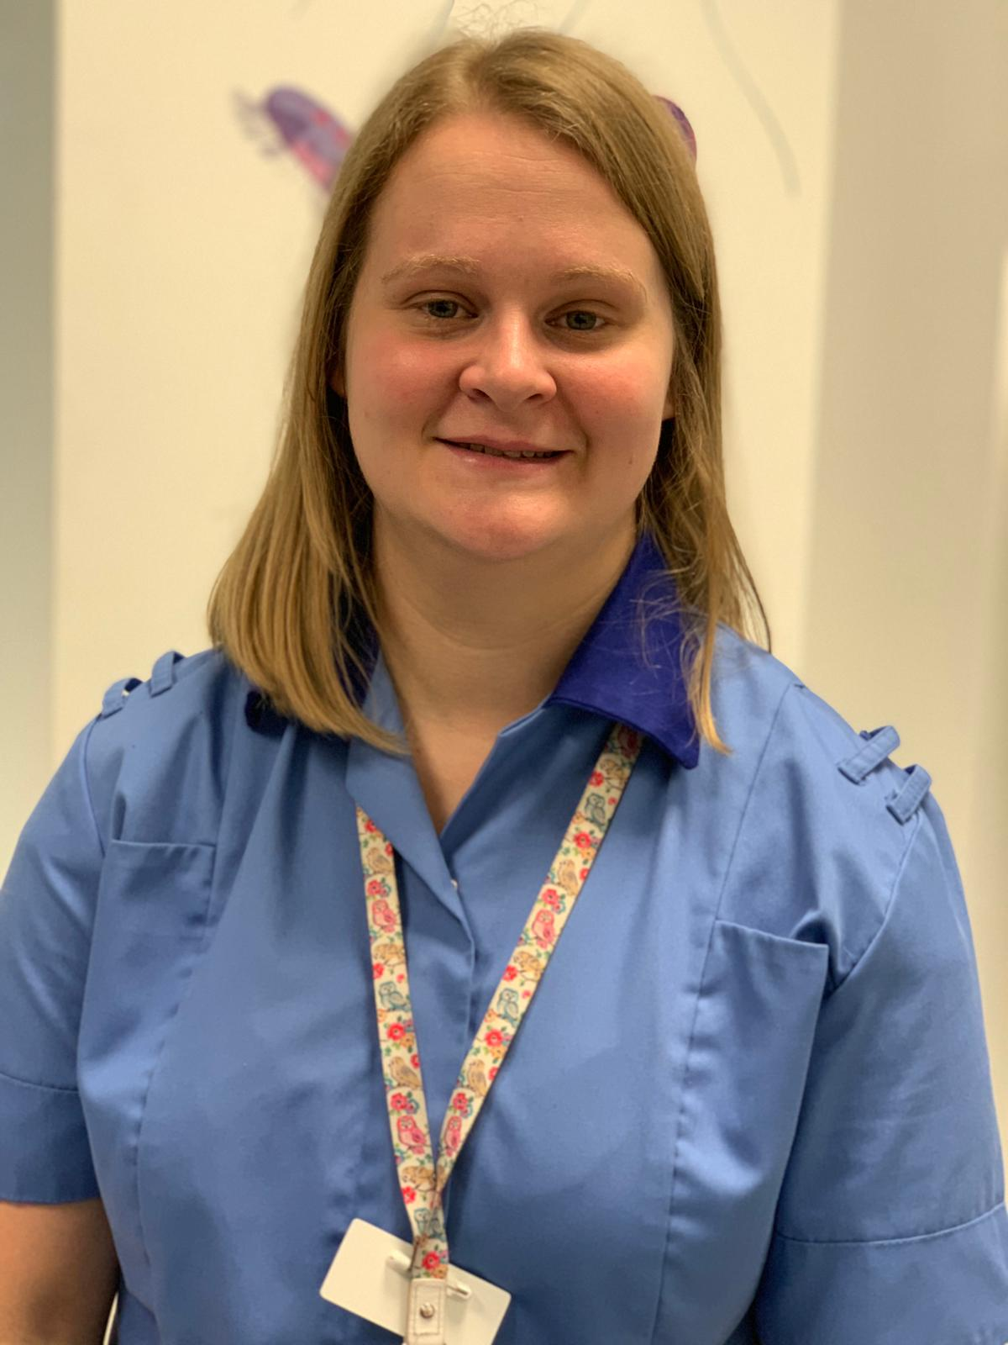
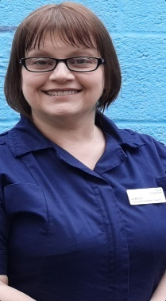

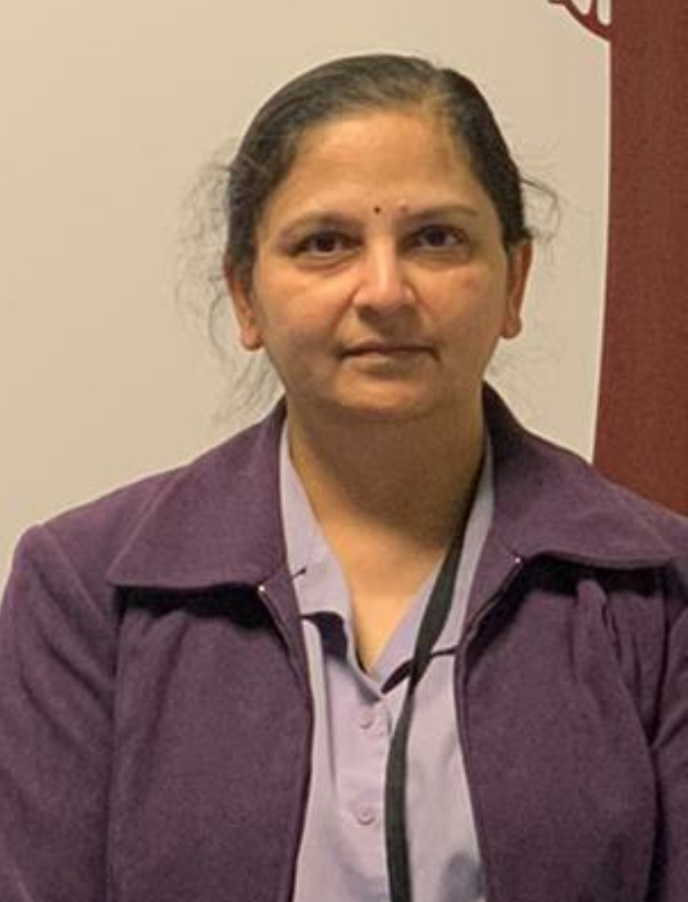
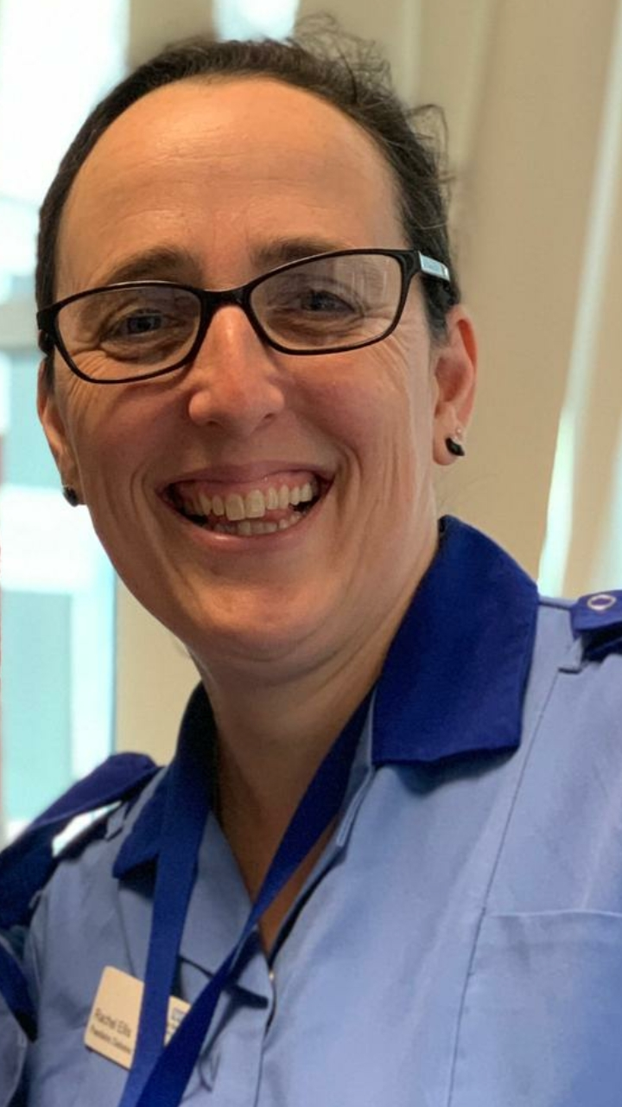
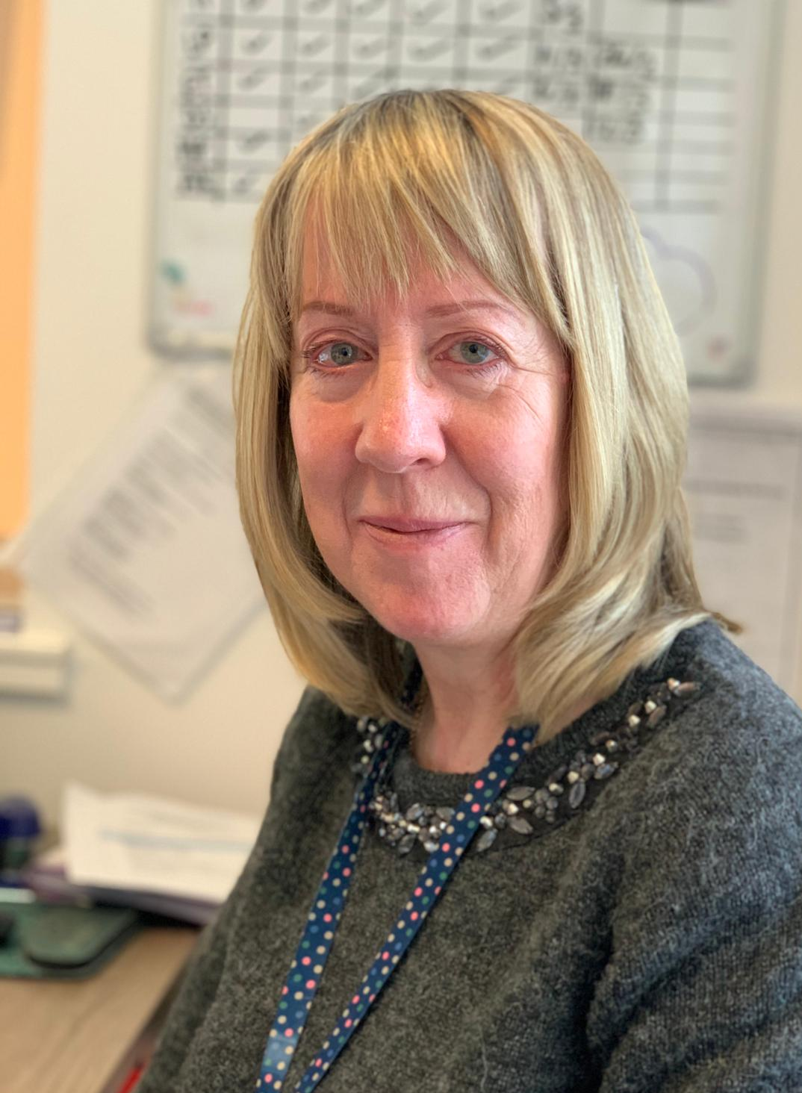
Paediatric Diabetes – Mandatory Training

Slide 2
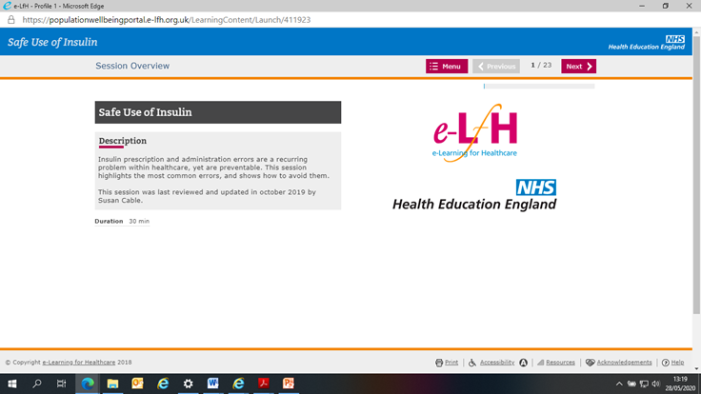
Safer Use of Insulin Module
In addition to this package, you must complete the Safer Use of Insulin module via E-Learning for Health.
National E-Learning through e-Learning for Healthcare:
Access to this requires your use of your Trust or NHS e-mail address and, where your profession is part of a registered body (e.g. GMC, NMC), your registration number. A step-by-step guide explaining how to register with the portal and complete its online programmes is available for viewing or printing here.

Slide 3
Learning Aims of
In-Service Training
Consolidate learning from Mandatory Training E-Learning Module
Strengthen links and communication between ward and diabetes team
Improve ward team’s confidence in care of children and young people with diabetes
Opportunity to share ideas for improving future practice and support for ward team

Slide 4
Paediatric Diabetes Mandatory Training (1)
What is Type 1 Diabetes ? - Causes, Incidence and Symptoms
Key messages for Patients
Presentation and Initial Management
Blood Glucose Testing
Ward Care Plan and Daily Record Sheet
Insulin Therapy
Injections & Pen Devices
Safe Sharps
Carbohydrate Counting

Slide 5
Paediatric Diabetes Mandatory Training (2)
Hypoglycaemia
Support at Diagnosis
Hyperglycaemia
Ketones
HbA1c
Admission due to Illness or Surgery
Transition
Pumps and Sensors
Life after Discharge
Further Support from the Team & Other Sources

Slide 6
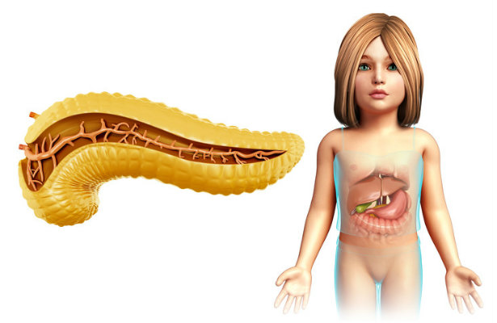
Type 1 Diabetes
It’s not connected with diet, weight or lifestyle - it is an auto-immune response.
The body attacks the cells that make insulin –the Beta cells in the islets of Langerhans in the pancreas.
Then the body is unable to produce any insulin at all.
Type 1 diabetes becomes
clinically symptomatic
when 90% of pancreatic
beta cells are destroyed.

Slide 7
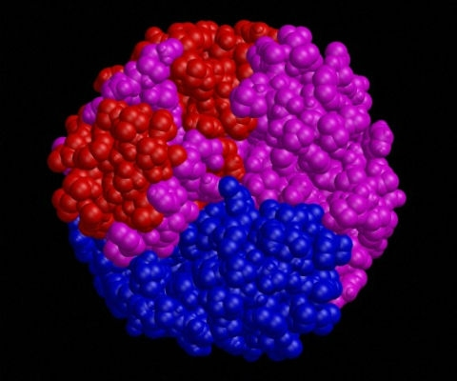
Insulin
Insulin is a major anabolic hormone. It is necessary for glycogen, triglyceride and protein synthesis.
Following the consumption of a meal, glucose concentration in the blood rises. Insulin is needed to facilitate glucose entry into cells via glucose specific transporters, particularly in the muscles and adipose tissue.
Insulin stimulates glycogen synthesis in the liver and muscle and inhibits gluconeogenesis in the liver.

Slide 8
Insulin Deficiency
Insulin deficiency in type 1 diabetes leads to hyperglycaemia and glycosuria. This leads to polyuria, urinary losses of electrolytes, dehydration and compensatory polydipsia.
There is also an increase in the stress hormones adrenaline, cortisol, growth hormone and glucagon, which further increase the blood glucose and metabolic decompensation.
Fat is broken down in the cells to meet cellular energy needs with resulting ketone body formation.
Ketones result in metabolic acidosis and compensatory rapid deep breathing in an attempt to increase CO2 excretion (Kussmaul breathing).
Ketones are excreted in the urine and further increase the osmotic diuresis and dehydration producing the clinical picture of diabetic ketoacidosis.

Slide 9
Cause of Type 1 Diabetes
Exact cause unknown, but contributory factors from evidence:
- inherited genetic predisposition
- preceding viral infection
- early introduction of cow's milk
Genetic factor – 5-6% increased risk for siblings, up to 20% increased risk if identical twin
Diabetes CANNOT be cured, but MUST be controlled.

Slide 10
Incidence and Prevalence of Type 1 Diabetes
Type 1 diabetes accounts for 95% of all childhood and adolescent diabetes, but only 5-10% of overall diabetes (both adults and children)
The incidence of type 1 diabetes in children under the age of 15 is 196.4/100 000
28,597 children and young people in the UK with type 1 diabetes
The incidence is rising by almost 2% a year. (NATIONAL PAEDIATRIC DIABETES AUDIT 2018/19)

Slide 11
Differences between Type 1 & Type2
 | Type 1 Diabetes | Type 2 Diabetes
Cause | Pancreas stops producing insulin | Pancreas produces inadequate amounts of insulin and/or the cells of the body become resistant to insulin
Treatment | Tablets won't work as no insulin is being produced at all. The patient therefore needs to be given insulin, which is a hormone that would be digested if administered orally (hence the need for injections) | Diet and Lifestyle changes. Patients can take tablets to make them more sensitive to insulin that is produced and also to influence the pancreas to produce more insulin. They may also need insulin injections.

Slide 12
Key Messages on Diagnosis
It’s not your fault
– not connected to diet or lifestyle
It’s very different to
Type 2 Diabetes
It is a life-long condition – no cure but can be managed with treatment
You can lead a fulfilling life!
There are Olympic athletes with Type 1 Diabetes
Diabetes
Team
Support

Slide 13
Initial Symptoms
In young children or children with a disability, symptoms may be less obvious.
If in doubt,
test blood glucose.

Slide 14
Any suspicion of Type 1 Diabetes?
Immediate capillary blood glucose
If 11 mmol/L or above or unable to do test = same day assessment on ward
Children who have been detected early may present as very well.
Children who have been detected at a later stage may be in
Diabetic Ketoacidosis and need HDU or PICU.
Follow guidelines on hub for:
DKA
Newly Diagnosed Child with Diabetes

Slide 15
What can I do to support them before the Specialist Team come?
After medical diagnosis:
Give “newly diagnosed patient” blue rucksack
Get the Patient Information Leaflet out and give it to the family (Can be printed from Hub)
“Diabetes in five minutes –
a survival guide for going home
Paediatric Diabetes Department”

Slide 16


Blood Glucose Testing
How- Avoid pads of fingers, thumb and forefinger
Handwashing is vital – no alcogel or baby wipes – dry well
Wipe away first blood drop
When – Pre-meals, 2 hours post meals,
Before bed & if symptomatic
Use Fastclix Device in Rucksack
(not Unistix – more painful)

Slide 17

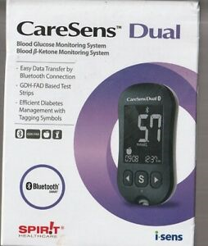
Monitors given on diagnosis
Accu-chek Instant Meter CareSens Dual Ketone Meter
Both have user guides in their boxes and are straightforward to use.

Slide 18
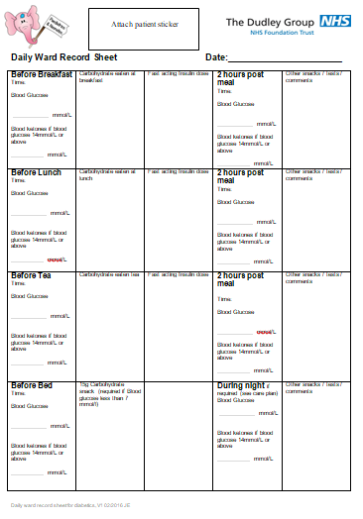
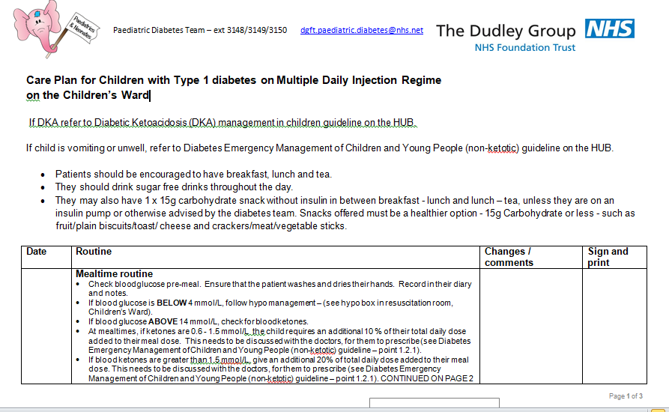
Ward Care Plan & Daily Record Sheet
3 page Care Plan: | http://thehub/paediatrics/SiteAssets/Diabetes/Diabetes%20daily%20record%20sheet.pdf
These tools have been developed to support the ward team to
deliver safe and consistent care. Please use them!

Slide 19
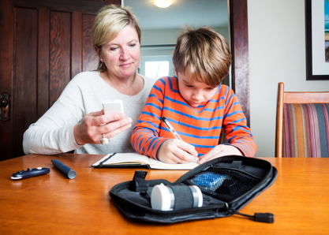
Treatment Aims of Insulin Therapy
Alleviate primary symptoms and sustain life
Promote normal growth and development
Avoid complications
Enable a good quality of life
Target range of 4-7mmol/L
All patients commenced on
Multiple Daily Injection (Basal/Bolus) Regime from diagnosis (unless Consultant instructs otherwise)

Slide 20
Multiple Daily Injection/Basal Bolus Regime
– aim to imitate normal physiology
Basal Insulins
– Levemir (Detemir) - Lantus (Glargine)
- Tresiba (Degludec)
Rapid Acting Insulins
– Novorapid (Aspart)
- Fiasp (Aspart with Vitamin B3)

Slide 21
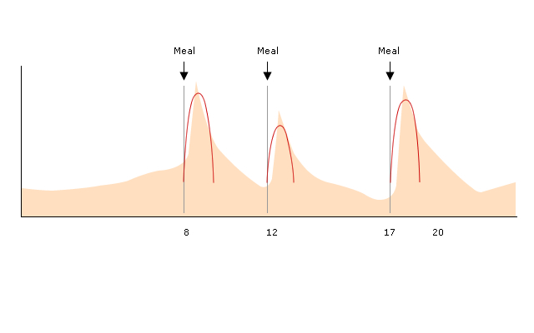
Bolus Insulin Profile
Red line shows action of Novorapid (Aspart)/Fiasp (Aspart with Vitamin B3)
Pink background is normal physiological insulin levels
Bolus Insulin provides rapid increase in blood insulin levels after meals (food bolus) and limits hyperglycaemia after meals
The dosage required is related to the amount of carbohydrate consumed and the blood glucose level.
Onset – 5-15 mins
Peak – 1-2 hours
Duration – 4 hours

Slide 22
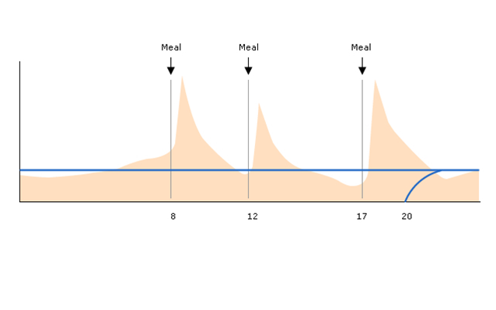
Basal Insulin Profile
Blue line shows the action of Levemir (Detemir) Lantus (Glargine) Tresiba (Degludec)
Pink background is normal physiological insulin levels
Basal Insulin provides relatively constant low blood insulin levels during fasting (taken at 20.00 in this example)
Controls blood glucose in between meals and overnight
Provides approximately 50% of the total daily insulin requirement
Basal insulins are designed to have minimal peak and last at least up to 24 hours

Slide 23
Multiple Daily Injection Regime
  At least 3 fast acting injections of Novorapid
  One long acting injection of Lantus or Levemir or Tresiba
  Flexible mealtimes
  Novorapid – Inject 15mins before food/ Fiasp – 0-10 mins before food
(Toddlers maybe initially during/after eating due to difficulty in
predicting intake in hospital)
  Lantus/Levemir /Tresiba– To be given within an hour of the same time each night. Parent/Young person to choose a convenient time.
  Eg: 8pm – so can be given between 7-9pm
  No need for snacks if not desired (except bedtime if blood glucose below 7mmol/L, see careplan)
  Some adolescents may be prescribed, in clinic by the Consultant, Tresiba (Degludec) as a long acting insulin.
  For more information, see https://www.tresiba.com/

Slide 24
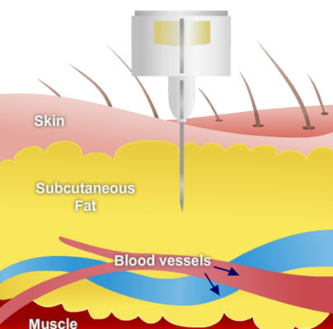
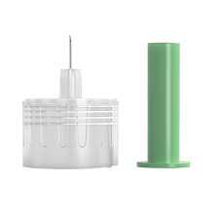
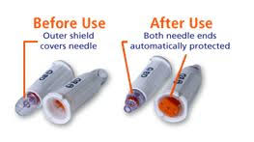
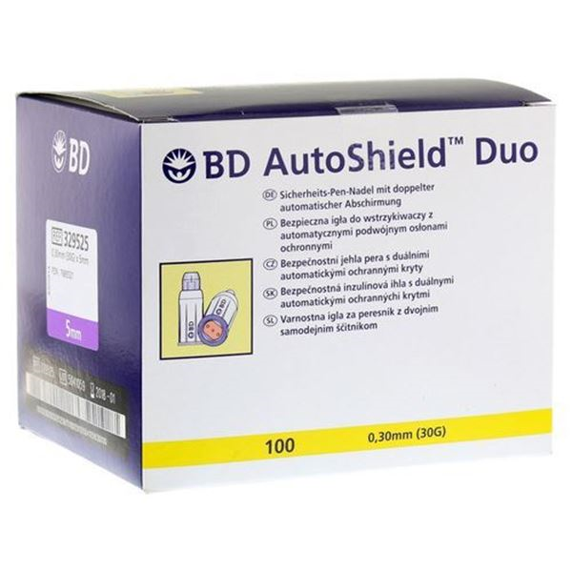
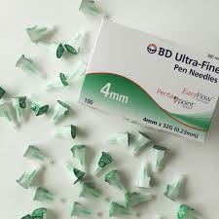
Injections
Sites - suitable areas are those with a substantial amount of fat below the skin - thighs, buttocks and abdomen
Important to rotate sites to avoid injection lumps and poor insulin absorption
Insulin is injected into the fat layer under the skin – short needles mean there is no need to routinely “pinch up” unless it is a very young or lean child. In this case, a gentle skin fold will ensure it does not become an intramuscular injection.
Must not inject through clothing
Staff should use Autoshield Safety Needles
Always give patients 4mm needles

Slide 25
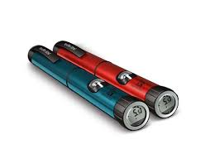
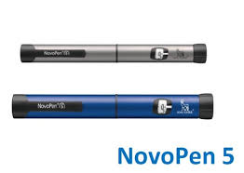
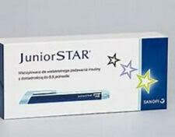
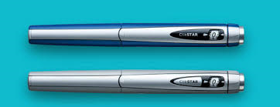
Pen Devices
Novopen Echo Red used for Novorapid or Fiasp
Novopen Echo Blue used for Levemir or Tresiba
0.5 unit increments/max dose 30 units
Novopen 5 (Silver – Novorapid, Blue - Levemir or Tresiba) can be used.
1 unit increments/max dose 60 units)
Colour of pens are advised by the team for consistency and to reduce errors
Sanofi Junior Star Blue (0.5 unit increments)
or Clikstar Blue (1 unit increments) used for Lantus
Always do at least a 2 unit air shot before use
and be confident insulin is expelled
All pens come with user guides

Slide 26
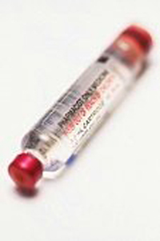
Insulin Storage
Unopened insulin should be stored in a fridge, but refrigerated insulin should be left at room temperature for 1 hour before use.
Once taken out of the fridge, the insulin can be kept at ambient room temperature for 28 days and must be thrown away after this time.
Insulin should not be stored near a radiator, in direct sunlight or near any heat source.

Slide 27
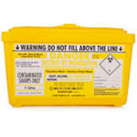
Safer Sharps
It is the responsibility of the ward nurse to supply the sharps box to the patient at bedside at first injection.
Injection should always be done in close proximity to sharps box.
Sharps boxes should be kept out of reach and with consideration of individual needs of patient, and those in the same area.

Slide 28
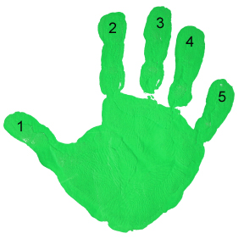
A child/their caregiver needs five key skills to achieve good glycaemic control on a basal bolus regime:
Frequent blood glucose monitoring (at least 4 times a day)
Ability to carbohydrate count and use ratio to decide meal bolus
Ability to use correction doses
Attention to detail
Ability to adjust doses during sick days, exercise, etc.

Slide 29



Life after the Ward:
Admission is a golden window of opportunity for education and support from the team. Discharge should be timely but not rushed
Information has to be repeated and given at the right pace for the family
More than one carer to be trained where possible
Negotiating discharge with family – are they ready?
Dietetic Education on ward
Diabetes Consultant to review before discharge if available
Order TTO asap to avoid unnecessary delays – JAC template
2week OPA in Diabetes Clinic
Initially daily telephone contact from team
Seen 3 times in first 2 weeks after discharge
Return to school ASAP following care planning meeting
Following first OPA, will be seen every 3 months in clinic.

Slide 30
Hypoglycaemia – <4mmol/L
Risk Factors & Signs
Risk Factors:
Missed or delayed meals, Illness, Extremes of weather conditions
Too much insulin (for various reasons)
Exercise, which may lead to low blood sugar levels after some hours
Early signs of a low blood sugar include:
feeling hungry, sweating, tingling lips, feeling shaky or trembling,
dizziness, feeling tired, palpitations, becoming easily irritated, tearful,
moodiness, turning pale
If not treated, other symptoms may present, such as:
weakness, blurred vision, difficulty concentrating, confusion, unusual behaviour, slurred speech or clumsiness, feeling sleepy, seizures, collapse

Slide 31
Treatment of Hypoglycaemia
Treat Hypoglycaemia FIRST with fast acting
Glucose even if meal is due
If blood glucose is less than 4 mmol/L, and child is conscious
↓
Give 15g of Fast Acting Glucose
E.g. 4 glucotabs/1 x Lift glucose drink bottle
If unable to take oral glucose as above, give tube of Glucogel as a buccal treatment
(The diabetes team advise 0.3g glucose/kg up to a MAX of 18g- on individual patient basis and
this can he followed if documented. If in doubt, use 15g as above)
↓
Repeat blood glucose test after 15 minutes
↓
If blood glucose still below 4 mmols,
give a further 15 grams (or individual dose as above) of Fast Acting Glucose
↓
Repeat blood glucose test after 15 minutes
↓
When blood glucose is above 4 mmol/L,
give 15g Long Acting Carbohydrate (or individual dose as above)
such as plain biscuits/slice of toast
This follow-up snack is not required if on insulin pump or about to have meal with usual insulin or if the established patient/family prefer not to.
If child is unconscious, give IM Glucagon/IV Dextrose as guideline
DIABETES EMERGENCY MANAGEMENT IN PAEDIATRICS (NON KETOTIC) GUIDELINE

Slide 32
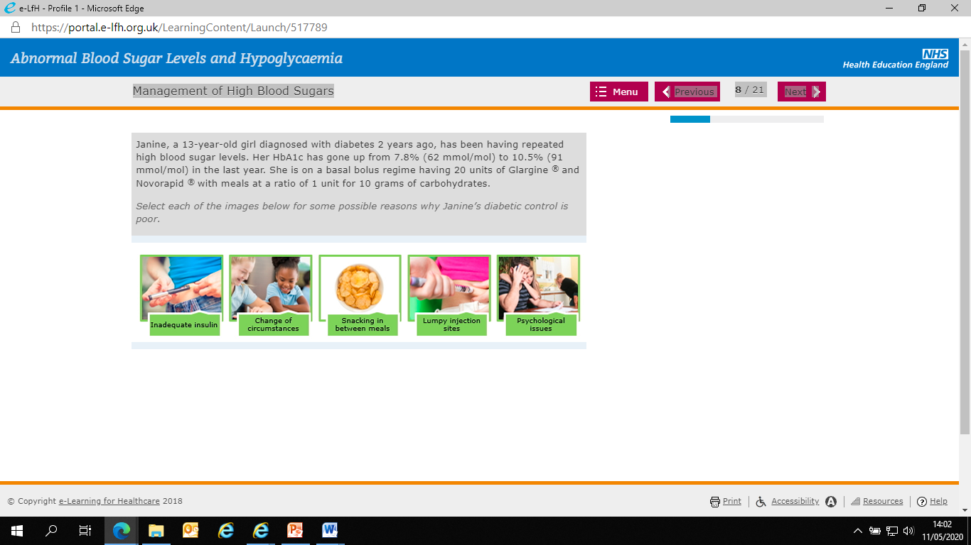
Hyperglycaemia
Symptoms – thirst, increased urination, tiredness, blurred vision, headache
Patients are encouraged to titrate insulin doses to maximise time within range
If above range at mealtimes only, a correction dose should be added to insulin dose for carbohydrate.
Use patient’s correction chart (or will be calculated via the pump if on pump)
Correction doses should not be given between meals unless on a pump.
Illness can cause high blood glucose levels – see Sick Day Rules Guideline.
If >14mmol/l, check for Ketones.
Other reasons for hyperglycaemia:

Slide 33
Ketone Management
When the body has insufficient insulin to deal with the amount of glucose, it starts to break down other body tissue as an alternative energy source.
Ketones are the by-product of this process, are poisonous chemicals which , if left unchecked, will lead to metabolic acidosis.
If blood glucose level greater than 14mmol/L, check for ketones:
If ketones below 0.6mmol/L, no additional action needed
If ketones 0.6mmol/L or above, they must have prescribed dose of Novorapid for ketone management – see care plan
Ketones 0.6mmol/L and above – give 10% of Total Daily Dose
Ketones 1.5mmol/L and above – give 20% of Total Daily Dose
Calculate Total Daily Dose by adding together basal insulin + average boluses
(excluding correction doses)
Blood glucose and ketones should be checked 2 hourly until resolved and repeat doses given no more than 2 hourly if required.
Liaise closely with medical team.

Slide 34

Meal times on the ward
There is no such thing as a diabetes diet.
The same principles of healthy eating and regular mealtimes apply as to the rest of the population.
No-one likes cold food – it usually works best to test, select food and leave in oven if appropriate, calculate insulin dose, inject & eat.
In between meals – sugar free drinks &
1 x 10 g healthy snack ONLY without insulin.
Insulin will be required by pen or pump if snack more than 10g.

Slide 35
Carbohydrate Counting
The ward team have a key role in supporting the family to calculate the total carbohydrate content of each meal/snack.
It is important that you are able to identify which foods/drinks contain carbohydrates accurately.
This is needed to calculate the meal – time dose of prescribed insulin.
Mealtime insulin is prescribed according to a ratio –
E.g: 1 unit of Novorapid to 10g Carbohydrate

Slide 36


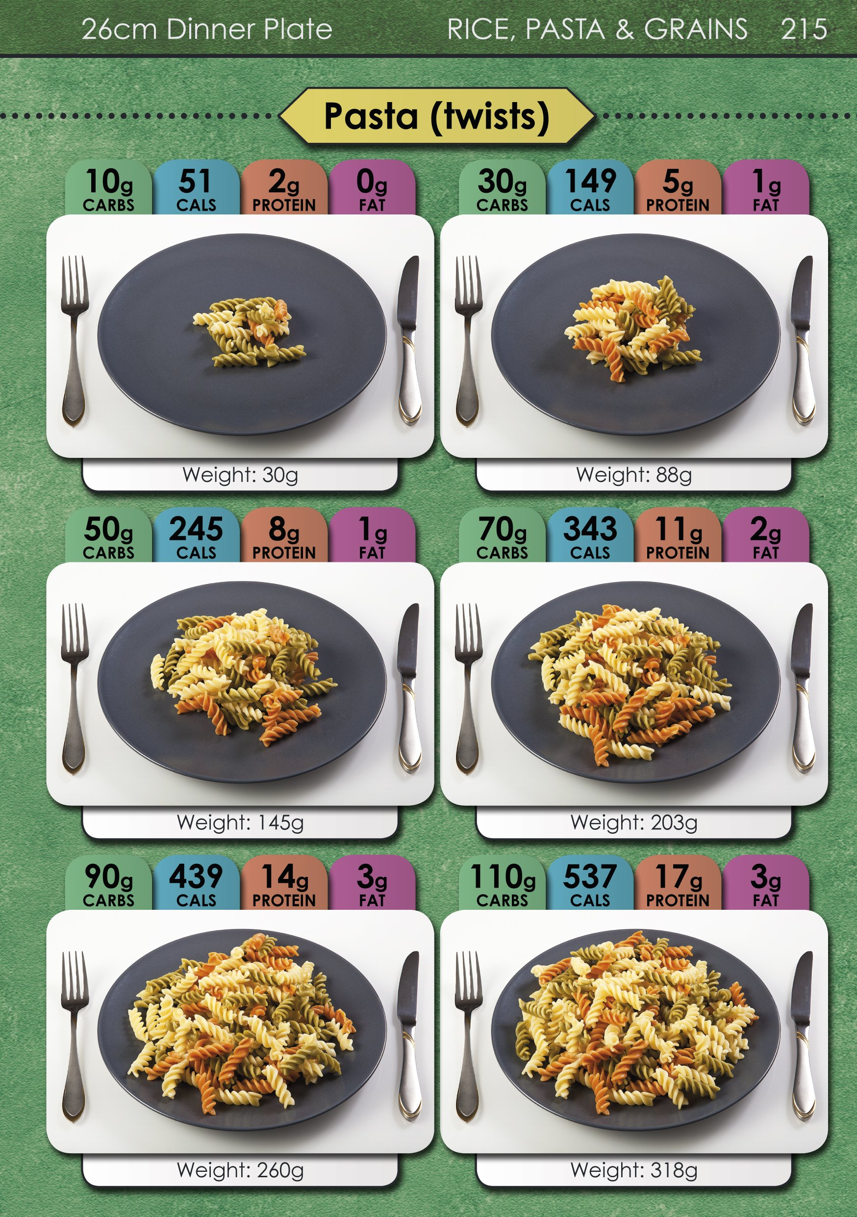
Tools to support carbohydrate counting on the ward
Digital Scales
Carbs & Cals Book
Diabetes & Diet - Patient Information Booklet on Hub
Carbohydrate Counting - DigiBete videos – in different languages

Slide 37

Support at Diagnosis
This will be a very distressing time for the patient and family, that they will always remember.
Although life is very manageable with diabetes, the pressure of it can be relentless. They can never have a “day-off”.
Managing glucose levels and insulin requirements will be needed every day for the rest of their life.
The shock of diagnosis is often described as equivalent to a bereavement.
A listening ear can mean a lot to an anxious family on diagnosis. If you do not know all the answers, it is ok to say so and to find out for them.
It is so important that they feel that they are getting the same, consistent messages from all professionals. Please use the leaflets, guidelines and care-plans to support you to support the family.

Slide 38
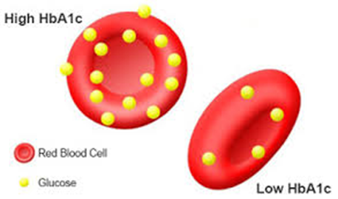
HbA1c
The term HbA1c refers to glycated haemoglobin. It develops when
haemoglobin, a protein within red blood cells that carries oxygen
throughout your body, joins with glucose in the blood, becoming
'glycated'.
In people who have been diagnosed with diabetes, a glycated
haemoglobin (HbA1c) test is often used to show how well their
diabetes is being controlled.
The HbA1c test is done every 3 months in clinic and measures the amount of glucose that is being carried by the red blood cells in the body. The higher the levels of glucose in the blood over time, the more glucose will be stuck to the red blood cells. This will result in a higher HbA1c measurement.
An ideal HbA1c level is 48mmol/mol or 6.5%.(NICE Guidelines 2015)
A high HbA1c level (above 9% or 75mmol/mol) means that the patient is more at risk of complications due to diabetes.

Slide 39
Complications of Diabetes
Diabetic retinopathy leading to visual impairment and blindness
Diabetic nephropathy leading to hypertension and renal failure
Diabetic neuropathy leading to pain, paraesthesia, muscle weakness and autonomic dysfunction
Consequences of macro-vascular disease include cardiac disease, peripheral vascular disease and stroke
Good glycaemic control, screening and treating complications early can improve long term health and minimise complications.

Slide 40
Admission due to Illness or Surgery
See guidelines on hub:
Diabetes Emergency Management in Paediatrics (Non-Ketotic) Guideline
Surgery (Paediatrics) for Patients with Diabetes Mellitus Guideline

Slide 41
Transitional Care
Adolescence is a difficult time for a young person, which can make it more challenging when transferring from a paediatric diabetes service to an adult diabetes service
Transition is the Purposeful, planned movement of adolescents and young adults with chronic physical and medical conditions from child-centred to adult-orientated health care systems
It has been found that often young people do not have a positive experience of transition to adult services and this can have a negative impact on the management of the young persons diabetes (Diabetes UK, 2015)

Slide 42
The Transition Service at DGFT
According to the diabetes transition service specification (2016) there are 3 stages of transition:
Paediatric Preparation
Planned Transfer
Support Integration
All of our patients in Dudley are seen in an Adolescent Clinic from the age of 14 years, then from 15-16 years of age onwards they can be moved to a transitional care clinic which is jointly staffed by Adult and Paediatric Diabetes Teams. For more information see the Transitional diabetes clinic -paediatric to adults - standard operating procedure

Slide 43
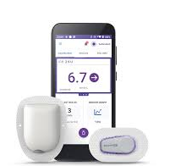
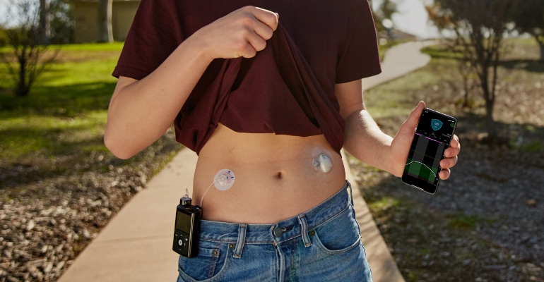
Insulin Pumps
A CSII is a programmable pump and insulin storage device that gives fast-acting insulin by a subcutaneous needle or cannula.
The pump can be programmed to deliver a basal rate of insulin throughout the day/night, with higher infusion rates triggered by the push of a button at meal times and to correct high blood glucose levels.
The insulin pumps used in Dudley at present are Omnipod 5, Omnipod Dash, Medtronic 780 and Tandem with Control IQ (Air Liquide).
All children and young people are eligible for pump therapy. The decision of when to start is made on an individual basis by the MDT to meet patient needs safely.
Pump therapy requires intensive management. Patients and their families must complete rigorous education before commencement. The family must be motivated and engage well with the team. The team work hard to provide support required for individuals so there are no barriers to access this technology.
The team can provide further input to the team about pumps as needed.
Please see the guideline on the Hub: Insulin Pump (Paediatric) Therapy Guideline

Slide 44


Continuous Glucose Monitors
All of our patients are now offered this technology soon after diagnosis to improve their diabetes control and quality of life. (Dexcom, Libre or Medtronic Guardian Sensors are used) Some patients use these sensors as "stand alone sensors" alongside their injections.
Hybrid Closed Loop Pumps
Within the next 3 years, all children and young people in Dudley with Type 1 Diabetes, as per NHSE guidance, will be offered Hybrid Closed Loop Pump Therapy at a time that the MDT assess as safe for the individual child/young person. (currently 56 users)
A hybrid closed loop system takes readings from a continuous glucose monitor and uses an algorithm to tell an insulin pump how much insulin to deliver. It does this 24 hours a day. The user/carer must enter carbohydrate when eating. Here is a link for more information.
Technology & Innovation - Hybrid Closed Loop Systems - DigiBete

Slide 45
Paediatric Diabetes Specialist Team
Dr Anjali Petkar, Dr Radhika Puttha, Dr Udeni Kollurage – Consultant Paediatricians
Jo Elford – Lead Paediatric Diabetes Specialist Nurse
Rachel Ellis - Paediatric Diabetes Specialist Nurse
Sam Northern - Paediatric Diabetes Specialist Nurse
Cat Robinson - Paediatric Diabetes Specialist Nurse
Adam Jones - Paediatric Diabetes Specialist Nurse (secondment)
Hannah McOnie – Dietitian (Mat leave covered by Kim Lewis & Ines Jabir)
Jill Danks & Ferne Roberts – Admin Support
Vacant Post – Psychologist

Slide 46
Paediatric Diabetes Specialist Team
We are here to offer support to the ward team with the aim of improving care for our patients.
We can offer further training and practical demonstrations
Please contact us:
dgft.paediatric.diabetes@nhs.net
01384 456111 ext 3148/3149/3150
We work weekdays 09:00 – 17:00 and provide a newly diagnosed review service via telephone at weekends for newly diagnosed patients on the ward and for 7 days post discharge after new diagnosis..
Based in Paediatric Clinical Nurse Specialists Office near Children’s Outpatients

Slide 47
Further Sources of Information:
E-learning for Health have a free online Paediatric Diabetes Course
https://portal.e-lfh.org.uk/
www.digibete.org essentials videos in many languages
www.diabetes.org.uk
www.jdrf.org.uk
www.bpsed.org.uk
www.ispad.org

Slide 48
Employee Confirmation
Paediatric Diabetes Mandatory Training
You must confirm that:
I have reviewed the Paediatric Diabetes Education Package
I have also completed Safer Use of Insulin – E-Learning for Health Module
Either:
Print this page, complete the details below manually, and return the page via:
Learning and Development Department, 1st Floor Clinical Education Centre,
Russells Hall Hospital, Dudley, DY1 2HQ
Name:
Ward / Area / Department:
Date of Review:
Or:
2) Send an email from your NHS.net account to dgft.learning@nhs.net to confirm your
completion as above, identifying your name and Ward/Department.

