Slide 1
The Dudley Foundation Group
Monthly Safer Staffing
December 2024 – November 2025
Martina Morris Chief Nursing Officer (CNO) DGFT and Deputy CNO DGFT & SWBH
Dr Jonathan Odum Medical Director

Slide 2
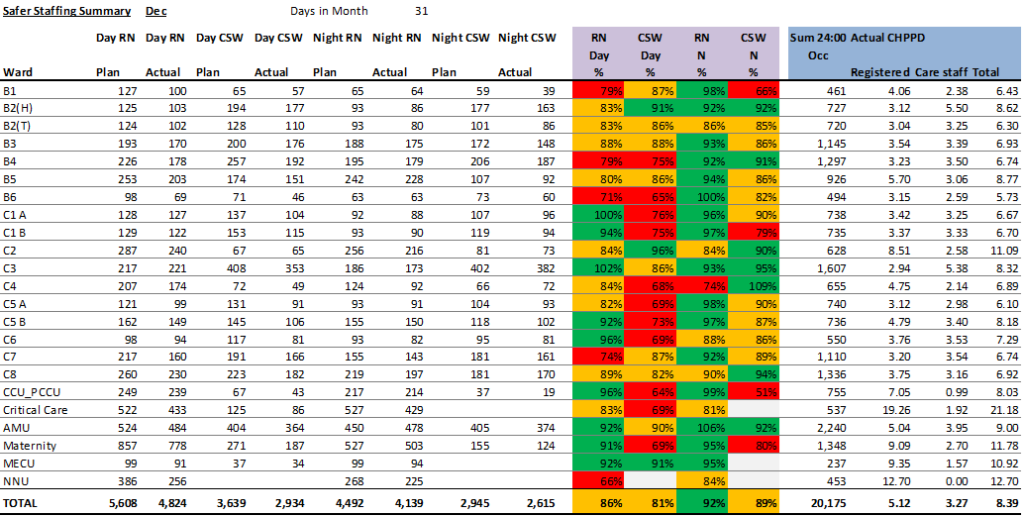
Safer Staffing – Dashboard December 2024
Date
December 2024

Slide 3
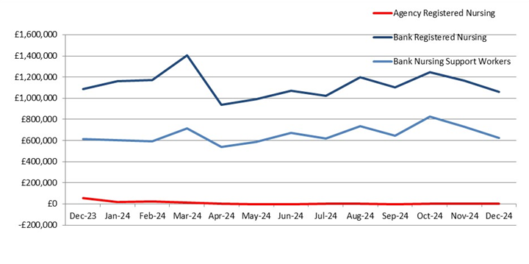
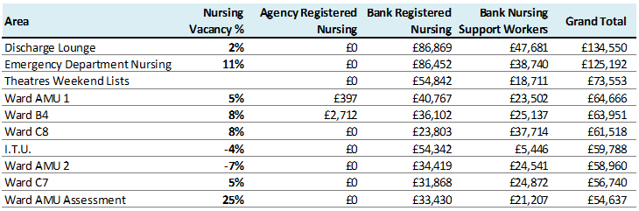
Safer Staffing
Background
Performance
What are the charts showing us
Safe staffing % and CHPPD both down marginally compared to November 24 – Suspect this is to do with minimal staffing levels of Christmas & New Year bank holidays. Chart A - nursing bank & agency cost by month over last year – note reduction in bank costs for registered nursing and support workers in Dec24 due to lower levels of bank engaged over Christmas & new year period Table B - detail of Top 10 departments using bank & agency in Dec24. Note Agency expenditure below relates to prior period usage (Jun24 on AMU & Dec22 on B4). There remains no nursing agency being used in recent months.
Areas Impacting on Compliance
Unfunded additional capacity in discharge lounge (fully bedded), super surge (26 beds), AMU 1&2 10 additional beds. In response to 45 minute ambulance handover, 4 additional beds open in ED Imaging.
Mitigations / Timescales / Blockers
Aim to close additional beds by March 2025. Trust wide rota to assist with staffing these areas. Lack of social care to facilitate discharge of medically fit patients
Risk Register
Key Points to Note
Additional capacity impacting on Lead Nurses and Matrons having to work clinically 2 days per week.
Date
December 2024
Trust Performance
A) B)
Performance Target / KPI
N/A
A
A - Bank Usage
B – Top 10 depts. using Bank & Agency, Dec 2024

Slide 4
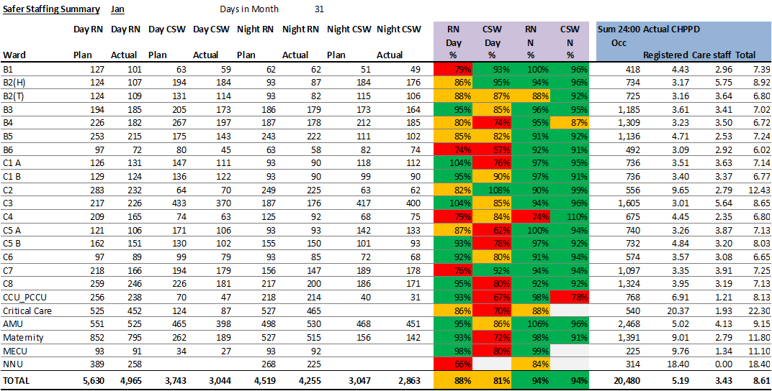
Safer Staffing – Dashboard January 2025
Date
January 2025

Slide 5
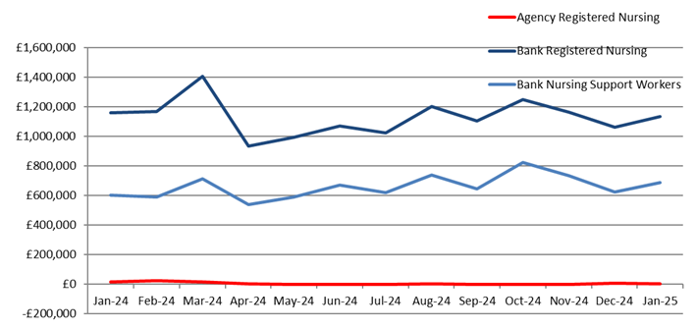
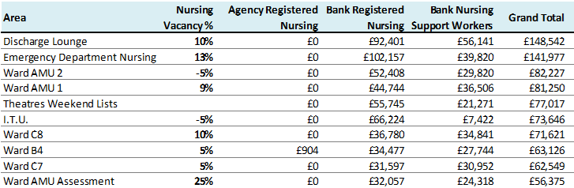
Safer Staffing
Background
Performance
What are the charts showing us
Safe staffing % and CHPPD both up marginally in Jan25 compared to Dec 24. Chart A - note increase in bank costs for registered nursing and support workers back to usual levels in Jan25. Table B - Note Agency expenditure below relates to prior period usage (Oct22 on B4). There remains no nursing agency being used in recent months
Areas Impacting on Compliance
Unfunded additional capacity in discharge lounge (fully bedded), super surge (26 beds), AMU 1&2 10 additional beds. In response to 45-minute ambulance handover, 4 additional beds open in ED Imaging.
Mitigations / Timescales / Blockers
Aim to close additional beds by March 2025. Trust wide rota to assist with staffing these areas. Lack of social care to facilitate discharge of medically fit patients 7-day census for a focus around discharge
Risk Register
Key Points to Note
Additional capacity impacting on Lead Nurses and Matrons having to work clinically 2 days per week. Temporary Escalation SOP (TES) has been approved at Q&S Group. Working with the divisions to review the impact of red flags generated on the safer care tool, to patient care and staffing numbers Recruitment and Retention of staff We have recruited 41 out of the 51 nursing graduates who qualified in September, even with reduction of vacancies available Of the 399 nurses/midwives recruited as part of the international recruitment programme, we have had only 20 nurse's leave the trust, giving us a retention rate of 95%
Date
January 2025
Trust Performance
A) B)
Performance Target / KPI
N/A
A
A - Bank Usage
B – Top 10 depts. using Bank & Agency, Jan 2025

Slide 6
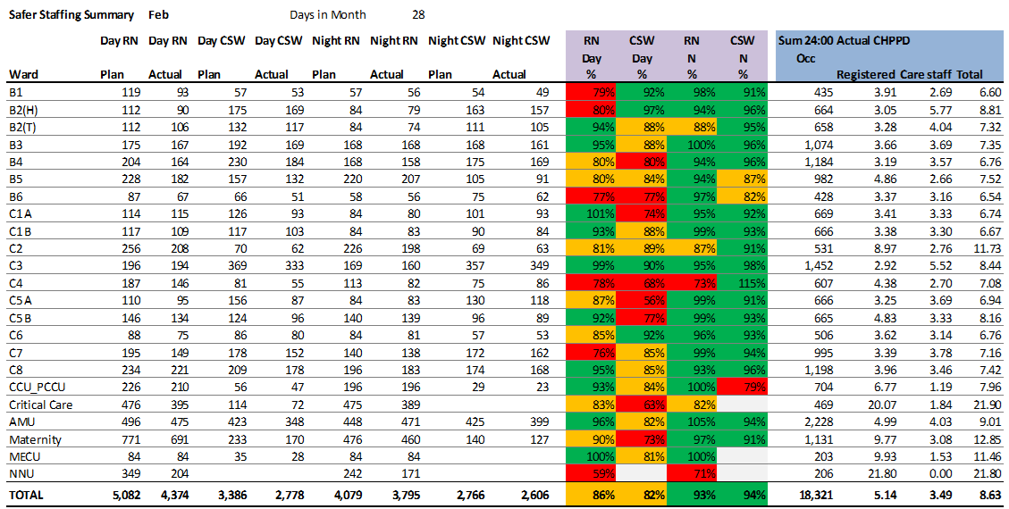
Safer Staffing – Dashboard February 2025
Date
February 2025

Slide 7
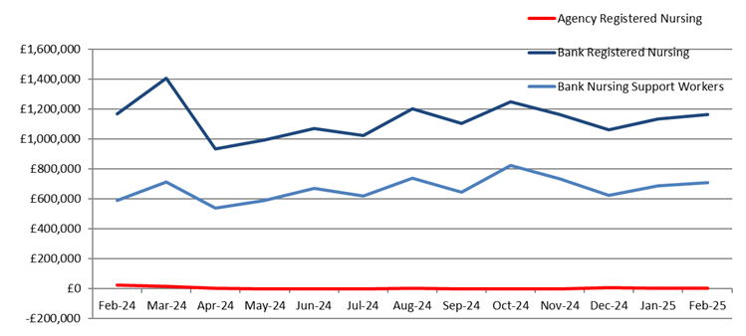
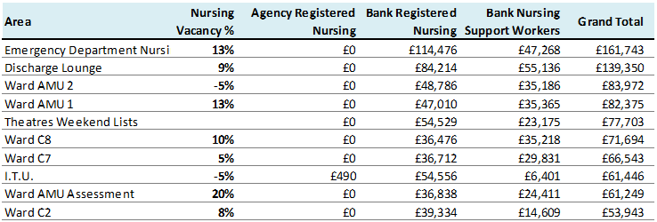
Safer Staffing
Background
Performance
What are the charts showing us
Safe staffing % is around the same as Jan 25 and CHPPD is down compared to Jan25 Chart A - note increase in bank costs for registered nursing and support workers is up due to additional beds open Table B - Note Agency expenditure is only ITU due to the specific nursing requirements. The excessive bank use is mainly in areas with additional beds
Areas Impacting on Compliance
Unfunded additional capacity in discharge lounge (fully bedded), super surge (26 beds), AMU 1&2 10 additional beds. In response to 45-minute ambulance handover, 4 additional beds open in ED Imaging.
Mitigations / Timescales / Blockers
Aim to close additional beds by March 2025. Trust wide rota continues to assist with staffing these areas. Lack of social care to facilitate discharge of medically fit patients
Risk Register
Key Points to Note
Working with divisions to review bank use Recruitment and Retention of staff International Nurses/Midwives Head count Starters - 399 Leavers - 21(will be 22 at end of March 2025) Retention rate - 95% (target for 31/3/25 was to retain 80%) Remaining employed as of 31/3/25 - 377
Date
February 2025
Trust Performance
A) B)
Performance Target / KPI
N/A
A
A - Bank Usage
B – Top 10 depts. using Bank & Agency, Feb 2025

Slide 8
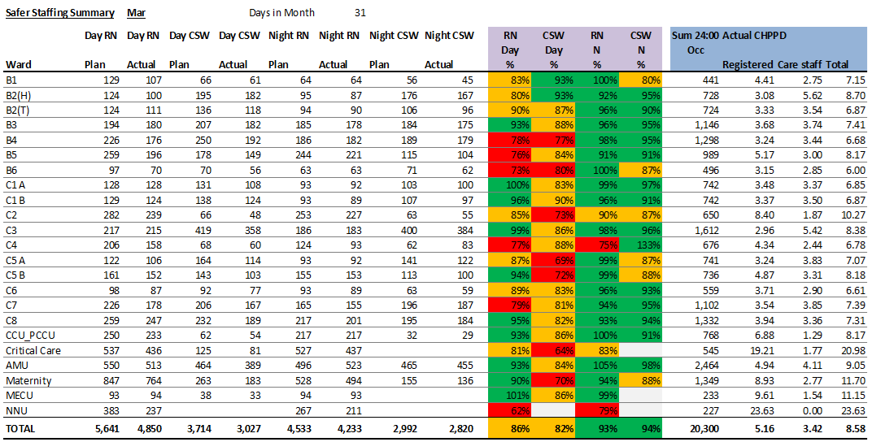
Safer Staffing – Dashboard March 2025
Date
March 2025

Slide 9
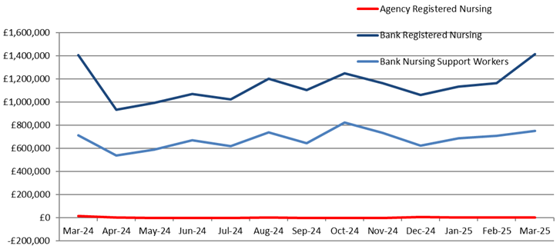
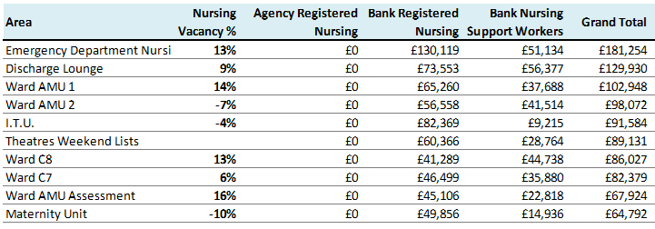
Safer Staffing
Background
Performance
What are the charts showing us
Safe staffing % and CHPPD are around the same for March as compared to Feb 25 Chart A - note increase in bank costs for registered nursing and support workers is up due to additional beds still open Table B - - bank remains high in areas with increase vacancy rates
Areas Impacting on Compliance
Unfunded additional capacity in AMU 1&2 10 additional beds and TES area in ED.
Mitigations / Timescales / Blockers
Additional beds on super surge are now closed but additional beds on AMU are still open. TES area continues to be utilised based on capacity needs and recently to utilise the corridor when a high increase of capacity.
Risk Register
Key Points to Note
Safer staffing report for January (see appendix ?) Overall, the safer staffing establishments within the assessed areas are in a positive position to maintain the provision and delivery of safe, effective, high-quality care. However, based on professional judgement and triangulation of quality metrics and acuity, some clinical areas feel additional staffing or change of skill mix may enhance care and experience in these areas. The Nurse Sensitive Indicators reviewed as part of the review, indicate that ongoing improvement work is required for example, with regards to patient observations, medicine management, pressure ulcers and falls amongst others. Recruitment and Retention of staff 36 Student Nurse are due to qualify between Jan and July 2025, 6 already offered jobs with us and the remaining 30 still looking
Date
March 2025
Trust Performance
A) B)
Performance Target / KPI
N/A
A
A - Bank Usage
B – Top 10 depts. using Bank & Agency, Mar 2025

Slide 10
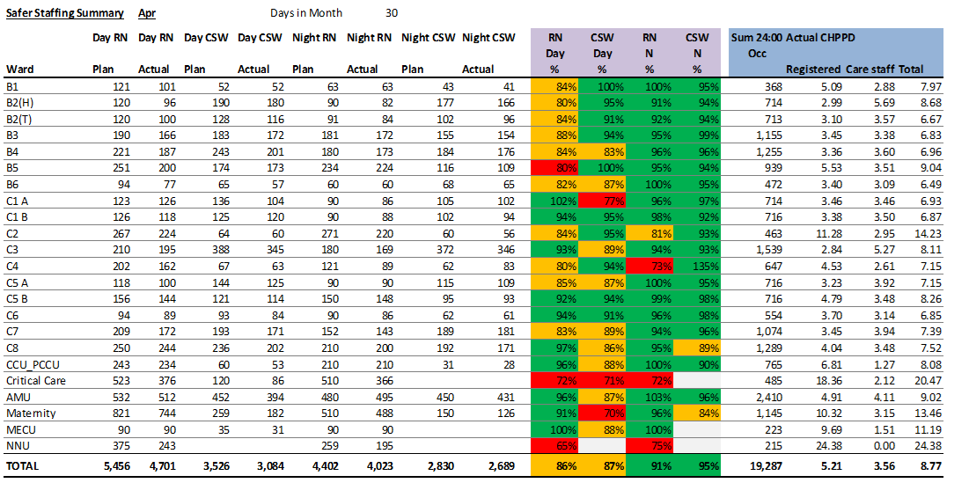
Safer Staffing – Dashboard April 2025
Date
April 2025

Slide 11
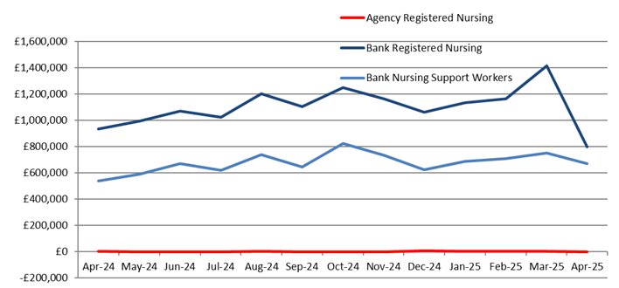
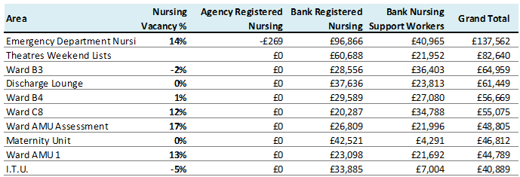
Safer Staffing
Background
Performance
What are the charts showing us
Safe staffing % and CHPPD are around the same for April as compared to March 25 Chart A – April has seen a decrease of registered nurses use on bank and support workers is a slight decrease. This may be due to work recently undertaken to reduce the amount of bank spend, now it is to analyse the metrics to understand drivers behind the reduction in bank usage in April and determine if sustainable. Table B - - bank remains high in areas with increase vacancy rates especially in ED when the use of bank is used to staff the TES areas and AMU due to the additional beds.
Areas Impacting on Compliance
Unfunded additional capacity in AMU 1&2 10 additional beds and TES area in ED.
Mitigations / Timescales / Blockers
TES areas continues to be utilised on a regular base's due high capacity demands in both ED x-ray and the corridor.
Risk Register
Key Points to Note
Recruitment and Retention of staff Since 2024- student nurses who qualified whilst on placement in the trust, 48 engaged with us, of which 43 offered jobs with us and 5 still applying for jobs with us. 2025 qualifiers - 130 currently engaged with us 15 have been offered jobs with us and 115 are still looking for a job, these are based on students qualifying in January and April.
Date
April 2025
Trust Performance
A) B)
Performance Target / KPI
N/A
A
A - Bank Usage
B – Top 10 depts. using Bank & Agency, April 2025

Slide 12

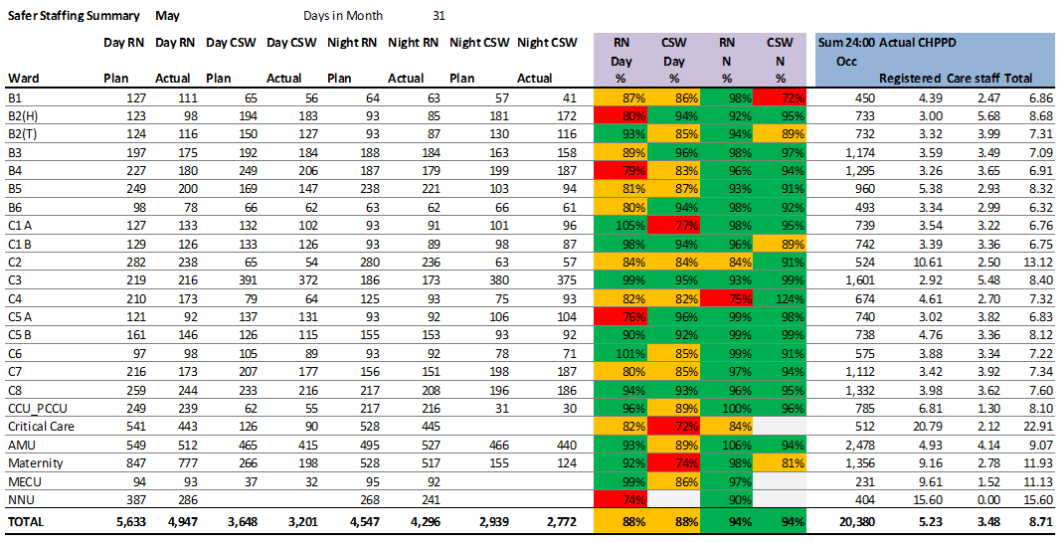
Safer Staffing – Dashboard May 2025
Date
May 2025

Slide 13
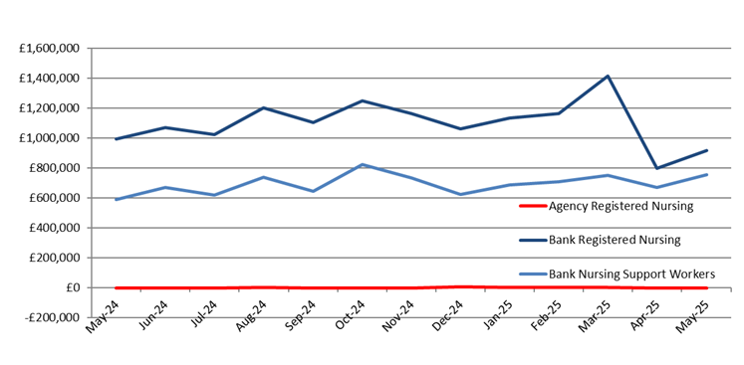
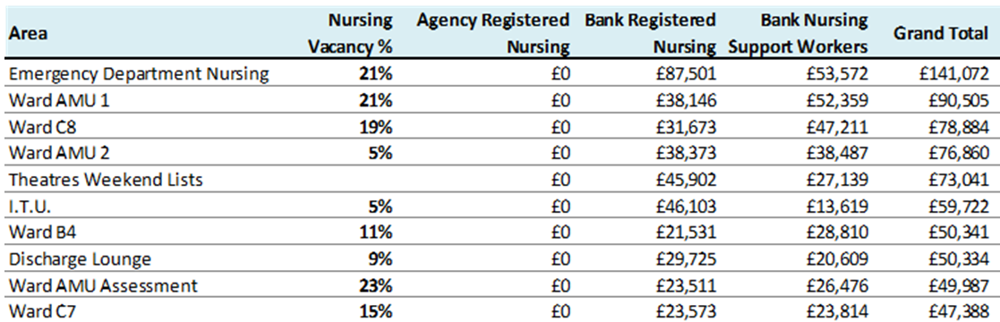
Safer Staffing
Background
Date
May 2025
What are the charts showing us
Safe staffing % and CHPPD are around the same for May as compared to April 25 Chart A – May has seen a slight increase of registered nurses and support workers since April. Working group continues to aim to reduce the bank usage. Table B - - bank remains high in areas with increase vacancy rates especially in ED and Medical emergency wards
Areas Impacting on Compliance
Unfunded additional capacity in AMU 1&2 with 10 additional beds and TES area in ED continues to be utilised.
Mitigations / Timescales / Blockers
TES areas continues to be utilised on a regular base's due high capacity demands in both ED x-ray and the corridor.
Risk Register
Key Points to Note
Work is underway for the transition of the CSW with re-banding the aim to proceed with the transition of the new roles by 1st August. Then to start the appropriate training to upskill the new band 3 with the appropriate clinical skills and competencies. Recruitment and Retention of staff – Work continues to support our third-year students into recruitment in current vacancies in the trust, with interview techniques and application process
Trust Performance
A) B)
Performance Target / KPI
N/A
A - Bank Usage
B – Top 10 depts. using Bank & Agency, May 2025

Slide 14
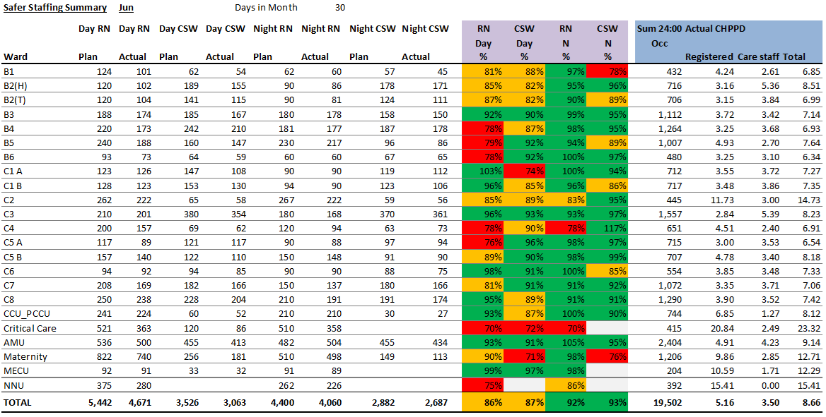
Safer Staffing – Dashboard June 2025
Date
June 2025

Slide 15
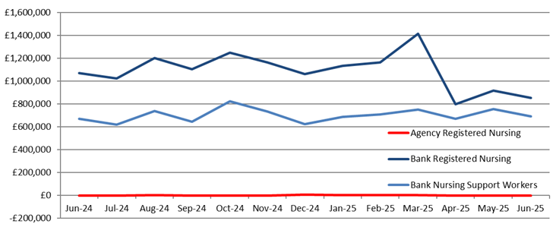
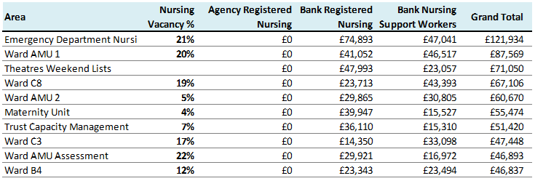
Safer Staffing
Background
What are the charts showing us
Safe staffing % and CHPPD slightly lower in June 25 compared to May. 25 Comparing the CHPPD with peers based on the Model hospital April 25 data – Nursing/Midwifery - Trust – 5.2 / peers 4.6, Care support worker – Trust 3.6 /peers 3.6 Chart A – show a slightly decrease in bank use in June 25, the main use for bank is vacant posts and short-term sickness Table B - bank remains high in areas with increase vacancy rates especially in ED and Medical emergency wards . Also, due to the bank being utilised in the TES areas in ED and the additional beds on AMU1/2 requiring additional staff.
Areas Impacting on Compliance
Unfunded additional capacity in AMU 1&2 with 10 additional beds and TES area in ED continues to be utilised. Discharge lounge aims by the end of July to be functioning as the main purpose of opening days only to support with discharges.
Mitigations / Timescales / Blockers
TES areas continues to be utilised on a regular base's due high capacity demands in both ED x-ray and the corridor.
Risk Register
Key Points to Note
The Trust has completed and submitted its self-assessment to NHSE on the workforce safeguards based on the published safer staffing guidance. A significant amount of work has been completed by the Chief Nurse’s team over the last 16 months to strengthen our compliance with NQB and NHSE safe staffing guidance, which has resulted in a much-improved position. Main actions There is ongoing work required to ensure that aspects such as consistency in completion of Quality Impact Assessments (QIAs) To develop a locally agreed safer staffing escalation process to support and manage workforce challenges to support business as usual activity. To improve use of the Allocate Safe Care module Recruitment and Retention of staff – Student Nurses qualifying between Feb & Sept 25 -130 who have been on placement in the trust, 22have been offered jobs with the trust but we have 108 Nursing students who are still looking for jobs
Date
June 2025
Trust Performance
A) B)
Performance Target / KPI
N/A
A - Bank Usage
B – Top 10 depts. using Bank & Agency, June 2025

Slide 16
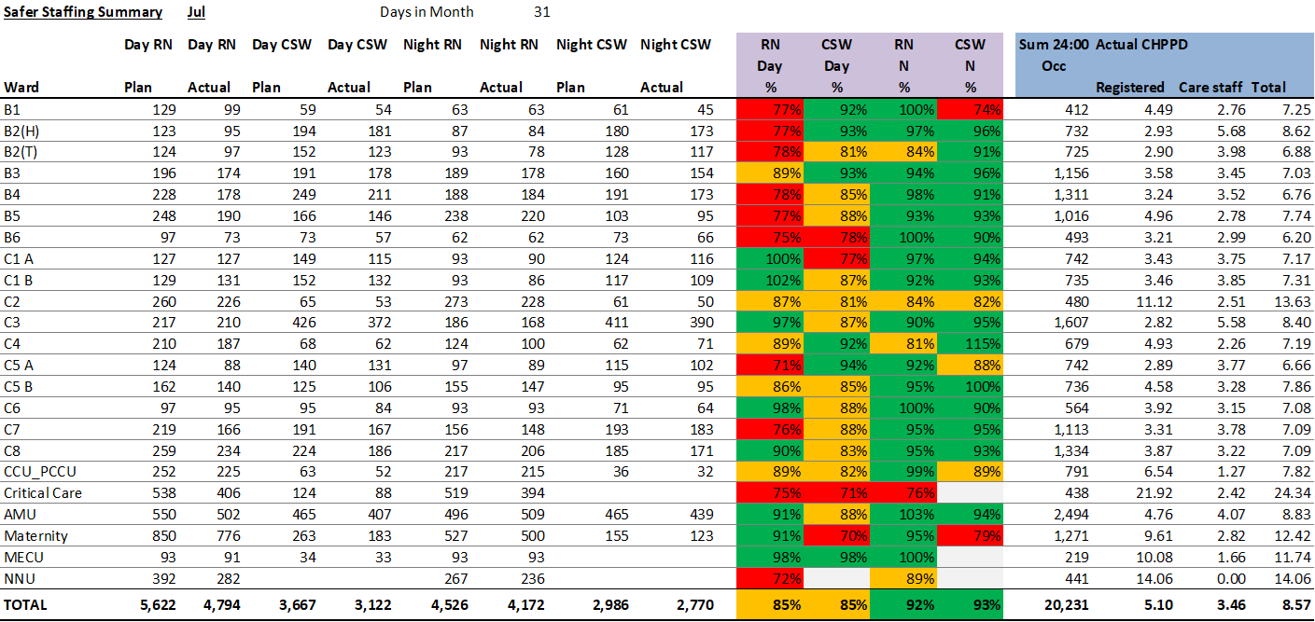
Safer Staffing – Dashboard July 2025
Date
July 2025

Slide 17
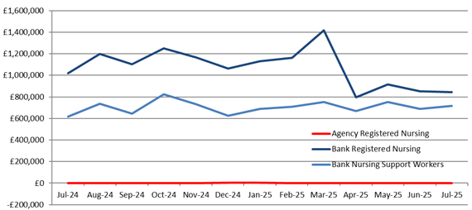
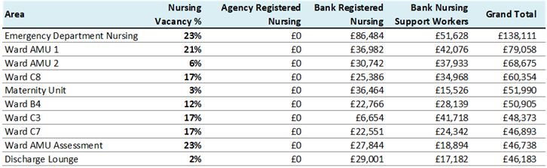
Safer Staffing
Background
Date
July 2025
What are the charts showing us
Safe staffing % and CHPPD slightly lower in July 25 compared to June. 25 for days for nights remain the same Comparing the CHPPD with peers based on the Model hospital July 25 data – Nursing/Midwifery - Trust – 5.2 / peers 4.9, Care support worker – Trust 3.6 /peers 3.8 Chart A – show a slightly increase CSW bank use in June 25, RN's remain the same Table B - bank remains high increase with increase vacancy rates especially in ED and Medical emergency wards . Also, due to the bank being utilised in the TES areas in ED and the additional beds on AMU1/2 requiring additional staff.
Areas Impacting on Compliance
Unfunded additional capacity in AMU 1&2 with 10 additional beds and TES area in ED continues to be utilised. Discharge lounge is now back to the orginal purpose following the made event
Mitigations / Timescales / Blockers
TES areas continues to be utilised on a regular base's due high capacity demands in both ED x-ray and the corridor.
Risk Register
Key Points to Note
Safer staffing report for June, overall, the safer staffing establishments within the assessed areas are in a positive position to maintain the provision and delivery of safe, effective, high-quality care. However, based on professional judgement and triangulation of quality metrics and acuity, some clinical areas feel additional staffing or change of skill mix may enhance care and experience in these areas. The Nurse Sensitive Indicators reviewed as part of the review, indicate that ongoing improvement work is required for example, with regards to patient observations, medicine management, pressure ulcers and falls amongst others. Recruitment and Retention of staff – Student Nurses qualifying between Feb & Sept 25 -130 who have been on placement in the trust, 22have been offered jobs with the trust but we have 108 Nursing students who are still looking for jobs
Trust Performance
A) B)
Performance Target / KPI
N/A
A - Bank Usage
B – Top 10 depts. using Bank & Agency, July 2025

Slide 18
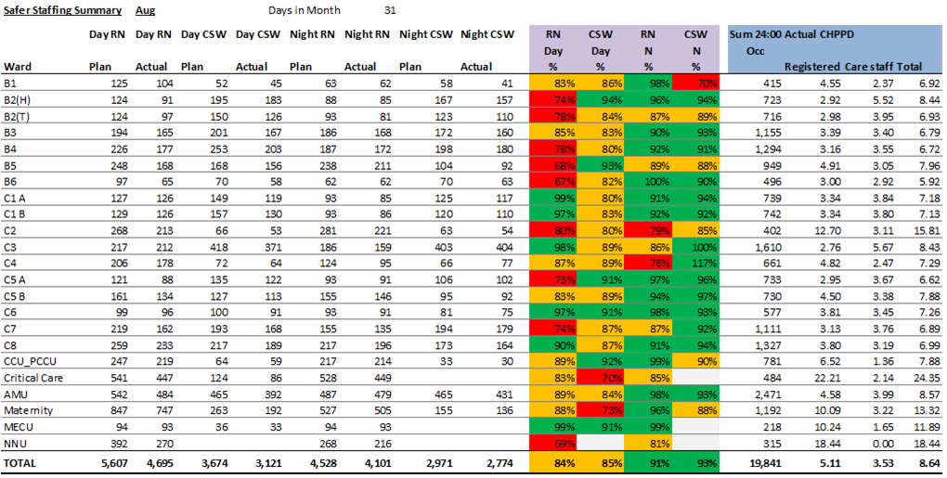
Safer Staffing – Dashboard August 2025
Date
August 2025

Slide 19
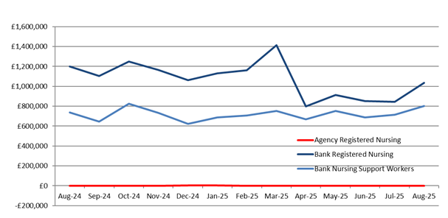
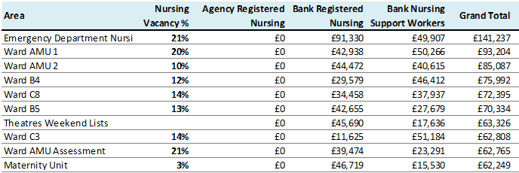
Safer Staffing
Background
Date
August 2025
What are the charts showing us
Safe staffing % and CHPPD slightly lower in August 25 compared to July 25 Chart A – show an increase in both RN and CSW bank use in August 25, may be due to the high acuity and requiring increasing 1-1 care and TES areas being utilising on a regular basis Table B - bank remains high increase with increase vacancy rates especially in ED and Medical emergency wards . Also, due to the bank being utilised in the TES areas in ED and the additional beds on AMU1/2 requiring additional staff.
Areas Impacting on Compliance
Unfunded additional capacity in AMU 1&2 with 10 additional beds and TES area in ED continues to be utilised.
Mitigations / Timescales / Blockers
TES areas continues to be utilised on a regular base's due high capacity demands in both ED x-ray and the corridor.
Risk Register
Key Points to Note
Recruitment and Retention of staff – Student Nurses qualifying between Feb & Sept 25 -130 who have been on placement in the trust, 29 have been offered jobs with the trust but we have 47 Nursing students who are still looking for jobs. Internal nurses and Midwives we still have maintained a 93% retention rate, especially as majority are now renewing their visa after the initial 3 year period.
Trust Performance
A) B)
Performance Target / KPI
N/A
A - Bank Usage
B – Top 10 depts. using Bank & Agency, August 2025

Slide 20
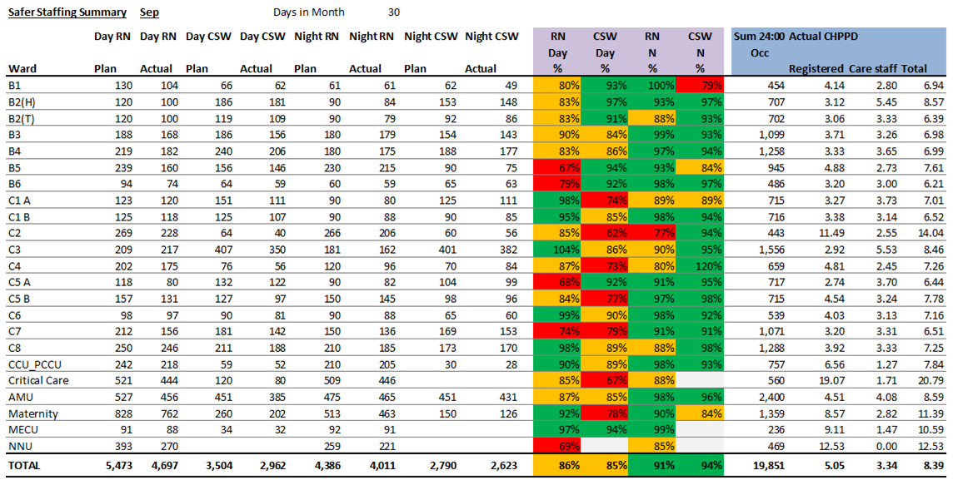
Safer Staffing – Dashboard September 2025
Date
September 2025

Slide 21
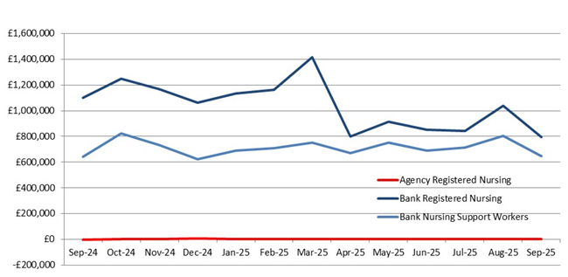
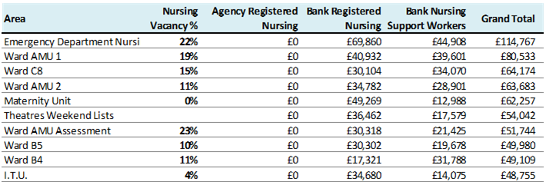
Safer Staffing
Background
What are the charts showing us
Safe staffing % and CHPPD remains roughly the same for September compared to August. Chart A – show a a decrease in CSW and RN bank use, due to the work done in divisions that include the lead and Matron's increasing clinical time and corporate team undertaking a clinical shift per week Table B - shows areas of high bank use to maternity leave and areas with vacancies or wating for new starters to commence the trust
Areas Impacting on Compliance
Unfunded additional capacity in AMU 1&2 with 10 additional beds
Mitigations / Timescales / Blockers
Corridor in ED is utilised only when high cpacity and approved by execs
Risk Register
Key Points to Note
Recruitment and Retention of staff – Student Nurses qualifying between Feb & Sept 25 –134, 76 continue to engage with the trust from these 29 have jobs and 47 are still looking for jobs
Date
September 2025
Trust Performance
A) B)
Performance Target / KPI
N/A
A - Bank Usage
B – Top 10 depts. using Bank & Agency, September 2025

Slide 22
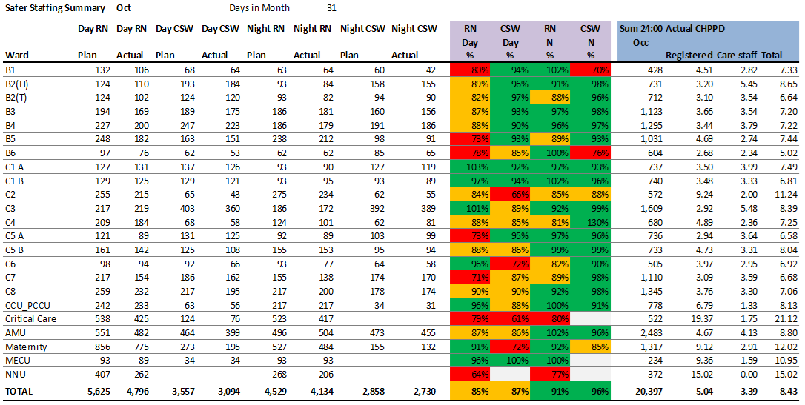
Safer Staffing – Dashboard October 2025
Date
October 2025

Slide 23
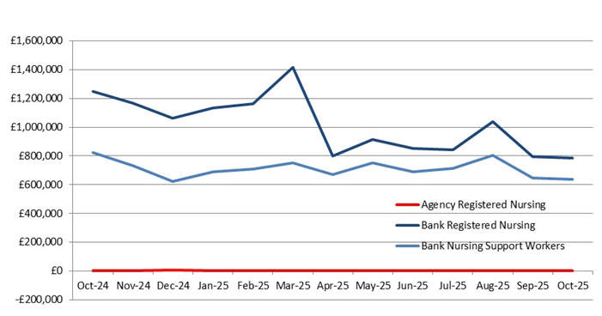
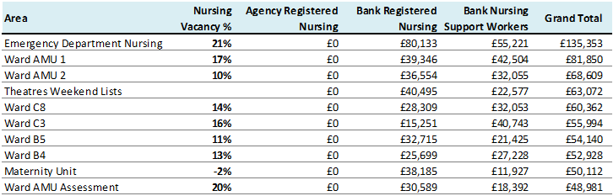
Safer Staffing
Background
What are the charts showing us
Safe staffing % and CHPPD remains roughly the same for October compared to September. Comparing the CHPPD with peers based on the Model hospital August 25 data – Nursing/Midwifery - Trust median– 4.8/ peers 4.7, Care support worker – Trust 3.6 /peers 3.9 Chart A – shows the bank usage remains the same for both RN's and CSW's even with and Matron's increasing clinical time and corporate teams undertaking a clinical shift per week Table B - still shows areas of high bank use to cover maternity leave and areas with vacancies or wating for new starters to commence the trust
Areas Impacting on Compliance
Unfunded additional capacity in AMU 1&2 with 10 additional beds
Mitigations / Timescales / Blockers
ED corridor is being utilised regularly due to high capacity and approved by execs
Risk Register
Key Points to Note
Recruitment and Retention of staff – 135 Nursing students qualified in 2025 and 47 are still looking for jobs with us as a trust. The potential plan is to offer fixed term contracts to cover maternity leave and to reduce bank spend. This also gives the new graduates an opportunity to complete their preceptorship period and potential of securing a substantive post in the trust. Internationally recruited staff still has a retention rate of 92.8%. Safer staffing Safer staffing in community was completed in September using the recognized Community Nurse safer staffing tool (CNSST), the establishments within the District nurse teams are in a positive position to maintain the provision and delivery of safe, effective, high-quality care. Work is to be undertaken to review the geographic areas of the teams to ensure a fair share of allocated caseloads.
Date
October 2025
Trust Performance
A) B)
Performance Target / KPI
N/A
A - Bank Usage
B – Top 10 depts. using Bank & Agency, October 2025

Slide 24
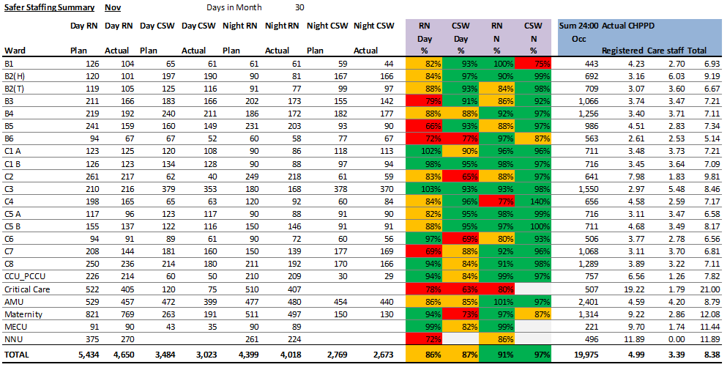
Safer Staffing – Dashboard November 2025
Date
November 2025

Slide 25
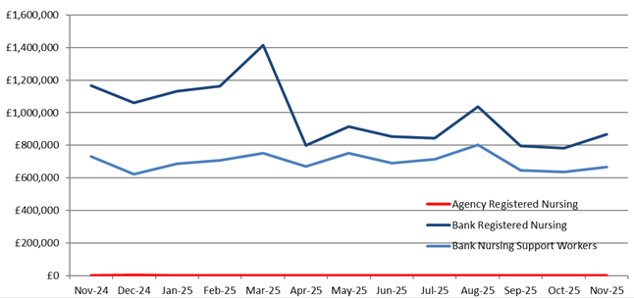
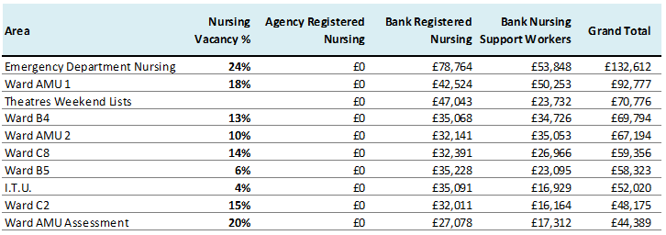
Safer Staffing
Background
Date
November 2025
What are the charts showing us
Safe Staffing and CHPPD Overview Safe staffing percentages and CHPPD remained broadly consistent in November compared to October (RN 4.9 & CSW 3.39) CHPPD Benchmarking (Model Hospital Data) September 2025: Nursing/Midwifery: Trust median – 5.1 vs peers – 4.7 Care Support Worker: Trust – 3.3 vs peers – 3.7 Chart A Bank usage has increased for both Registered Nurses (RNs) and Care Support Workers (CSWs), despite Leads and Matrons increasing clinical time and corporate teams undertaking one clinical shift per week. This may be attributed to higher patient acuity, including increased requirements for 1:1 care, which cannot be managed within current ward establishments. Table B Continues to highlight areas of high bank usage, primarily to cover maternity leave and vacancies, as well as wards awaiting commencement of new starters.
Areas Impacting on Compliance
Unfunded additional capacity in AMU 1&2 with 10 additional bed.
Mitigations / Timescales / Blockers
ED corridor is being utilised regularly due to high capacity and approved by execs. November also saw an increase of additional patients in most ward areas per day.
Risk Register
Key Points to Note
Recruitment and Retention of staff – 135 Nursing students qualified in 2025 and 47 are still looking for jobs with us as a trust. The potential plan is to offer fixed term contracts to cover maternity leave and to reduce bank spend. This also gives the new graduates an opportunity to complete their preceptorship period and potential of securing a substantive post in the trust. Internationally recruited staff still has a retention rate of 91%.
Trust Performance
A) B)
Performance Target / KPI
N/A
A - Bank Usage
B – Top 10 depts. using Bank & Agency, November 2025

