Slide 1
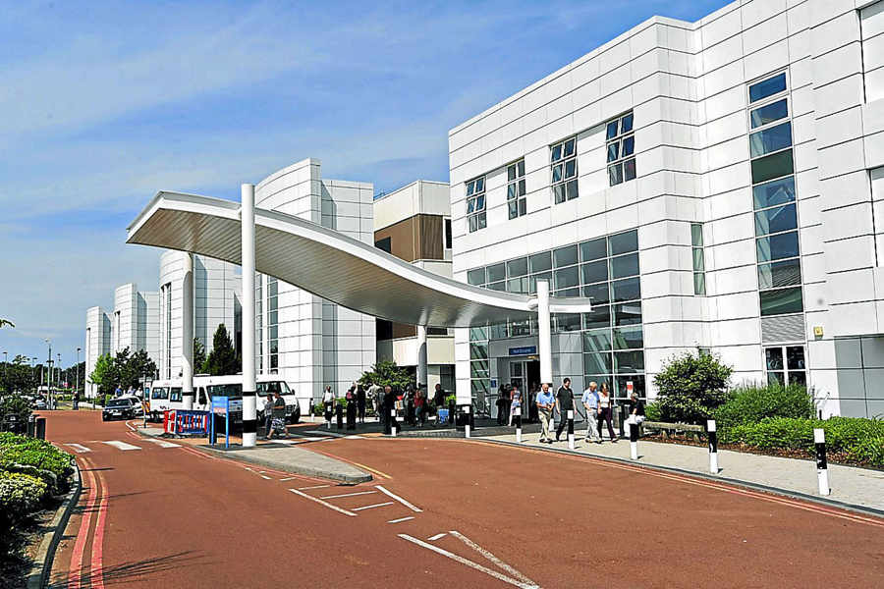

Education pack for patients with Rheumatoid Arthritis treated with Biologics and Targeted synthetic DMARDs at Dudley Group NHS FT

Slide 2
Education pack for patients with Rheumatoid Arthritis treated with Biologics and Targeted synthetic DMARDs at Dudley Group NHS FT
Contents
Section 1: Introduction to Biologics and Targeted synthetic DMARDs
Section 2: Timeline for starting enhanced therapies
Section 3: Biologics given as a hospital infusion
Section 4: Treatments given by TABLET or Home INJECTION
Section 5: Frequently Asked Questions
Section 6: Vaccinations, Infections & Travel
Section 7: Surgery and Pregnancy
Section 8: Cancer consideration
Section 9: Research & Psychology

Slide 3
Education pack for patients with Rheumatoid Arthritis treated with Biologics and Targeted synthetic DMARDs at Dudley Group
Section 1
Introduction to enhanced therapies

Slide 4
Biologics and Targeted Synthetic DMARD Treatments
The first treatments prescribed for patients with Rheumatoid Arthritis (RA) nationally are usually conventional DMARDs e.g. Methotrexate or Hydroxychloroquine, DMARDs stands for Disease Modifying Anti-Rheumatic Drugs
DMARDs should control RA individually or in combination.
If at least 2 of these drugs have not sufficiently controlled the disease after taking the maximum tolerated doses & a review with rheumatology team, the next step is often to consider escalation to an enhanced therapies in the form of a Biologic or Targeted Synthetic DMARDs (tsDMARDs )
These high costing treatments have been scientifically designed to target specific parts of the inflammation path involved in RA
Rheumatologists worldwide have been using these treatments for over 20 years

Slide 5
Biologics and Targeted Synthetic DMARDS
Biologic and tsDMARDs have been proven to be very effective and safe in the treatment of RA
To work these drugs will dampen a part of your immune system so they are called immunosuppressive drugs
Biologic drugs are given by injection or infusion
Targeted synthetic DMARDs are tablets
For more information about RA treatments, please visit Arthritis UK & National Rheumatoid Arthritis Society websites:
Rheumatoid arthritis | Arthritis UK
Biologics For Rheumatoid Arthritis (RA) | NRAS

Slide 6
Types of Biologics and Targeted Synthetic DMARDS
  Biologics & tsDMARDs have a generic name and a brand name, e.g Ibuprofen = generic name & Nurofen® = brand name
  When better value brands become available Dudley Group Hospitals will assess and aim to switch patients to the better value brands, this supports sustainability for DGH & the NHS.
  Below is a list of the treatments available & their generic names.
  Biologics
Anti-TNF class: Adalimumab, Etanercept, Certolizumab & Golimumab (all are INJECTIONS) Infliximab (available as INJECTION & hospital INFUSION)
B cell depletion class : Rituximab (INFUSION)
Anti-IL6 class: Tocilizumab, Sarilumab (both are INJECTIONS)
Anti-CD40 class: Abatacept (INJECTION)
Target Synthetic DMARDs
JAK inhibitors: Baricitinib, Tofacitinib, Upadacitinib & Filgotinib (all are TABLETS)

Slide 7
Education pack for patients with Rheumatoid Arthritis treated with Biologics and Targeted synthetic DMARDs at Dudley Group
Section 2: Timeline for starting enhanced therapies

Slide 8
The time it takes to initiate your treatment can vary
Discussion about escalating treatment
Education & consent sent to you to read & return
Pre-screening tests & assessments
Your prescription is sent to Medical Day Case or Homecare company depending on which treatment you are having
Virtual Biologic Clinic Review
The Day Case or Homecare team will contact you to arrange your treatment start/ delivery, the timeline will be dependent on your availability & ability to be contacted

Slide 9
Pre-treatment screening & starting treatment
Biologic and tsDMARDs can dampen down the immune system more than conventional DMARDs. Therefore, before starting one of these drugs, we routinely undertake checks including a set of blood tests and a Chest Xray to make sure you have no underlying risks.
The things we screen for are:
  Tuberculosis
  Hepatitis B / C
  HIV
If any of the results of above tests are abnormal, we will let your rheumatologist know and you may need to be referred to a specialised team for further advice before we proceed to biologic therapy

Slide 10
Pre-treatment screening & starting treatment
When starting one of these drugs it is also important to take into consideration any other health problems that you may have.
Biologics and tsDMARDs are high-cost treatments that are commissioned by NHSE & other NHS commissioners. We, therefore, for each patient, must seek commissioner approval by providing initial & continued recorded tests & assessments to show that you meet the national criteria to have treatment. It is therefore mandatory to attend all appointments & undertake all blood tests that the rheumatology invite you to.
DGH undertake a Virtual Biologics Clinic (VBC) prior to commencing your treatment which includes a Multidisciplinary team: Rheumatologists, Clinical Nurse Specialist, Specialist Pharmacist and Administrative support. The VBC will ensure your proposed treatment is safe, effective, appropriate, sustainable & available for you.
Once VBC approve & gain funding for your proposed treatment, a prescription will be generated.

Slide 11
Once your drug is approved by the Virtual Biologic Clinic what happens next?
The biologic admin team will have sent you this presentation so you can learn more about the process, the drugs and some guidance about using the drug safely.
What happens next depends on whether the drug you are to have, is one that is:
A TABLET
An INJECTION that you can do yourself at home
OR
Given as a HOSPITAL INFUSION as a day case. This is the case for Rituximab and infliximab, but in rare cases tocilizumab or abatacept can be given by infusion.

Slide 12
Education pack for patients with Rheumatoid Arthritis treated with Biologics and Targeted synthetic DMARDs at Dudley Group
Section 3
Biologics given as a hospital infusion
Skip to section 4 if you are having a TABLET or INJECTION

Slide 13
For treatments that you have as an infusion in the hospital?
Education sent to patient
Your paperwork and prescription is sent to the medical day case unit (Ward A2) at Russells Hall Hospital
The day case staff will contact you and arrange your first treatment

Slide 14
Medical Daycase Unit
Treatments given by infusion will take place on A2 Medical Day Case Unit, Ground floor, Russells Hall Hospital
The lead nurse is Sister Cole and she and her team have many years of experience treating rheumatology patients.
There is a waiting list for treatment, but the day case team will arrange a convenient time as quickly as possible
You may be in the day case unit just a few hours or for rituximab it may be a full day and simple refreshments will be available.
If you are unable to attend, then you must let the day case staff know ASAP (not the rheumatology nurses).
If relevant you must book your next infusion with the day case staff before you leave.
Medical day case phone number: 01384 456111 ext 3365 or 2096

Slide 15
How often do I have my infusion?
Rituximab | Given as 2 infusions 2 weeks apart initially, then as a single infusion when needed at least 6 months later
Infliximab | One infusion every 8 weeks after loading doses at 0, 2 and 6 weeks
Tocilizumab | Monthly infusion
Abatacept | Monthly infusion, after loading doses at 0, 2 and 4 weeks

Slide 16
Education pack for patients with Rheumatoid Arthritis treated with Biologics and Targeted synthetic DMARDs at Dudley Group
Section 4
Treatments given by TABLET or Home INJECTION

Slide 17
Homecare consent and referral
Like most Hospitals nationally, we use Homecare companies that prepare and deliver enhanced therapies.
As we need to provide these companies with some of your private details, e.g. your phone number and address we will need to have your consent to share this.
The link to the electronic consent form is:
https://forms.office.com/e/S764F5qaar or you can access it via using the QR code on the next slide.
For a document format of the consent form see:
Dudley-Homecare-Service-Consent-Form.pdf (dgft.nhs.uk)
Or contact dgft.biologics.admin@nhs.net
Please complete and sign the form either electronically or on paper and return by post/ email back to the above address asap
We cannot proceed with your prescription until we have your consent

Slide 18
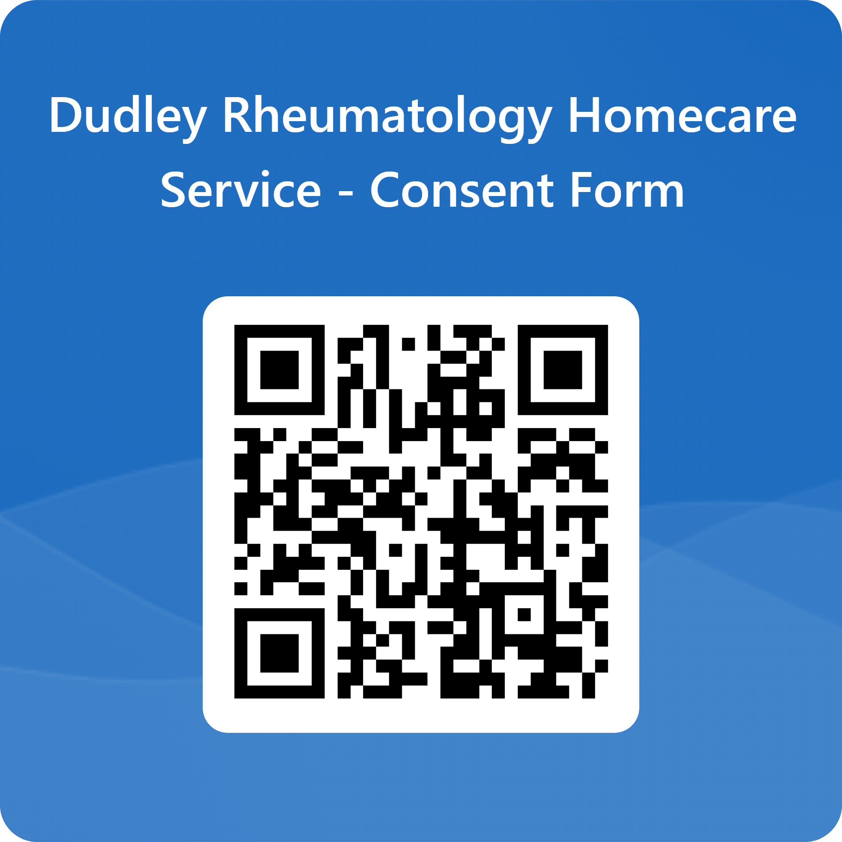
QR code for Homecare consent
Your smartphone has a built-in QR code reader
Point your camera at the code. ...
When your camera scans the QR code, you'll see an icon or web address on your screen near the code. ...
You'll go to the associated website via your phone's web browser, which should launch automatically.

Slide 19
Homecare companies
We currently use the companies listed below to provide enhanced treatments to your own home, or at another agreed address.
Sciensus contact number 0333 1039 499
Lloyds contact number 01279 456 789
HealthNet contact number 08000 833 060
Alcura contact number 01604 433 510
Fresenius contact number 01623 518 919
Pharmaxo contact number 01225 302 188
Calea contact number 0800 0902 461
Once you have returned your consent form, we will forward your prescription to the relevant company.
It is important to note the company will call on a withheld number so please ensure your phones accept withheld numbers & please ensure you provide up to date contact details to your clinic team when you consent for treatment.

Slide 20
Ongoing prescriptions
Future prescriptions will be requested by the homecare provider; a prescription is created by the rheumatology admin team. A rheumatology doctor or CNS reviews blood tests and clinical details and if safe the prescription is signed and sent from pharmacy to the homecare provider.
For prescription queries please first contact your Homecare Provider, if they do not have a prescription or there is an issue with the prescription, please then contact:
The Rheumatology biologic admin team on 01384 456111 ext 4297 or email dgft.biologics.admin@nhs.net
The Rheumatology advice line 01384 244789
It is important to chase prescriptions at least 2 weeks before you are due your last dose

Slide 21
How often do I have my biologic injection?
Adalimumab | Fortnightly injection
Etanercept | Weekly injection
Golimumab | Monthly injection
Certolizumab | Fortnightly injection after loading dose
Tocilizumab | Weekly injection
Sarilumab | Fortnightly injection
Abatacept | Weekly injection

Slide 22
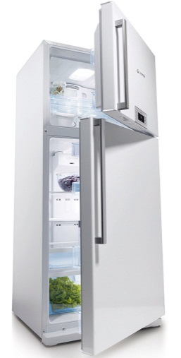
How do I store the drug?
Your injections must be stored in a refrigerator (2° C – 8° C).
Do not freeze injections.
The information leaflet will tell you how long the injections can be left out the fridge until it is no longer safe to use.
Tablets do not require any special temperature storage conditions.
Store tablets in the original packaging in order to protect from moisture & light

Slide 23
How long can it be out of the fridge
Drug | Time it is stable outside the fridge
Adalimumab | Up to 14 days outside of the fridge
Etanercept | Up to 4 weeks outside of the fridge
Golimumab | Up to 24 hours outside of the fridge
Certolizumab | Up to 10 days outside of fridge
Tocilizumab | Up to 8 hours outside of the fridge
Sarilumab | Up to 14 days outside of fridge
Abatacept | Up to 8 hours outside the fridge.
Please Contact the Rheumatology advice line, should you have any concerns about your medications.

Slide 24
Education pack for patients with Rheumatoid Arthritis treated with Biologics and Targeted synthetic DMARDs at Dudley Group
Section 5
Frequently Asked Questions

Slide 25
What can I expect to happen after I start taking my biologic?
You may start to experience improvement in your arthritis within a few days to weeks. Sometimes, it may take a bit longer to work but we would hope you would start to feel better within 3 months.
Most patients will respond to treatment.
You will be monitored for your response.
If you do not respond, we will stop the drug and consider swapping it to another agent.

Slide 26
How often will I need to attend the Rheumatology clinic?
We will see you ideally 3-4 months after you start treatment to check it is working well, that there are no side effects and arrange regular monitoring
Even when your condition is under controlled, you must come back at least for annual review
If your disease in not under control, contact the advice line as you would do normally.
If you have not had an appointment and you think you should have one, please contact us.
If you don’t attend for your appointments or blood tests, your prescription may be stopped!

Slide 27

How often will I need to have blood tests done?
Most drugs require blood test at least every 3 months
Tocilizumab & sarilumab - Blood tests monthly until stable then every three months
Tocilizumab, sarilumab, baricitinib, tofacitinib, upadacitinib and filgotinib also require a 3-month cholesterol test after treatment starts. Your doctor may want to keep a check of this
Please be warned: we check blood results every time when we sign a prescription. So, if you haven’t had a blood test done, we cannot safely sign your prescription, and your treatment may be delayed

Slide 28

What are the most common side effects?
Most people tolerate these medications well and do not have any side effects.
Some patients can experience redness and soreness at the site of the injection. This usually goes away with time. If not let us know!
Some patients report:
  headaches, rashes or mood changes
  more coughs, cold and other minor infections
If you have concerns, contact the rheumatology team or your own doctor

Slide 29

What are the serious side effects?
Serious side effects are rare.
Occasionally, severe rash and more severe infections which required hospitalisation have been reported. We will discuss infection in more detail.
If you get any of these, do not take any more of your biologic and seek emergency medical advice.
If you ever have concerns about your medication, do discuss these with your nurse or rheumatologist.

Slide 30

Do I need to tell other medical professionals that I am on a biologic?
YES
Show your alert card (in your drug information pack) to any health professional.
We will inform your GP once you are started on biologic therapy, but we would recommend that you let them know also and if possible, add it to your GPs electronic list of medications.
Don’t assume that non-rheumatology medical professionals understand the drug or how it is given as it is a specialist drug rarely used outside rheumatology

Slide 31
What do I do if I miss a dose?
If it is because you have forgotten, then take it as soon as you remember, but keep in mind that the next dose must be taken when it is due and not too early/late.
If you have had a gap in treatment due to an infection, then restart it when you are well again.
If you are not sure, please ask or contact the advice line

Slide 32
Education pack for patients with Rheumatoid Arthritis treated with Biologics and Targeted synthetic DMARDs at Dudley Group
Section 6
Vaccinations, Infections & Travel

Slide 33

Vaccinations - 1
Inform your GP before you start your biologic therapy, preferably for arrangements of vaccinations as below:
  Yearly flu vaccine.
  A pneumonia vaccine (once only)
  For COVID vaccine, follow the current national guidelines.
  For shingles vaccination in patients over 18 years old, two doses of Shingrex, recombinant vaccine, should be given
  Chickenpox vaccine before biologic treatment if low antibody level is noted on screening

Slide 34
Vaccinations - 2
You should NOT have live vaccines. If it is essential that you need a live vaccine, please discuss with your rheumatologist
Patients on rituximab should time any vaccination around treatment to get the best response to the vaccine, ie 3 months after treatment.
Certification of yellow fever vaccine is an entry requirement to some African countries. If you intend to travel to an exotic location in the future, it may be worthwhile considering a yellow fever vaccine before you start your biologic drug.
Those with children, remember to be aware that the kids nasal flu vaccine, MMR and Rotavirus (avoid nappies for 3 weeks) are all live vaccines
There is currently a local Measles outbreak. If you are on a biologic drug, you should not have an MMR vaccine. If you are in contact with measles you should contact your GP.

Slide 35
Avoid Live Vaccinations
Below is a table of vaccines, you should avoid while on a biologic or tsDMARDs.
If a live vaccine is required, you should consider having this before starting the biologic or you will have to come off the drug for a period of time before you have a live vaccine .
 | Brand Name
BCG | Bacillus Calmette-Guerin Vaccine
Measles, Mumps and Rubella combined vaccine (MMR) | MMRvaxPRO®, Priorix®
Poliomyelitis (Live oral vaccine) | Poliomyeltis Vaccine, live (oral) GSK OPV
Rotavirus (Live oral vaccine) | Rotarix®
Typhoid (Live oral vaccine) | Vivotif®
Varicella-Zoster, Chickenpox and shingles live Vaccine | Varilrix®, Varivax®, Zostavax®
Yellow Fever | Arilvax®, Stamaril®

Slide 36

What do I do if I get an infection?
Stop your biologic medication straight away and contact your GP.
If you are hospitalized, remember to tell the medical team about your biologic or tsDMARD drug.
Only restart it when you are feeling better and have finished antibiotics (if prescribed).

Slide 37
Are any special type of infection more commonly seen when using biologics?
Biologic drugs can reactivate an infection called Tuberculosis (TB) in patients who may have been exposed to the infection in the past.
All our patients are now being screened for TB using a chest x-ray and a T-SPOT blood test.
Patients with increased risk for TB will have been assessed and had appropriate treatment from the respiratory team.
If you have been in contact with TB or experience night sweats, weight loss or cough once on treatment, please inform your GP or the rheumatology department.

Slide 38

Chickenpox & Shingles
We do a blood test to make sure you have immunity (ie you have had Chickenpox and made antibodies against the virus) before you start your biologics. Most people are immune. If you are not immune we will probably already been in contact.
If you come into contact with Chickenpox or shingles and you are not sure if you are immune, we would advise:
Avoid on-going contact if possible
Do not take another dose of your drug until you have been checked.
Contact your GP or rheumatology urgently for advice
Possible blood testing to check that you are still immune
You may need some treatment
Contact department regardless before re-starting biologics

Slide 39
What do I do if I get shingles?
Shingles is caused by the reactivation of the chicken pox virus in someone who has previously had chicken pox. It is more likely to happen when someone’s immunity is suppressed.
Stop your biologic medication. If you are on methotrexate, leflunomide or sulphasalazine, you should also stop them.
You need to see your GP to start antiviral medication (aciclovir) and restart your medication when the spots have dried up and you are feeling better.

Slide 40

Travel Advice
  Try not to start a new medication just before holiday travel as monitoring is needed
  Take your biologic drug in your Hand luggage ONLY
    (see slide 23 for how long is it stable out of the fridge)
  Request a travel letter from us or the home care company in good time
  Carry your alert card
  Be sensible when you are away
    Hand washing
    Watch what you eat and drink to avoid tummy bugs
    Remember good sun protection
    Safe sex too

Slide 41

Other considerations
  Avoid food susceptible to
  transmit listeria or salmonella
  Raw eggs (fresh mayonnaise)
  Pâtés
  Uncooked meats/ fish
  Unpasteurised milk
  Unpasteurized cheese (e.g. Blue and goat cheese, Brie – check the label as UK Bries are usually pasteurised) )

Slide 42
PML (Progressive multifocal leukoencephalopathy)
What do I need to know about vaccinations?
This is a viral infection that can affect the brain.
A handful of cases internationally have occurred in patients on rituximab
It may evolve over the course of several weeks to months
The most prominent symptoms are:
  Clumsiness
  Progressive weakness
  Visual, speech, and sometimes personality changes
It is important that you tell your doctor if you experience any unusual neurological symptoms

Slide 43
Education pack for patients with Rheumatoid Arthritis treated with Biologics and Targeted synthetic DMARDs at Dudley Group
Section 7
Surgery and Pregnancy

Slide 44
What do I do if I need surgery?
Tell your surgeon and preoperative assessment team all the medications you are on including your biologic drugs, even if these are only by infusion.
Depending on the surgery you are having, you may be advised to stop these medications prior to surgery
  For rituximab: operation is ideally 3-6 months after last infusion
  For JAK inhibitors: stop 4 days before operation
  For anti-TNF, anti-IL 6 and abatacept skip one dose and have operation one week after the skip dose (see the table on the next slide).
If you need emergency surgery inform the surgeon what medication you are on and omit it until advised to restart
Your surgeon /rheumatologist should advise when to restart but usually this is after evidence of good wound healing, stitches have been removed and no signs of infection (usually around 2 weeks after operation).

Slide 45
A guide to when to stop Biologic or TsDMARD before having elective orthopaedic surgery ?
Drug | Mode of action and disease it is used in | Dosing interval | Recommended timing for surgery since last medication dose
Etanercept | Anti TNF inhibitors | Weekly (sc) | 2 weeks
Adalimumab |  | 2 weekly (sc) | 3 weeks
Golimumab |  | 4 weekly (sc) | 5 weeks
Certolizumab |  | 2 weekly (sc) | 3 weeks
Infliximab |  | 2 weekly (sc) 8 weekly (iv) | 3 weeks 9 weeks
Tocilizumab | IL-6 inhibitors | Weekly (sc) 4 weekly (iv) | 2 weeks 5 weeks
Sarilumab |  | 2 weekly (sc) | 3 weeks
Rituximab | B cell depletion | Adhoc iv typically 6 monthly | 3-6 months post treatment (consider which is the priority)
Abatacept | Inhibits T cell activation | Weekly (sc) Monthly (iv) | 2 weeks 5 weeks
Baricitinib | JAK inhibitors | Daily oral | 4 days
Upadacitinib |  | Daily oral
Filgotiinib |  | Daily oral
Tofacitinib |  | Daily oral

Slide 46
What do I do if I am planning a baby?
Women:
If you are planning a pregnancy, discuss this early on with your rheumatology team, ideally before you conceive.
We would normally take into consideration potential of pregnancy when planning for biologic treatment
With some biologic drugs, it is safe to continue at least part way into pregnancy, but other drugs you need to stop before considering getting pregnant.
Men:
For men wishing to father children, there does not appear to be a risk with infliximab, etanercept, adalimumab, certolizumab and golimumab but there is little information on the other drugs. No special precautions are needed as recent evidence suggests methotrexate does not need to be stopped in men.

Slide 47
Pregnancy
What if I unexpectedly find out I am pregnant?
Don’t worry! But contact your rheumatology team who will be able to advise you further. Most pregnancies in women who received a biologic at conception have had normal outcomes with no increased risk of birth defects.
Can I breastfeed on biologics?
Based on limiting but reassuring evidence women should not be discouraged from breastfeeding on infliximab, etanercept, adalimumab, certolizumab and golimumab. It appears that very little drug enters breast milk and likely even less absorbed by the baby.

Slide 48
Education pack for patients with Rheumatoid Arthritis treated with Biologics and Targeted synthetic DMARDs at Dudley Group
Section 8
Cancer consideration

Slide 49
Cancer and biologic drugs?
Data on thousands of patients around the world have now been analysed, including thousands of patients in the UK. There does not appear to be an increased risk of cancer in patients receiving biologic drugs with the exception of some skin cancers. So, you should be careful with sun protection.
If you have had a cancer, we will need to take this into consideration when choosing the right drug for you
If you are now or in the future being investigated / treated for cancer, we would ask you to stop your drug and inform the department.

Slide 50
Cancer and tsDMARDS ie JAK inhibitors drugs?
JAK inhibitors (tofacitinib, baricitinib, filgotinib and upadacitinib).
  A small increase in cancers has been seen in patients using tofacitinib. An increase in cancer has not to date been seen the other drugs which are being intensively studied.
As a precaution, we are advised to avoid using these drugs unless there is not a good alternative in patients over 65 years of age or who have a history of cancer or a pre-cancerous problem
If you are to start one of these drugs, please let us know asap if you are concerned that you are in an at-risk group.
Here is a link to the government advice:
  Janus kinase (JAK) inhibitors: new measures to reduce risks of major cardiovascular events, malignancy, venous thromboembolism, serious infections and increased mortality - GOV.UK (www.gov.uk)

Slide 51
Education pack for patients with Rheumatoid Arthritis treated with Biologics and Targeted synthetic DMARDs at Dudley Group
Section 9
Research & Psychology

Slide 52
Research
We are a department that regularly undertakes research and would be grateful if you could support any active research studies if approached. Full details of any active research studies will be discussed with you separately.
We are most often recruiting patients into national registries to monitor long term side effects from drugs
You do not have to participate, and it will not affect your treatment if you choose not to

Slide 53
Psychology
We are fortunate to have a psychologist within our department
We believe that well-being comes from a balance of good physical and psychological health
Long term conditions can have an impact on psychological health – it’s very common to feel low or anxious or hate tablets and needles!
If you want to have a chat with someone, ask one of the Rheumatology doctors or nurse to refer you to Ms Olivia Plant

Slide 54
Thank you for your attention
If you have any question please contact us via the advice line
We hope your new drug works well and without any side effects!
The Virtual Biologic team

