Slide 1
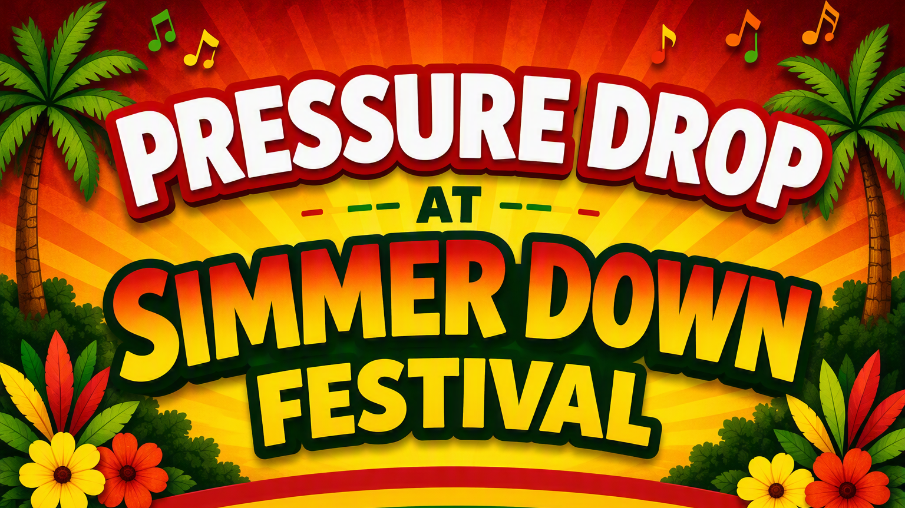

Slide 2
Simmer Down
Community festival celebrating reggae music, arts and cultural diversity
Our offer was blood pressure checks and advice:
  Anyone over 18
  Exclusions relating to alcohol and nicotine consumption
Engagement with African Caribbean community – we know blood pressure control is not as good as in white ethnicity and high risk of stroke
Culturally sensitive advice e.g. salt content of Caribbean cuisine

Slide 3
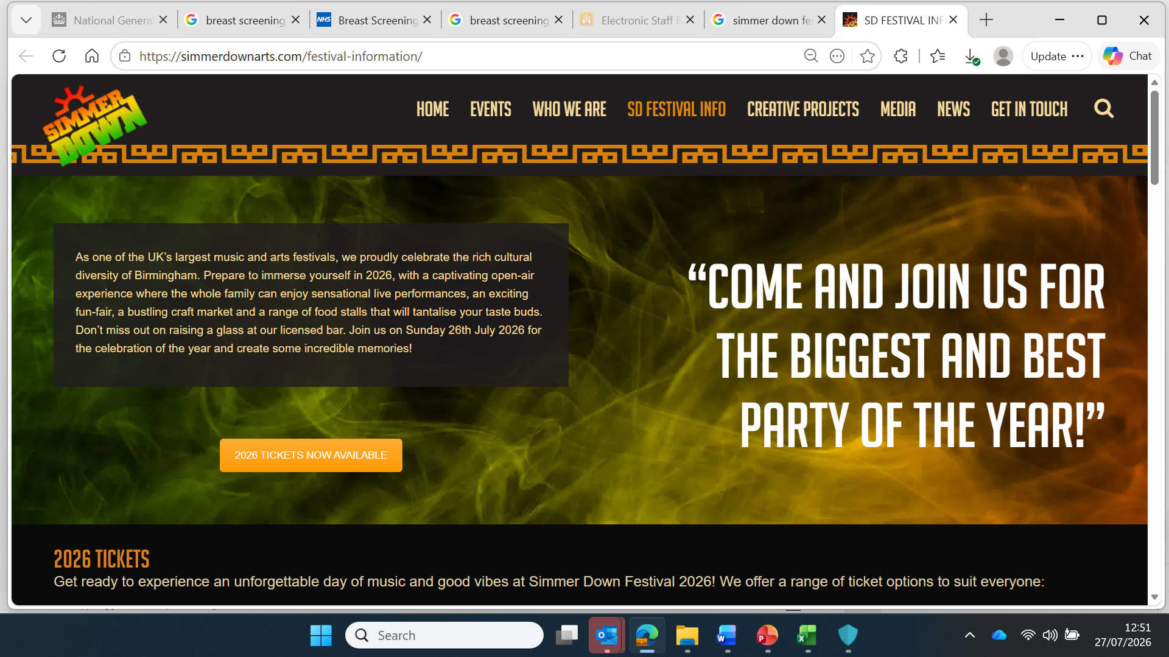

Slide 4
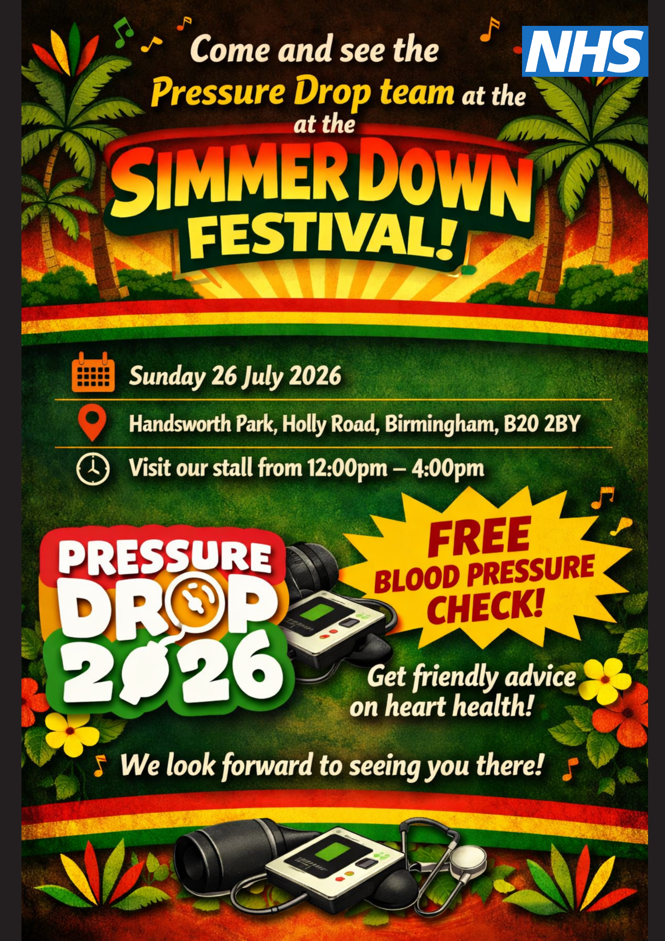

Slide 5
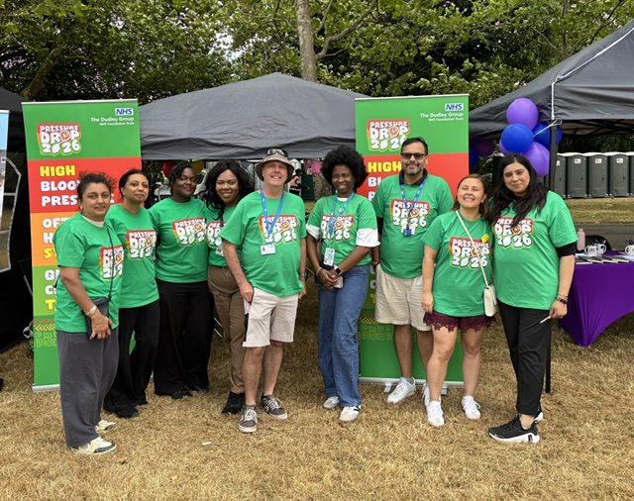
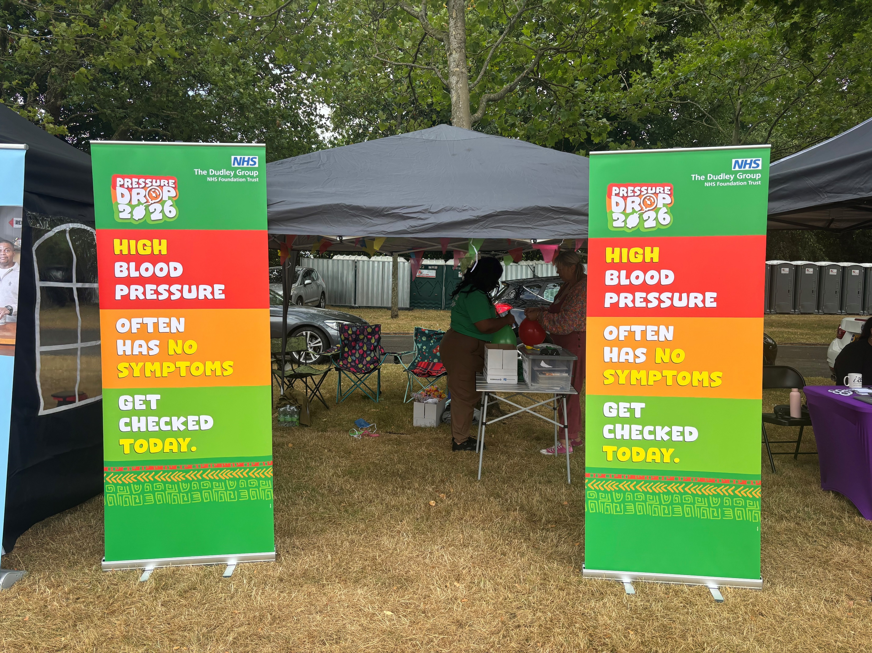
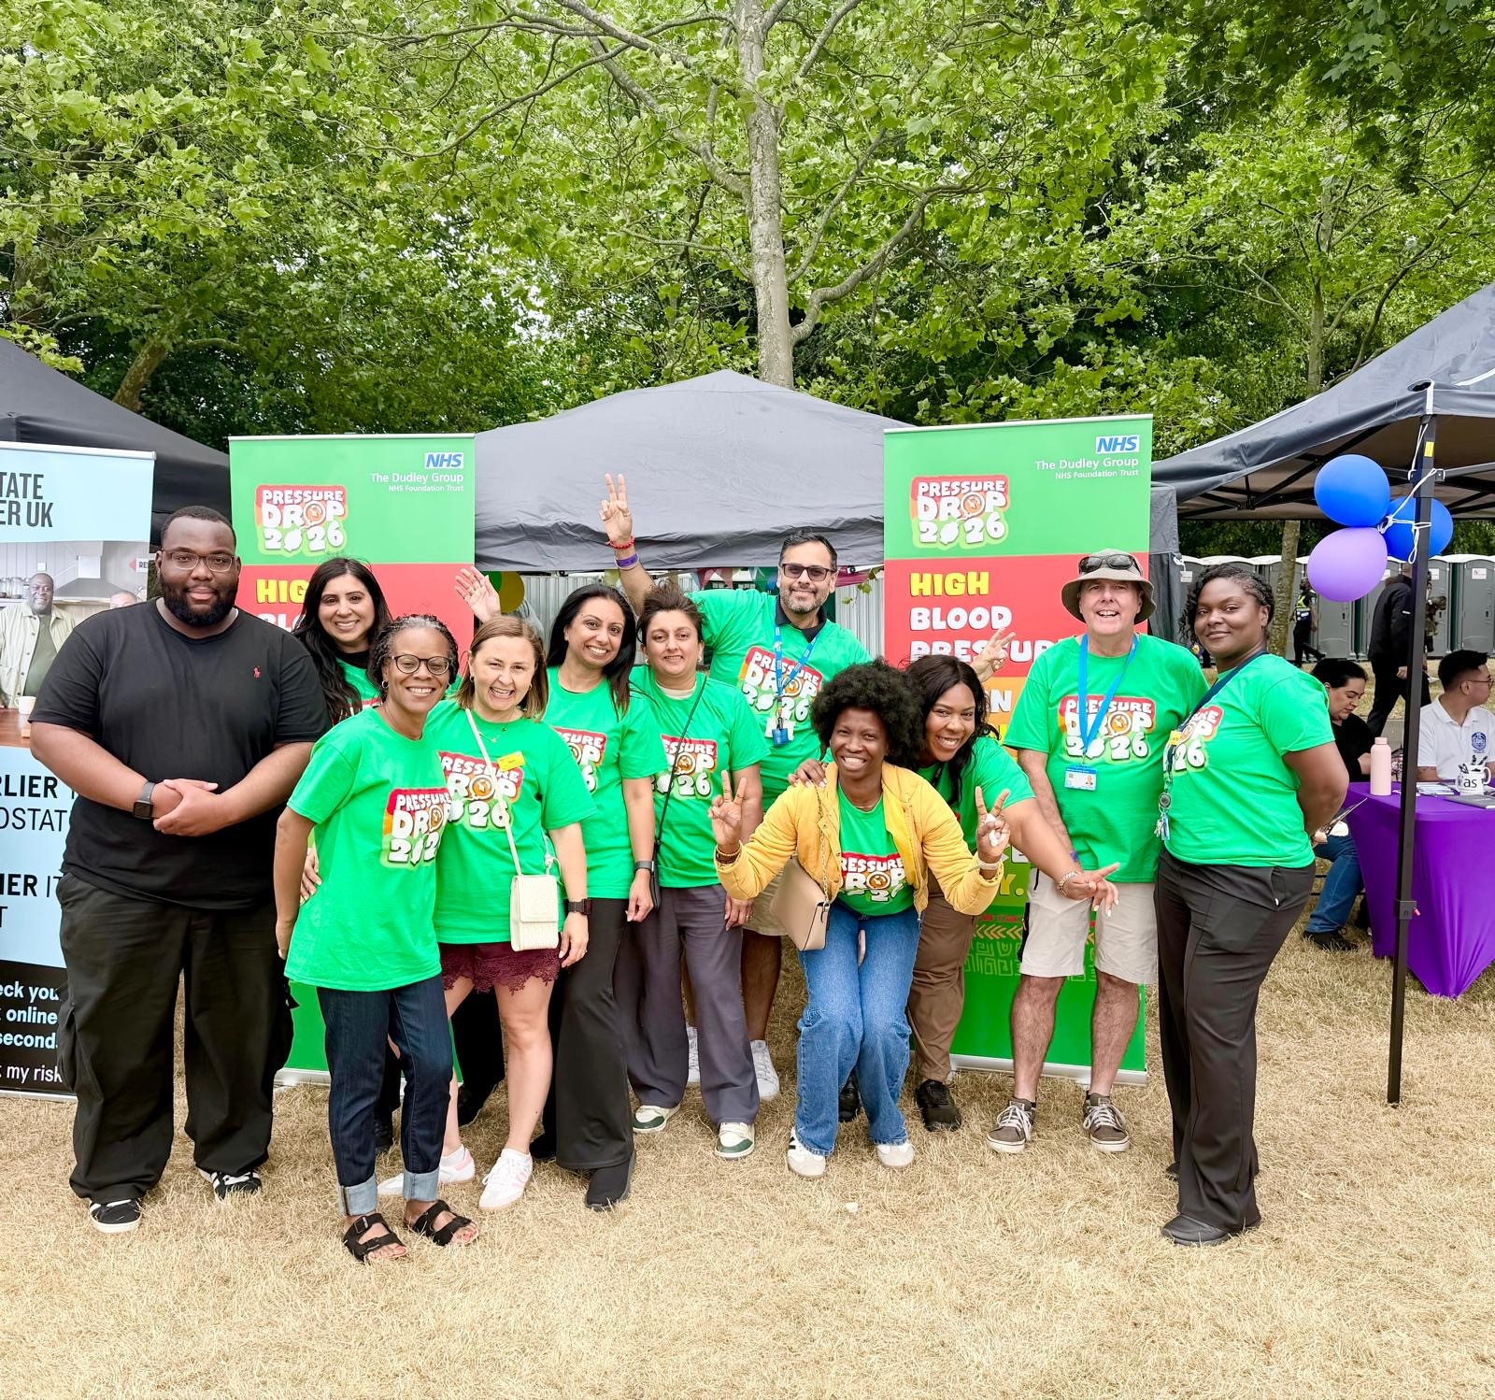

Slide 6
The team:
Volunteers from:
  Dudley Group NHS Foundation Trust
  Walsall Healthcare NHS Trust
  Sandwell and West Birmingham NHS Trust
  Integrated Care Board cluster
  Primary Care in Birmingham
  University of Birmingham School of Pharmacy
3 BP stations
Others out front to ‘sell’ blood pressure measurement and have conversations
Non-judgmental, non-clinical approach, personalised advice

Slide 7
Statistics
110
blood pressure checks carried out
Lots more conversations!!

Slide 12
1
borderline very high reading
signposted for urgent diagnostic monitoring

Slide 13
Conclusions
Excellent engagement opportunity
Our branding and friendly approach resulted in good conversations and uptake of BP tests
Very little spare capacity to do more tests
Good high reading detection rate and sign-posting/advice
Need to consider how to engage men!!
Need to consider how to scale to other community events and locations.

