Slide 1
The Dudley Foundation Group
Monthly Safer Staffing
December 2025 – June 2026
Marsha Jones Dorector of Nursing (DNO)
and Paul Hudson Medical Director

Slide 2

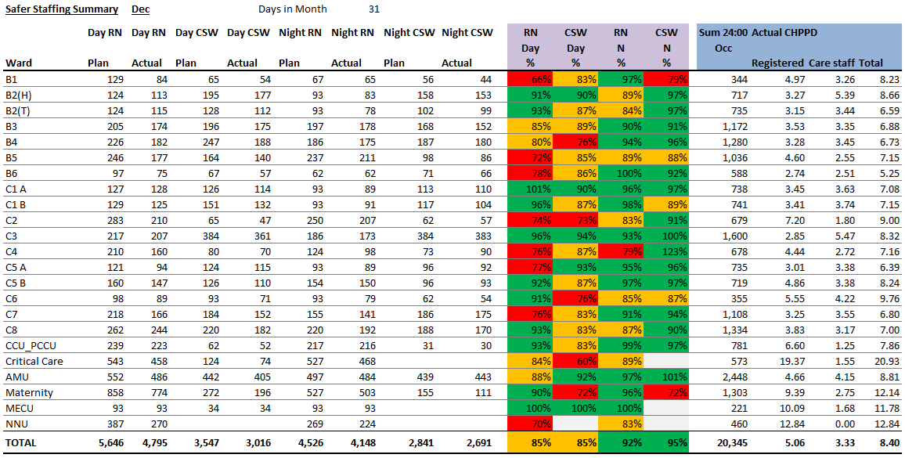
Safer Staffing - Dashboard
Date
December 2025

Slide 3
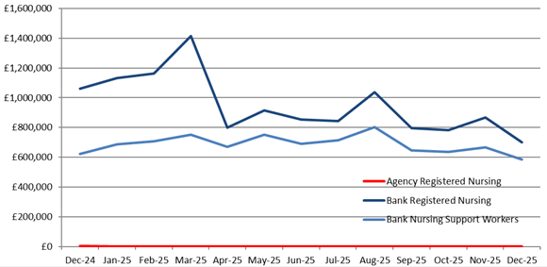
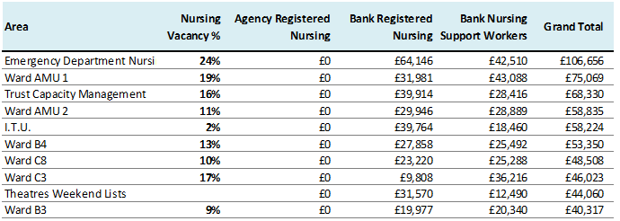
Safer Staffing
Background
Date
December 2025
What are the charts showing us
Safe Staffing and CHPPD Overview Safe staffing percentages and CHPPD is slightly higher in December compared to November (RN 5.06 & CSW 3.3) Chart A Bank usage has decreased slightly for both Registered Nurses (RNs) and Care Support Workers (CSWs) in December this may be due to limited annual leave for the Christmas period Table B December is consistent with November that continues to highlight areas of high bank usage, primarily to cover maternity leave and vacancies, as well as wards awaiting commencement of new starters.
Areas Impacting on Compliance
Unfunded additional capacity in AMU 1&2 with 10 additional bed and discharge lounge having the additional areas of surge and super surge that has a capacity of 21 beds.
Mitigations / Timescales / Blockers
TES areas of ED corridor and surge are being utilised regularly due to high capacity and approved by execs.
Risk Register
Key Points to Note
Trust Performance
A) B)
Performance Target / KPI
N/A
A - Bank Usage
B – Top 10 depts. using Bank & Agency, December 2025

Slide 4
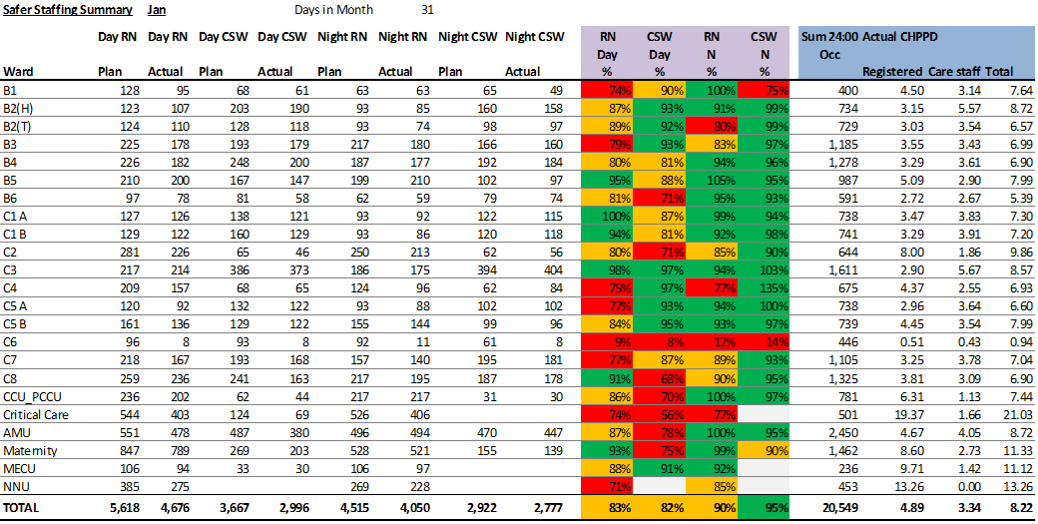
Safer Staffing - Dashboard
Date
January 2026

Slide 5
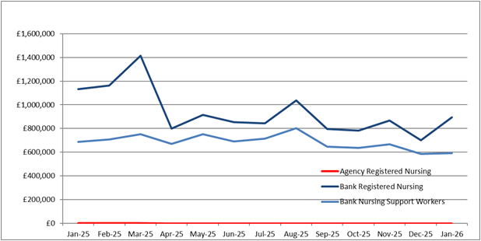
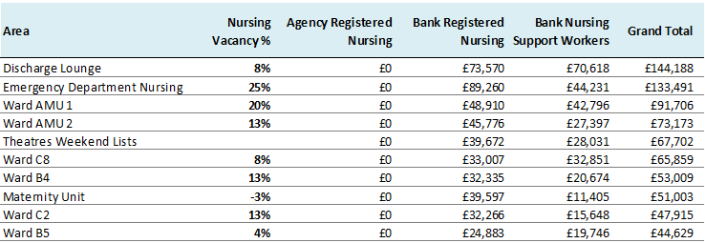
Safer Staffing
Background
Date
January 2026
What are the charts showing us
Safe Staffing and CHPPD Overview Safe staffing percentages and CHPPD is slight decrease in January compared to December (RN 4.89 & CSW 3.34) CHPPD Benchmarking (Model Hospital Data) November 2025: Nursing/Midwifery: Trust median – 5.0 vs peers – 4.7 Care Support Worker: Trust – 3.4 vs peers – 3.6 Chart A Bank usage has increased in January for Registered Nurses (RNs) this may be due to TES in ED/ Surge and Care Support Workers (CSWs) in January has remained the same usage as December. Table B January continues as the last few months, highlighting areas of high bank usage, primarily to cover maternity leave and vacancies, as well as wards awaiting commencement of new starters.
Areas Impacting on Compliance
Unfunded additional capacity in AMU 1&2 with 10 additional bed and discharge lounge having the additional areas of surge and super surge that has a capacity of 21 beds.
Mitigations / Timescales / Blockers
TES areas of ED corridor and surge are being utilised regularly due to high capacity and approved by execs.
Risk Register
Key Points to Note
January inpatient ward areas and Emergency department have undertaken a data collection for the Safer Nurse Care tool (SNCT).
Trust Performance
A) B)
Performance Target / KPI
N/A
A - Bank Usage
B – Top 10 depts. using Bank & Agency, January 2026

Slide 6
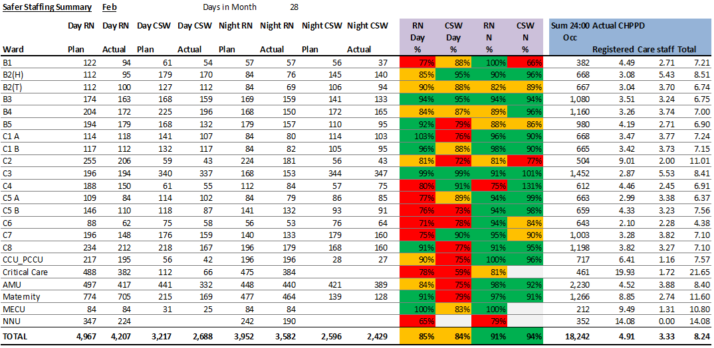
Safer Staffing - Dashboard
Date
February 2026

Slide 7
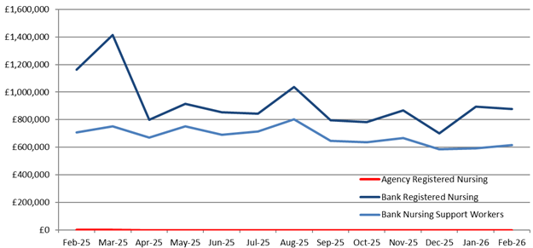
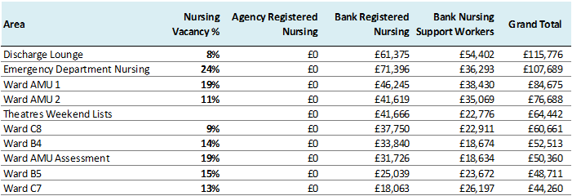
Safer Staffing
Background
Date
February 2026
What are the charts showing us
Safe Staffing and CHPPD Overview Safe staffing percentages and CHPPD is slight increase in February compared to January for RN 4.91 & a decrease in CSW 3.33 CHPPD Benchmarking (Model Hospital Data) December 2025: Nursing/Midwifery: Trust median – 5..1 vs peers – 4.9 Care Support Worker: Trust – 3.3 vs peers – 3.7 Chart A Bank usage has slight decrease in February for Registered Nurses (RNs) and Care Support Workers (CSWs) has seen an increase in February this may be due to patient acuity and requiring an increase 1-1 care or to support additional pts in ward areas Table B February continues as the last few months, highlighting areas of high bank usage, primarily to cover maternity leave and vacancies, as well as wards awaiting commencement of new starters.
Areas Impacting on Compliance
Unfunded additional capacity in AMU 1&2 with 10 additional bed and discharge lounge having the additional areas of surge and super surge that has a capacity of 21 beds.
Mitigations / Timescales / Blockers
Corridor care continues in ED Corridor plus the additional patients in corridors on the wards
Risk Register
Key Points to Note
Trust Performance
A) B)
Performance Target / KPI
N/A
A - Bank Usage
B – Top 10 depts. using Bank & Agency, February 2026

Slide 8
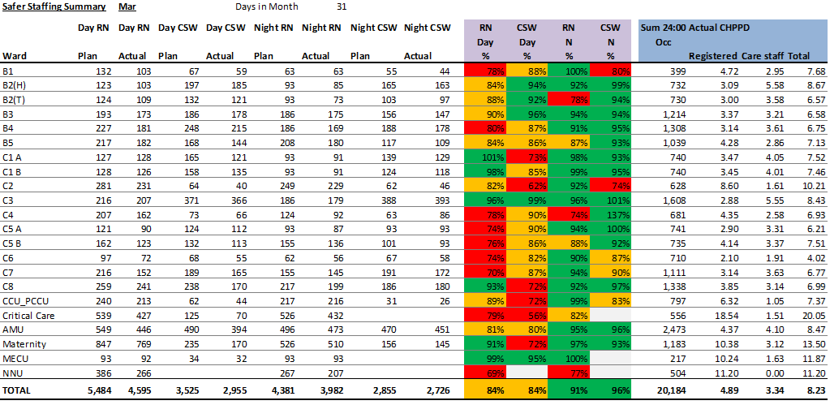
Safer Staffing – Dashboard (Acute)
Date
March 2026

Slide 9
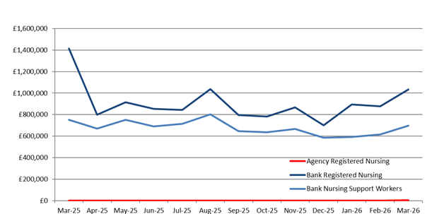
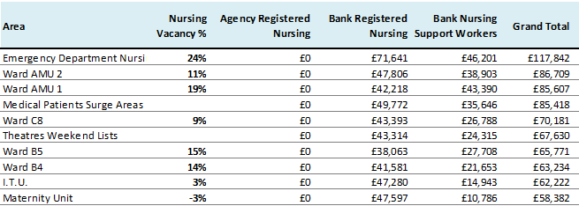
Safer Staffing
Background
Date
March 2026
What are the charts showing us
Safe Staffing and CHPPD Overview Safe staffing percentages and CHPPD is slight increase in March compared to February for CSW's but has a decrease for RN's. Chart A Bank usage has increased in March for both Registered Nurses (RNs) and Care Support Workers (CSWs) has seen an increase in March especially in surgery due to patient acuity and requiring an increase 1-1 care or to support additional pts in ward areas. An increase may also have been contributed to high sick leave and maternity leave and staff utilising their annual leave in this period. Table B March continues as the last few months, highlighting areas of high bank usage, primarily to cover maternity leave and vacancies, as well as wards awaiting commencement of new starters.
Areas Impacting on Compliance
Unfunded additional capacity in AMU 1&2 with 10 additional bed and discharge lounge having the additional areas of surge and super surge that has a capacity of 21 beds.
Mitigations / Timescales / Blockers
Risk Register
Key Points to Note
Safer staffing was completed as part of the bi-annual review in the inpatient areas and emergency department in January. Overall, the safer staffing establishments remained generally in a positive position to provide and deliver safe, effective, high-quality care. The significant change from the last 3 staffing reviews in the increase in 1b category of patients, who require increase of nursing care as they are dependent on nursing care teams to meet most or all their care needs and a decrease of acuity 0, that are patients who may only require minimum care. Plan to increase ED resus to 6 beds from October as part of winter planning.
Trust Performance
A) B)
Performance Target / KPI
N/A
A - Bank Usage
B – Top 10 depts. using Bank & Agency, March 2026

Slide 10

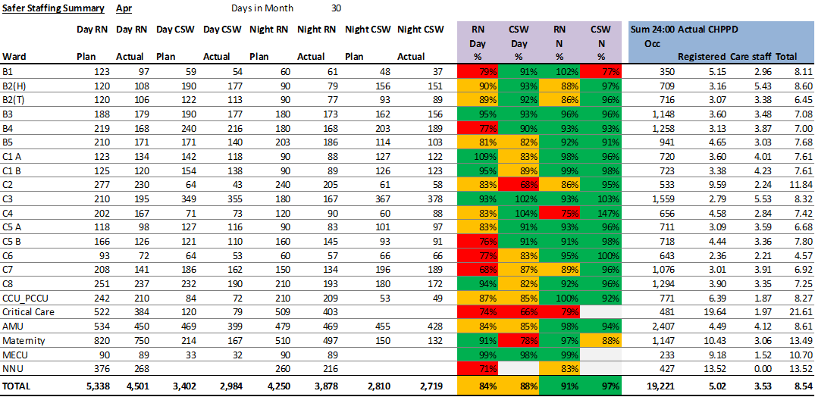
Safer Staffing – Dashboard (Acute)
Date
April 2026

Slide 11
Safer Staffing
Background
Date
March 2026
What are the charts showing us
Safe Staffing and CHPPD Overview Safe staffing percentages and CHPPD is slight increase in March compared to February for CSW's but has a decrease for RN's. Chart A Bank usage has increased in March for both Registered Nurses (RNs) and Care Support Workers (CSWs) has seen an increase in March especially in surgery due to patient acuity and requiring an increase 1-1 care or to support additional pts in ward areas. An increase may also have been contributed to high sick leave and maternity leave and staff utilising their annual leave in this period. Table B March continues as the last few months, highlighting areas of high bank usage, primarily to cover maternity leave and vacancies, as well as wards awaiting commencement of new starters.
Areas Impacting on Compliance
Unfunded additional capacity in AMU 1&2 with 10 additional bed and discharge lounge having the additional areas of surge and super surge that has a capacity of 21 beds.
Mitigations / Timescales / Blockers
Risk Register
Key Points to Note
Safer staffing was completed as part of the bi-annual review in the inpatient areas and emergency department in January. Overall, the safer staffing establishments remained generally in a positive position to provide and deliver safe, effective, high-quality care. The significant change from the last 3 staffing reviews in the increase in 1b category of patients, who require increase of nursing care as they are dependent on nursing care teams to meet most or all their care needs and a decrease of acuity 0, that are patients who may only require minimum care. Plan to increase ED resus to 6 beds from October as part of winter planning.
Trust Performance
A) B)
Performance Target / KPI
N/A
A - Bank Usage
B – Top 10 depts. using Bank & Agency, March 2026

Slide 12
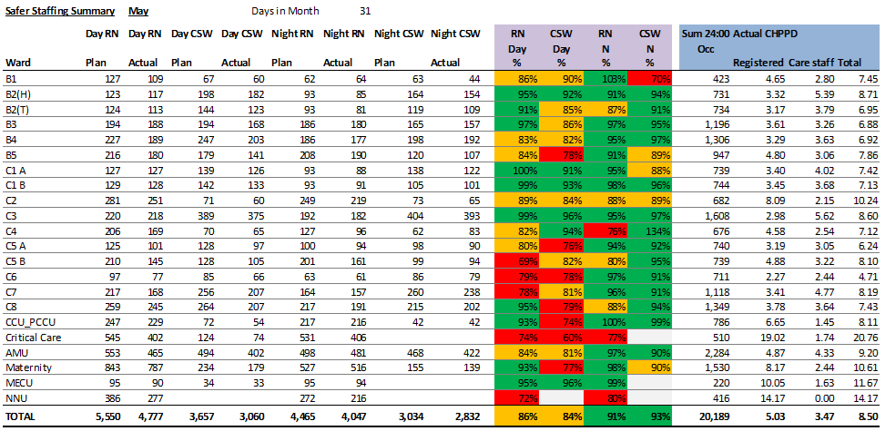
Safer Staffing – Dashboard (Acute)
Date
May 2026

Slide 13
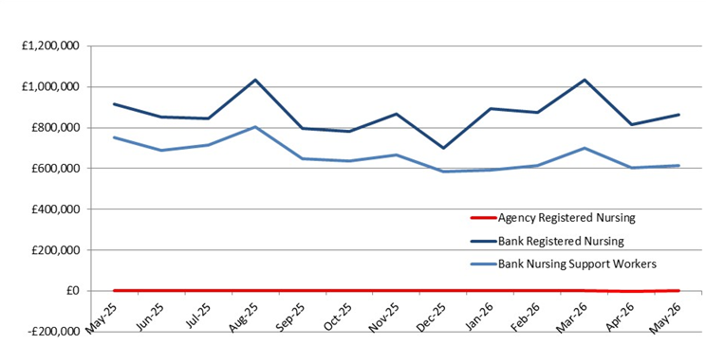
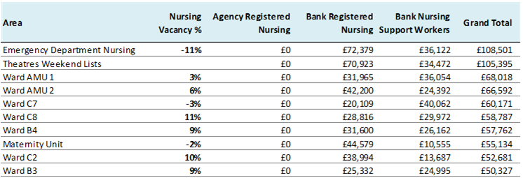
Safer Staffing
Background
Date
May 2026
What are the charts showing us
CHPPD Benchmarking (Model Hospital Data) March 2026: Nursing/Midwifery: Trust median – 4.6 vs peers – 4.7 Care Support Worker: Trust – 3.3 vs peers – 3.6 Chart A Bank usage has slight increase in May for Registered Nurses (RNs) and Care Support Workers (CSWs) this may be due to patient acuity and requiring an increase 1-1 care or to support additional pts in ward areas and increase sickness Table B Vacancy percentage have reduced this month due to the re-deployment of staff from AMU A and A4
Areas Impacting on Compliance
Additional unfunded beds are still on AMU 1 and 2, then we have had to utilise the discharge ward and frailty assessment unit over night and the ED corridor for additional patients.
Mitigations / Timescales / Blockers
Risk Register
Key Points to Note
AMU Assessment unit and A4 have now closed and staff have been re-deployed so next month we may see a reduction of bank usage, once their supernumerary period has ended
Trust Performance
A) B)
Performance Target / KPI
N/A
A - Bank Usage
B – Top 10 depts. using Bank & Agency, May 2026

Slide 14
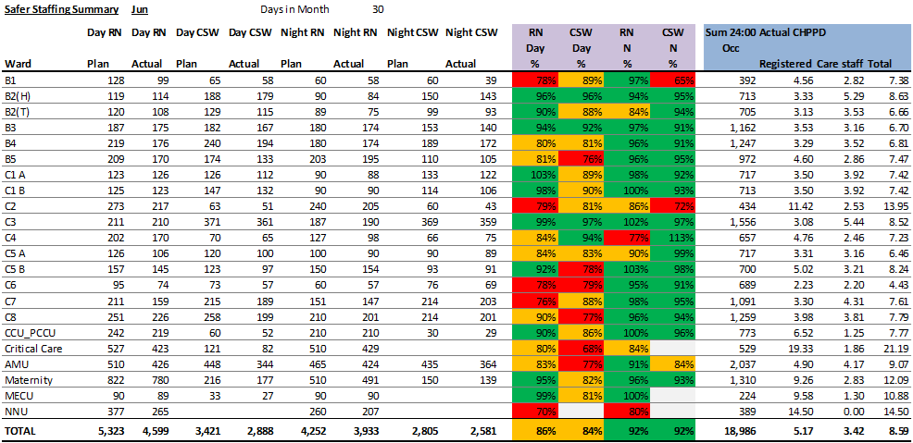
Safer Staffing – Dashboard (Acute)
Date
June 2026

Slide 15
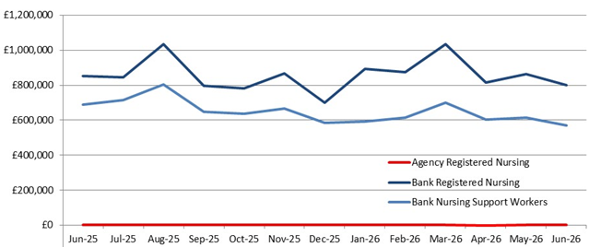
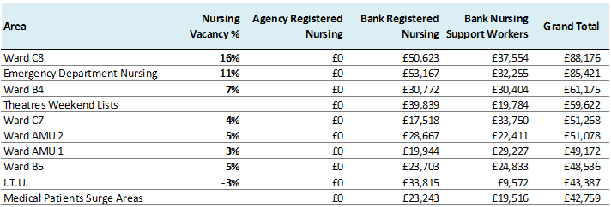
Safer Staffing
Background
Date
June 2026
What are the charts showing us
CHPPD Benchmarking (Model Hospital Data) April 2026: Nursing/Midwifery: Trust median – 4.8 vs peers – 4.7 Care Support Worker: Trust – 3.6 vs peers – 3.7 Chart A Bank usage has slight decrease in June for Registered Nurses (RNs) and Care Support Workers, this may be due to closure of A4 and AMU A Table B Vacancy percentage have reduced this month due to the re-deployment of staff from AMU A and A4
Areas Impacting on Compliance
Additional unfunded beds are still on AMU 1 and 2, then we have had to utilise the discharge ward and frailty assessment unit overnight. This month we have also opened surge area in old AMU assessment unit to support capacity
Mitigations / Timescales / Blockers
Risk Register
Key Points to Note
Vacancies are still being held for LAT programme
Trust Performance
A) B)
Performance Target / KPI
N/A
A - Bank Usage
B – Top 10 depts. using Bank & Agency, June 2026

